Slide 1

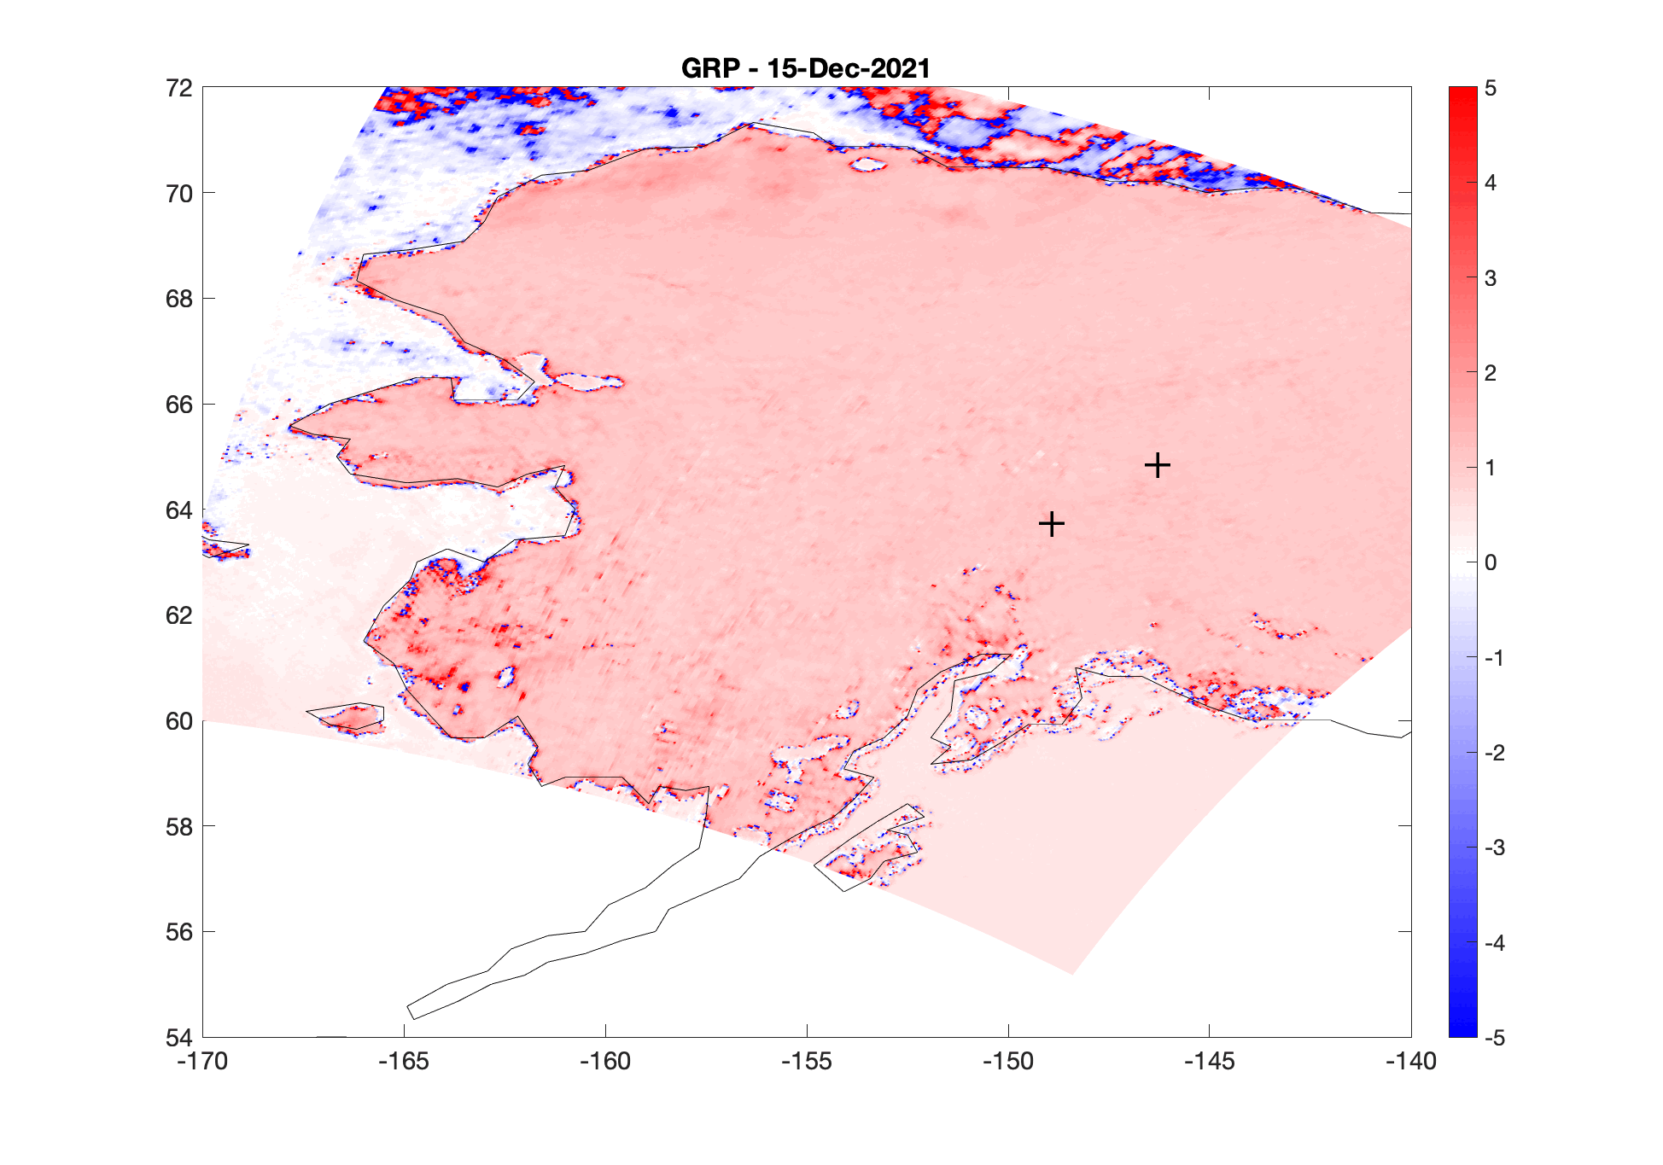
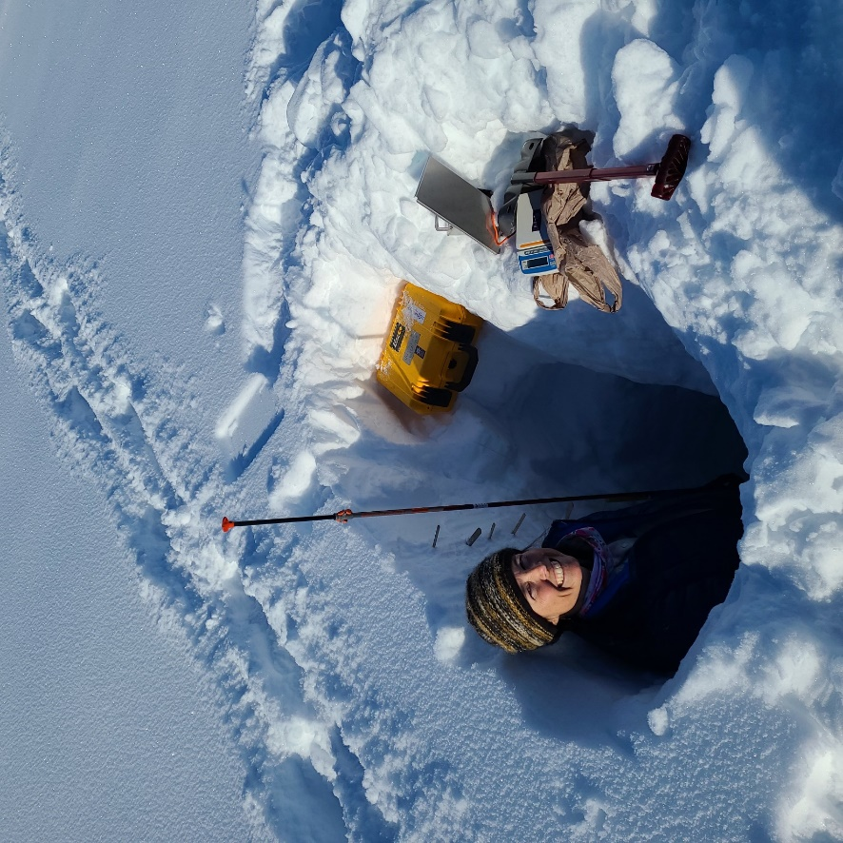
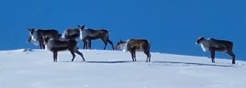
RESILIENCE OF CARIBOU TO EXTREME WEATHER
The Problem
Wet
snow
Storms are getting more powerful as the planet warms. How does extreme weather affect caribou?
Fairbanks
Denali
Caribou moved to higher elevations to find food after the storm.
PI Prugh measuring deep snow following the storm in Denali (March 2022).
Rain-on
-snow
The Solution
Gradient Ratio Polarization (GRP) values from AMSR retrievals
We used passive-microwave remote sensing (NASA AMSR-2) to document a record-shattering winter storm in Alaska in December 2021. We then used caribou data in Denali National Park to determine impacts on population growth.
The Impact
Caribou weathered a 150-year storm surprisingly well by taking advantage of complex terrain in their range. Habitat diversity can help wildlife persist through extreme weather events.
Notes:
Note: This is a “BDEC Nugget” slide I made during a workshop at the BDEC conference in May.. Citation: Prugh, L. R., J. D. Lundquist, B. K. Sullender, C. X. Cunningham, J. Dechow, B. L. Borg, P. J. Sousanes, S. Stehn, and M. T. Durand. 2024. Landscape heterogeneity buffers the impact of an extreme weather event on wildlife. Communications Biology 7:1515. 10.1038/s42003-024-07195-1.

