Slide 1
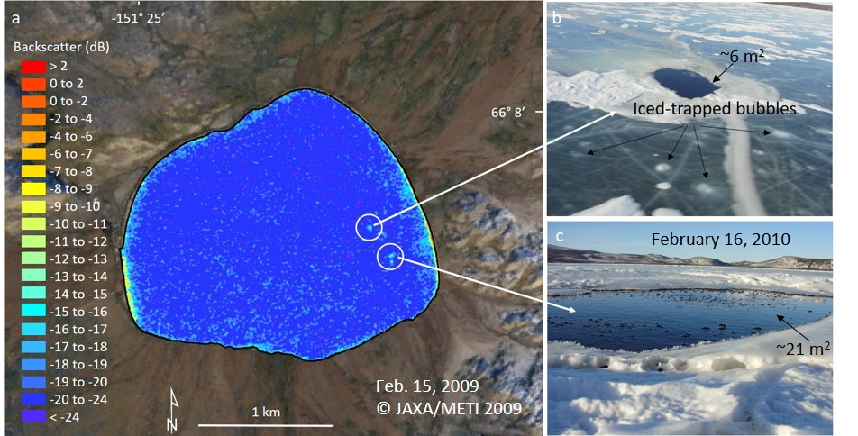
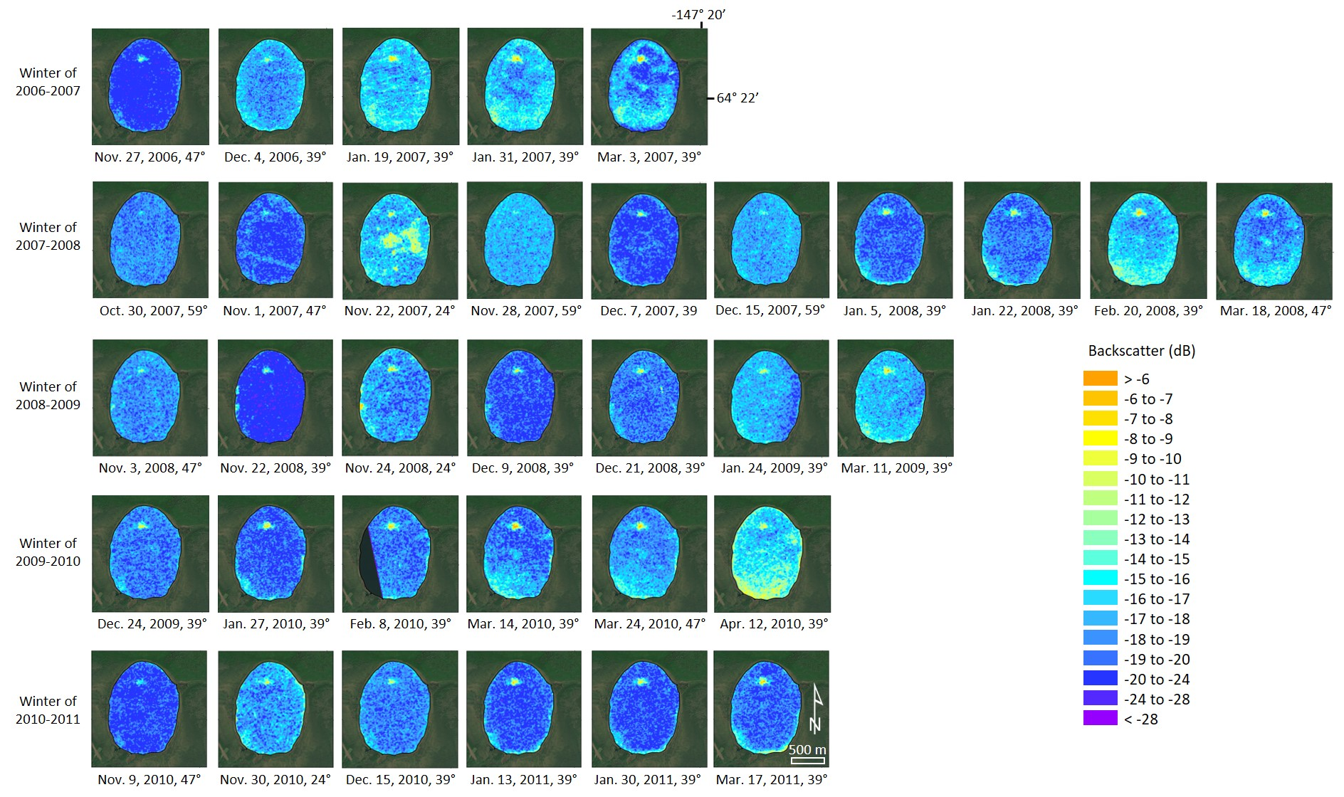
Synthetic aperture radar (SAR) detects large gas seeps in Alaska lakes
Melanie Engram and Katey Walter Anthony, Environ. Res. Lett. 19, 4 (2024). doi:10.1088/1748-9326/ad2b2a
Perennial high backscatter from lake ice in L-band SAR image (a), shows the location of sub-permafrost methane seeps (b, c) in Sithylementkat Lake in Alaska.
Large reservoirs of fossil (¹⁴C-depleted) methane exist below the permafrost, escaping where permafrost thaw creates open-
talik conduits. Little is known about the magnitude and variability of this methane source or its response to climate change.
High backscatter in L-band SAR image from lake ice appearing in same location in every scene guided researchers to discover a new sub-permafrost methane seep in North Blair Lake in interior Alaska.
We used SAR and multispectral remote sensing coupled with fieldwork (gas samples for analysis) at sub-permafrost methane seeps presenting in three lakes in Alaska (interior Alaska, Brooks Range, and Alaska North Slope).
SAR backscatter from lake ice shows locations of sub-permafrost, ¹⁴C-depleted methane seeps occurring in lakes that freeze, avoiding challenges sometimes encountered in alternative optical and multispectral imagery detection of seeps. This work could be continued with data from the upcoming NISAR mission.
Notes:
NOTES to help a person not involved with the research explain it to a lay audience:
Naturally occurring old, fossil methane is of two-fold interest: if methane previously impeded by permafrost can escape through newly formed conduits, greenhouse gas concentration in the atmosphere would increase in a way that is not currently accounted for in carbon budgets; additionally, a solid knowledge of natural ¹⁴C-depleted methane emissions is vital to an accurate estimate of anthropogenic methane emissions from petroleum industries Hence there is a need for development of satellite remote-sensing methods coupled to ground-truth sampling that can accurately detect and quantify large methane seeps to establish a baseline for change detection in vast Arctic landscapes.
Full citation: Melanie Engram and Katey Walter Anthony, Environ. Res. Lett. vol, issue (2024). doi:10.1088/1748-9326/ad2b2a

