Slide 1
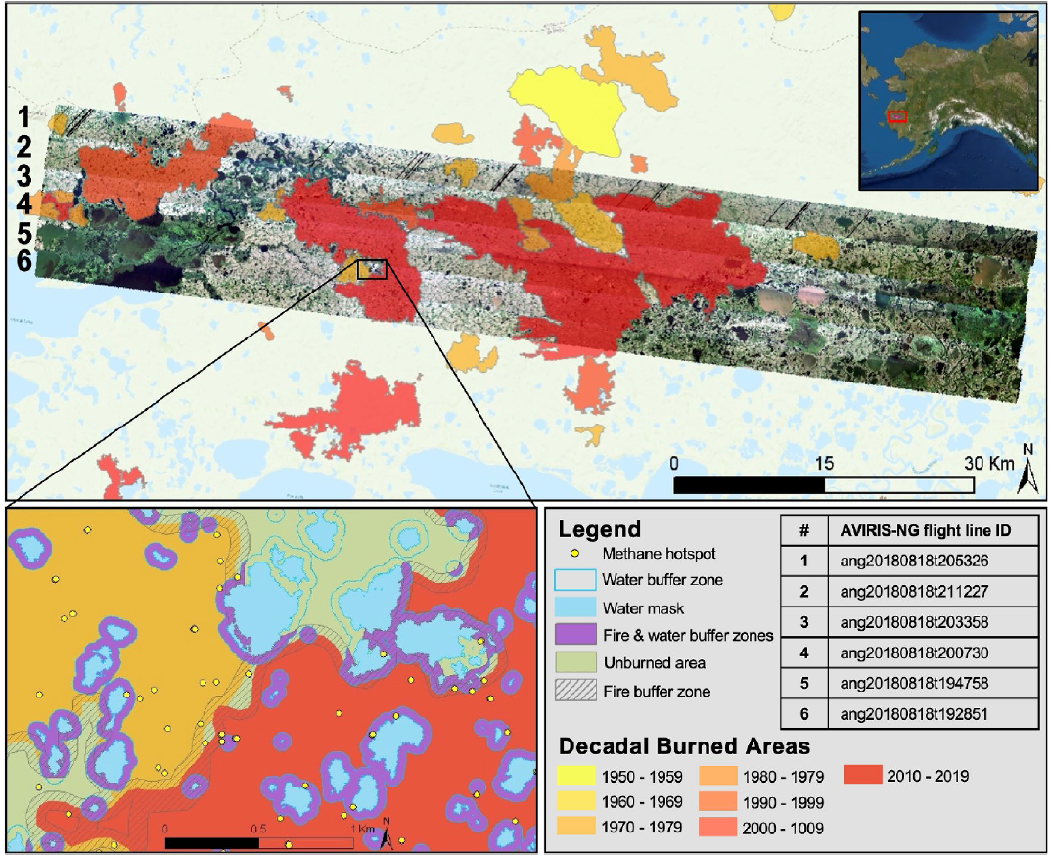
Tundra fire increases the likelihood of methane hotspot formation in the Yukon–Kuskokwim (YK) Delta, Alaska, USA
Yoseph, E., Hoy, E., Elder, C., Ludwig, S., Thompson, D. and C. Miller 2023
Environ. Res. Lett. 18 104042 [10.1088/1748-9326/acf50b]
Background: The YK Delta is a regional hotspot for CH₄ emissions; however, few studies are at scales able to see the influence of fire on process-level carbon dynamics and gas emissions.
Methods: We utilized high-resolution AVIRIS-NG airborne imaging spectroscopy (from JPL) to determine whether CH₄ hotspots were more likely in areas burned within the last 50 years.
Results: CH₄ hotspots are roughly 29% more likely in tundra that burned within the last 50 years compared to unburned areas and this nearly tripled along burn scar perimeters that are delineated by surface water features.
Implication: Emissions following tundra fire act as a positive feedback for further warming for decades following fire.
Notes:
The figures show (at left) the study area with the AVIRIS-NG imagery and decadal fire scars overlaid. The yellow points are the methane hotspots, the orange and red areas are fire scars from different decades and purple areas are where fire and water areas intersect on the map. These purple areas had the highest amount of hotspots across almost all flightlines.
Yoseph, E., Hoy, E., Elder, C., Ludwig, S., Thompson, D. and C. Miller. 2023. "Tundra fire increases the likelihood of methane hotspot formation in the Yukon–Kuskokwim Delta, Alaska, USA." Environmental Research Letters, 18 (10): 104042 [10.1088/1748-9326/acf50b]

