Slide 1
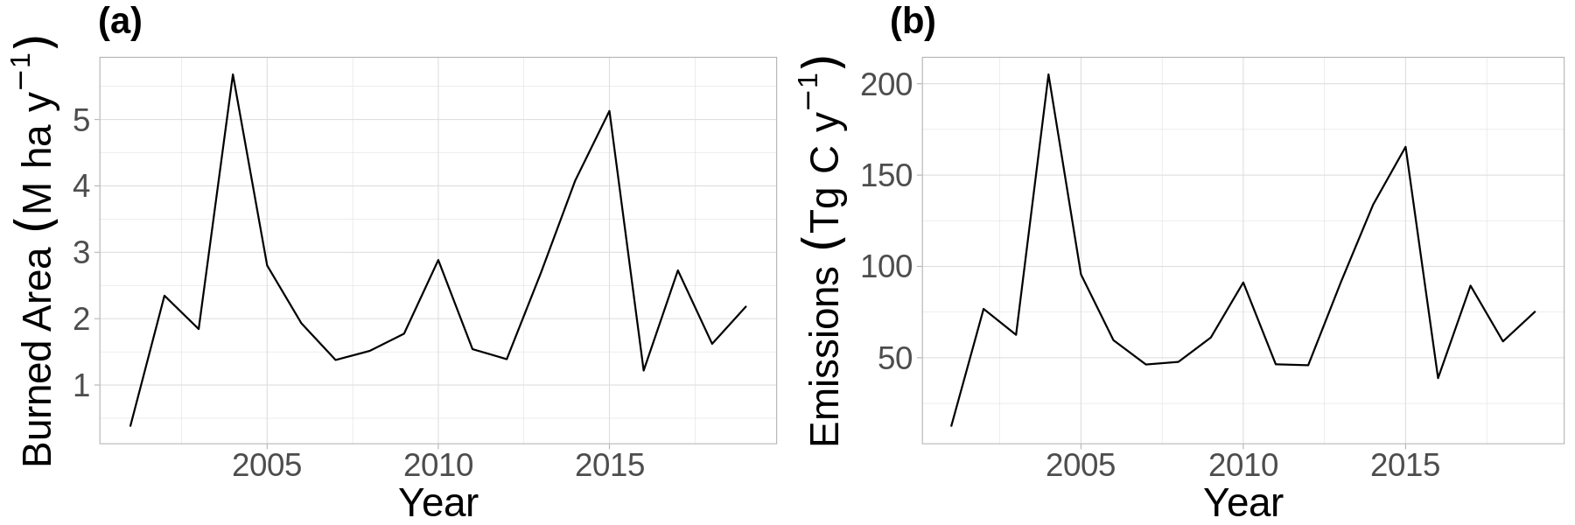
Burned Area and Carbon Emissions Across Boreal North America 2001-2019
Potter, S., Cooperdock, S., Veraverbeke et al. Burned area and carbon emissions across northwestern boreal North America from 2001–2019. Biogeosciences, 20(13), 2023. https://doi.org/10.5194/bg-20-2785-2023
Temporal variability in ABoVE-FED burned area (a), and emissions (b) from 2001-2019
In this work we developed a new burned area product for boreal North America which was used to estimate associated carbon combustion and emissions for each year 2001-2019
The burned area product was developed using 30 m Landsat satellite imagery and 500 m MODIS imagery. Statistical models of combustion were developed which were constrained by using field measurements of combustion (n = 769) across the domain.
We found burned area and total emissions are highly variable by year, averaging 2.37 Mha of burned area and 79.26 Tg emitted per year, which indicates previous studies have generally underestimated both burned area and emissions.
Notes:
Our burned area product differs from many other studies as we used 30 meter Landsat imagery to estimate the fraction of 500 meter MODIS pixels which burned. When Landsat imagery was not available we used MODIS imagery to detect fires. Our burned area mapping approach used a delta normalized burn ratio (dNBR ) thresholding approach aimed at minimizing both omission and commission errors. Using this burned area product we were able to predict combustion at a per pixel level using a statistical model (a random forest model) which was constrained using field measurements of combustion across the domain. By leveraging the new burned area product as well as the pixel level estimates of combustion from the random forest model we were able to explore both spatial and temporal variability in burned area and emissions, and our product generally estimates more burned area and emissions compared to previous studies.
Potter, S., Cooperdock, S., Veraverbeke, S., Walker, X., Mack, M. C., Goetz, S. J., Baltzer, J., Bourgeau-Chavez, L., Burrell, A., Dieleman, C., French, N., Hoy, E. E., Jenkins, L., Johnstone, J. F., Kane, E. S., Natali, S. M., Randerson, J. T., Turetsky, M. R., … Rogers, B. M. (2023). Burned area and carbon emissions across northwestern boreal North America from 2001–2019. Biogeosciences, 20(13), 2785–2804. https://doi.org/10.5194/bg-20-2785-2023

