Slide 1
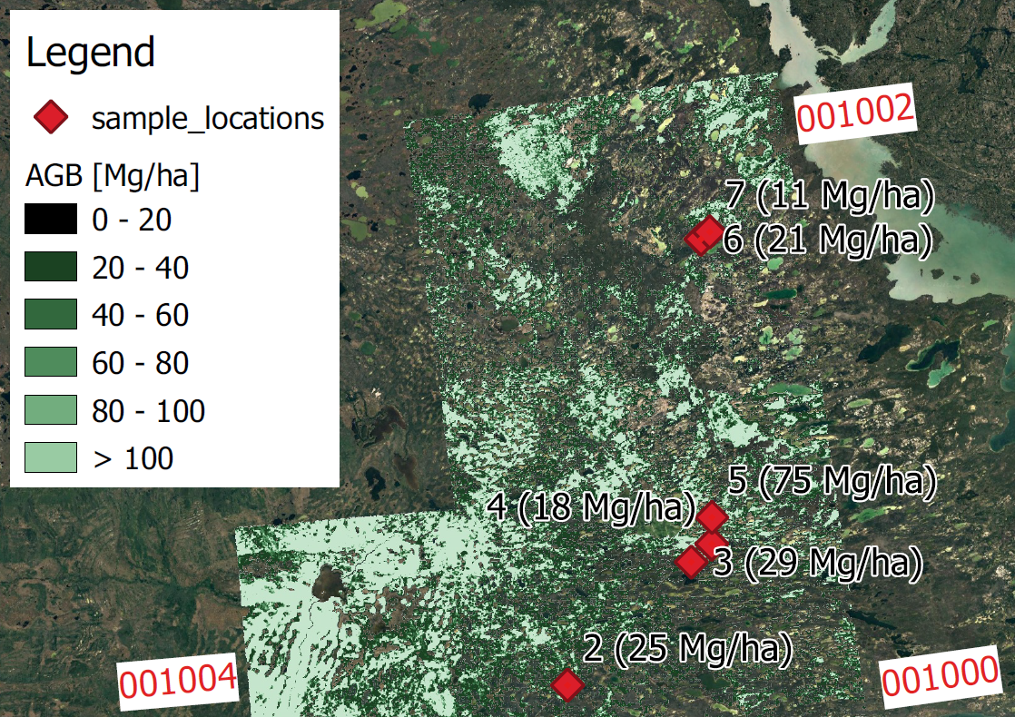
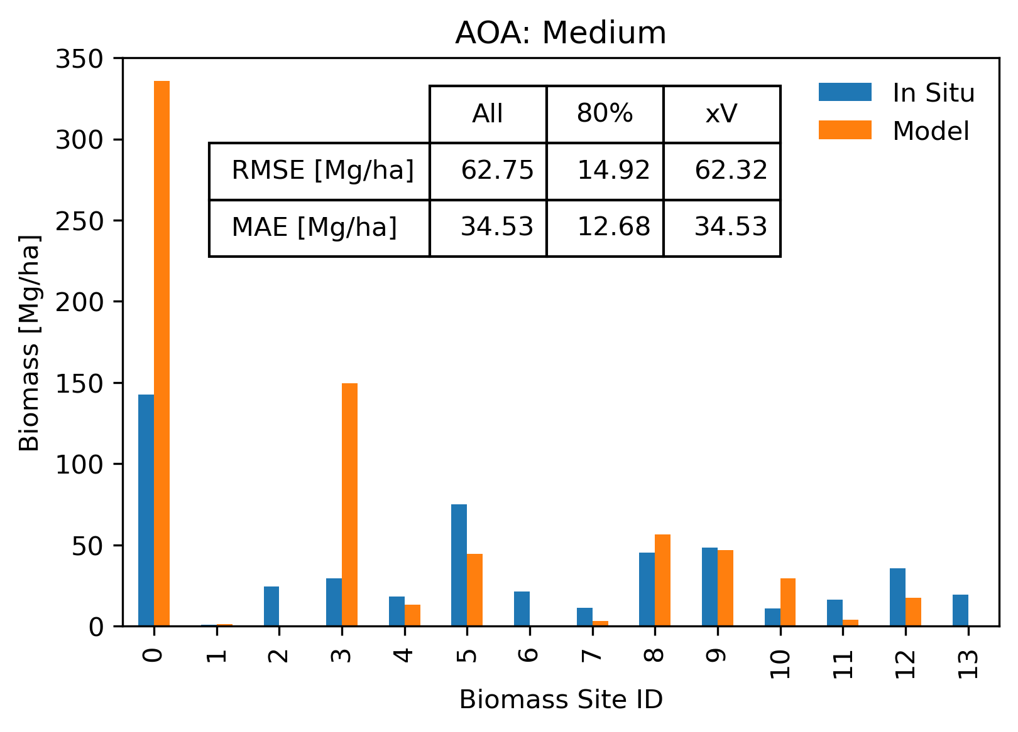
Mapping and Scaling of In Situ Above Ground Biomass to Regional Extent with SAR in the Great Slave Region
S. Kraatz, L. Bourgeau-Chavez, et al. (2022), Earth and Space Science, 9, https://doi.org/10.1029/2022EA002431
What we did
We produced an Above Ground Biomass (AGB) map for Great Slave Lake (GSL) study area
UAVSAR and ALOS-2 data processed to be interoperable
We calibrated SAR data to in situ AGB (14 sites)
We investigated inherent scaling mismatch of data
We assessed whether NISAR’s science requirement could be met
Why it matters
Interoperability allows for same-band SAR data to be combined at lower cost
Denser time series
Scaling mismatch reduces AGB mapping accuracy
Region is a great testbed for NISAR
matches AGB range (< 100 Mg/ha)
Low biomass sites are challenging for SAR
What we learned
NISAR’s science requirement could be met, but scaling was necessary
Important to not solely use 1 ha grids
(NISAR AGB map will be 1 ha only)
xV – leave one out cross validation
All data vali-dation
Above: Biomass map of northwestern portion of GSL study domain. Red diamonds are in situ sites. Black text shows site ID and AGB value. Red numbers identify ALOS-2 tiles.
NISAR criteria (AGB <100 Mg/ha)
Notes:
SAR: Synthetic Aperture Radar
ALOS-2 is a Japanese L-band satellite, but data is not yet freely available. There needs to be a research agreement or purchase. But swath/tiles are larger than UAVSAR, and hence used for mapping.
UAVSAR is a NASA Airborne L-band instrument, with data being freely available. UAVSAR data made time series denser, helping to make a more robust model calibration to be applied to ALOS-2 data for mapping.
The two instruments have very different characteristics (orbit, viewing geometry), so processing data in an interoperable way is highly valuable. It is called radiometric calibration and terrain correction projected to gamma naught plane.
There remain many questions on optimal scaling of AGB data, i.e., should they be calculated/posted on 100 m x 100 m grids, 200 m x 200 m grids … . This may be regionally dependent. It is important to examine how results change compared to in situ, based on different gridding. Key challenge is that in situ data are often quite small, perhaps only two 10 m x 10 m plots. And hydrology/terrain (imperfect correction) operate yet on other scales, causing mismatch between data and processes that impact SAR
Full citation: Kraatz, S., Bourgeau‐Chavez, L., Battaglia, M., Poley, A., & Siqueira, P. (2022). Mapping and scaling of in situ Above Ground Biomass to regional extent with SAR in the Great Slave Region. Earth and Space Science, e2022EA002431.

