Slide 1
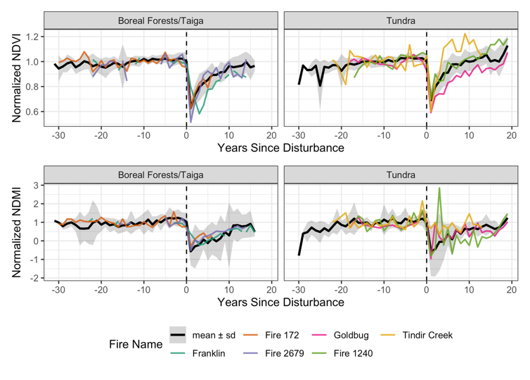
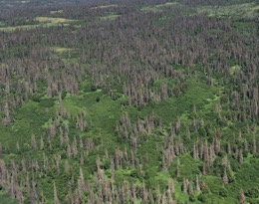
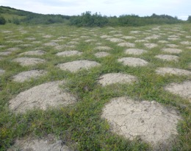
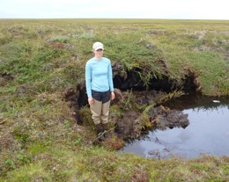
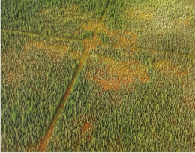
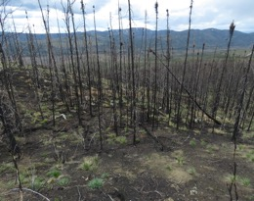
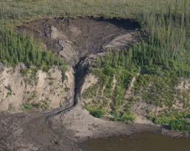
Disturbances in North American boreal forest and tundra: Synthesis of impacts, interactions and responses
Foster, A.C., Wang, J.A., Frost, G.V., et al. Environmental Research Letters 17, 113001 (2022). 10.1088/1748-9326/ac98d7
We assessed the major disturbances in the Arctic-Boreal region, both natural and anthropogenic.
Boreal forest
Tundra
fire
Landsat-based greenness (NDVI) and wetness (NDMI) before and after disturbance show vegetation impact and response.
Here we see response to wildfires.
cryoturbation
NDVI
ice wedge degradation
insect outbreak
1 m
NDMI
oil & gas exploration
wildfire
thaw slump
We synthesized the major disturbances within the North American Arctic and Boreal Region (ABR), focusing on temporal dynamics of vegetation loss and recovery, disturbance interactions, and major unknowns and data needs.
We included Landsat-based case studies of vegetation greenness and wetness before and following disturbance.
Most disturbances are predicted to increase with climate warming and will serve as local hotspots of change. These disturbances are key to understanding the resiliency of ecosystems in this region.
Notes:
Disturbances are a dominant driver of ecosystem dynamics in the ABoVE region, impacting vegetation structure and composition, belowground conditions, and biogeochemical cycling. Most of these disturbances are predicted to intensify with climate change. While many of the disturbances within this region are well studied, like fire, there are many that are less well studied such as those related to permafrost or those related to anthropogenic activities. We synthesized the major disturbances, both natural and anthropogenic, within the North American arctic and boreal regions. For each disturbance, we surveyed the literature, focusing on temporal dynamics of vegetation loss and recovery.
We also included case studies of each disturbance, where we investigated Landsat-based trends of vegetation loss and recovery.
We also looked at spatiotemporal characteristics of each disturbance, including spatial grain, return interval, occurrence timeline, and recovery timeline. Notably, the disturbances we covered varied considerably across these characteristics.
Finally, we discussed interactions between disturbances. Many of the disturbances interact now; for example wildfire can have an enhancing effect on cryogenic landslides whereby rapid thaw following a fire can lead to the formation of an active layer detachment. As these disturbances increase in frequency and extent, the capacity of them to interact will likewise increase.
Foster A C, Wang J A, Frost G V, Davidson S J, Hoy E, Turner K W, Sonnentag O, Epstein H, Berner L T, Armstrong A H, Kang M, Rogers B M, Campbell E, Miner K R, Orndahl K M, Bourgeau-Chavez L L, Lutz D A, French N, Chen D, Du J, Shestakova T A, Shuman J K, Tape K, Virkkala A-M, Potter C and Goetz S 2022 Disturbances in North American boreal forest and Arctic tundra: impacts, interactions, and responses Environmental Research Letters 17 113001 https://doi.org/10.1088/1748-9326/ac98d7.

