Slide 1
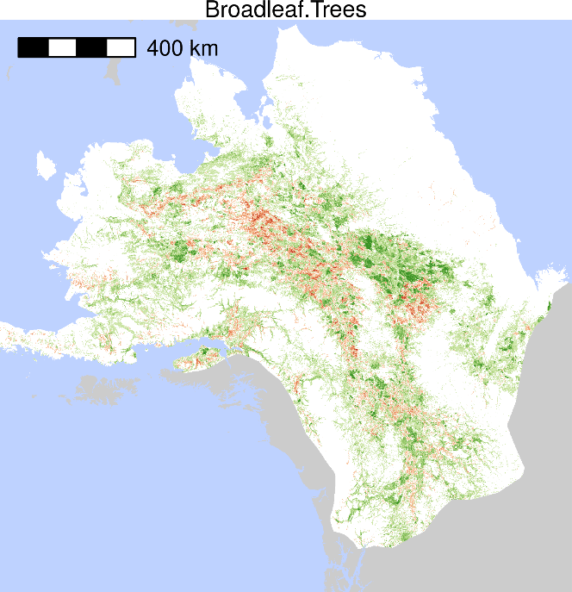
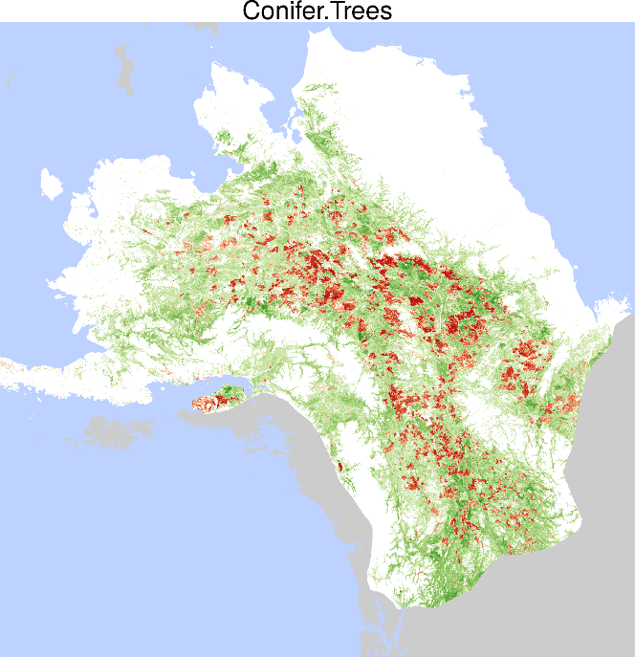
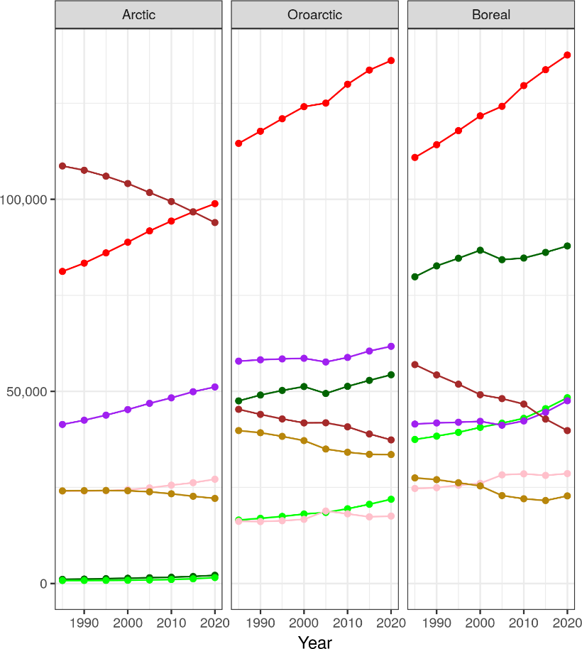
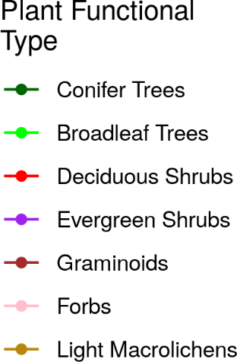
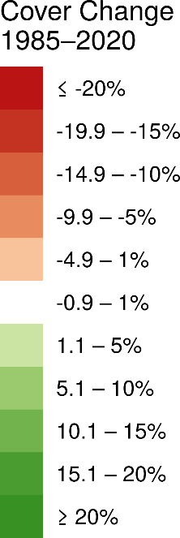
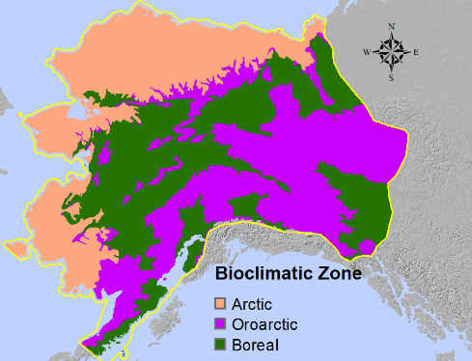
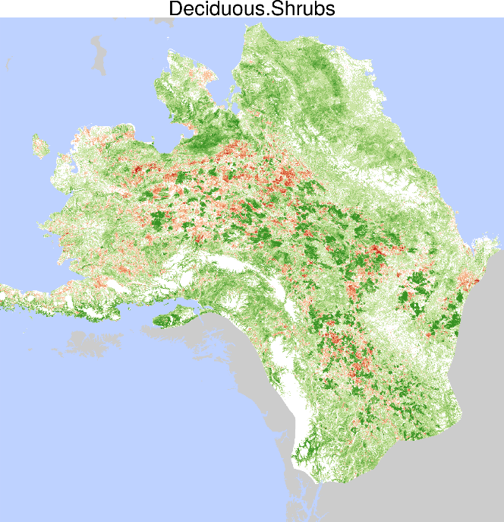
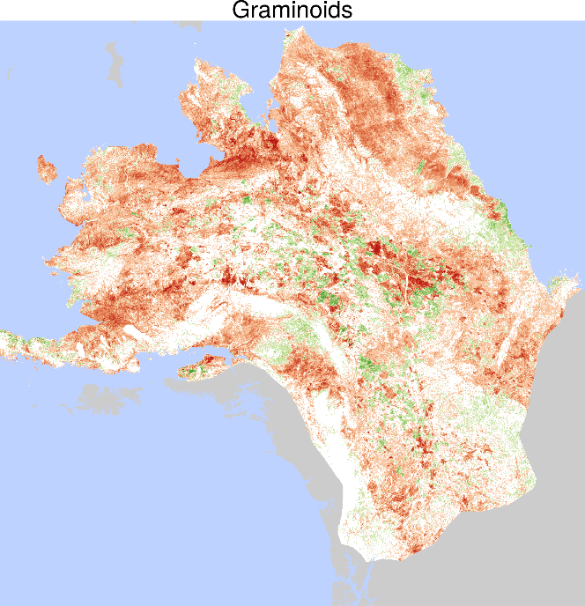
Time-series maps reveal widespread change in plant functional type cover across Arctic and boreal Alaska and Yukon
Macander et al. (2022) Environmental Research Letters.
(a)
(b)
Documented increases in Deciduous and Evergreen Shrub, Conifer and Broadleaf Tree top cover.
Associated decreases in Graminoid and Lichen top cover with fire disturbance and shrub increases.
These changes are highly relevant to resource management applications, including wildlife habitat.
Notes:
Notes: Plant functional types (PFTs) collectively include all vascular plants within the study area as well as light macrolichens, a nonvascular class of high importance to caribou management.
We identified net increases in deciduous shrubs (3.7% of study area), evergreen shrubs (1.1%), broadleaf trees (1.0%), and conifer trees (0.9%), and net decreases in graminoids -2.2%) and light macrolichens 0.8%) over the full map area, with similar patterns across Arctic, Oroarctic, and Boreal bioclimatic zones
Despite extensive wildfire over the 1985–2020 study period, our results indicated that both broadleaf and coniferous tree cover increased throughout the domain.
Rapid increases in deciduous shrub cover after fire and throughout the domain support both post-fire pulses in shrub abundance and long-term shrub increase and canopy dominance in the absence of fire disturbance.
Graminoid top cover decreased throughout the domain, likely driven by competition from deciduous and evergreen shrubs.
Slow, steady loss of lichen is related to both increases in shrubs and associated losses from fire.
Full citation: Macander, M.J., Nelson, P.R., Nawrocki, T., Frost, G.V., Orndahl, K., Palm, E.C., Wells, A.F. and Goetz, S.J., 2022. Time-series maps reveal widespread change in plant functional type cover across arctic and boreal Alaska and Yukon. Environmental Research Letters. https://doi.org/10.1088/1748-9326/ac6965
Data: Macander, M.J., and P.R. Nelson. 2022. ABoVE: Modeled Top Cover by Plant Functional Type over Alaska and Yukon, 1985-2020. ORNL DAAC, Oak Ridge, Tennessee, USA. https://doi.org/10.3334/ORNLDAAC/2032
Grants: This study was funded by the National Aeronautics and Space Administration (NASA) Arctic Boreal Vulnerability Experiment (ABoVE) grants (NNX17AE44G and 80NSSC19M0112) to Scott Goetz.
Abstract: Widespread changes in the distribution and abundance of plant functional types (PFTs) are occurring in Arctic and boreal ecosystems due to the intensification of disturbances, such as fire, and climate-driven vegetation dynamics, such as tundra shrub expansion. To understand how these changes affect boreal and tundra ecosystems, we need to first quantify change for multiple PFTs across recent years. While landscape patches are generally composed of a mixture of PFTs, most previous moderate resolution (30-m) remote sensing analyses have mapped vegetation distribution and change within land cover categories that are based on the dominant PFT; or else the continuous distribution of one or a few PFTs, but for a single point in time. Here we map a 35-year time-series (1985–2020) of top cover (TC) for seven PFTs across a 1,770,000 km² study area in northern and central Alaska and northwestern Canada. We improve on previous methods of detecting vegetation change by modeling TC, a continuous measure of plant abundance. The PFTs collectively include all vascular plants within the study area as well as light macrolichens, a nonvascular class of high importance to caribou management. We identified net increases in deciduous shrubs (66,000 km²), evergreen shrubs (20,000 km²), broadleaf trees (17,000 km²), and conifer trees (16,000 km²), and net decreases in graminoids (-40,000 km²) and light macrolichens (-13,000 km²) over the full map area, with similar patterns across Arctic, Oroarctic, and Boreal bioclimatic zones. Model performance was assessed using spatially blocked, nested 5-fold cross-validation with overall root mean square errors ranging from 8.3–19.0%. Most net change occurred as succession or plant expansion within areas undisturbed by recent fire, though PFT TC change also clearly resulted from fire disturbance. These maps have important applications for assessment of surface energy budgets, permafrost changes, nutrient cycling, and wildlife management and movement analysis.

