Slide 1
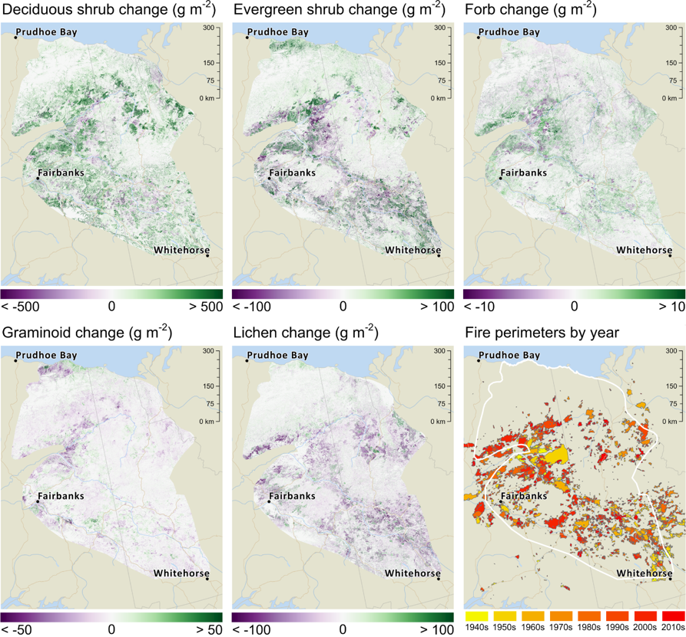
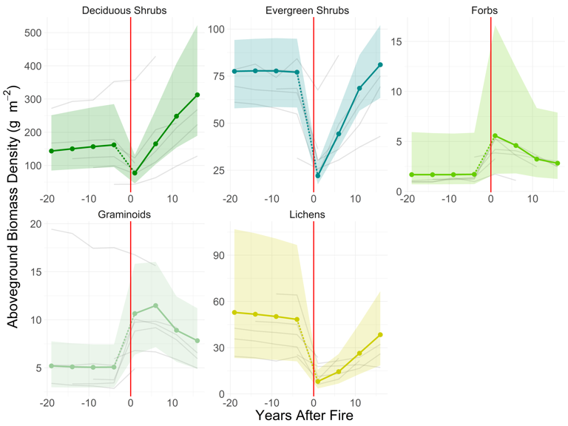
Plant functional type aboveground biomass mapped over 35-years (1985-2020)
across Alaska and northwest Canada
Orndahl, K.M., Macander, M.J., Berner, L.T., and Goetz, S.J., 2022. Environmental Research Letters. 10.1088/1748-9326/ac9d50
Change in average AGB_{PFT} density within the perimeters of fires that occurred in 2004. The year of the fire is indicated by a vertical red line. The X-axis indicates years after (+) and before (-) fire. Trends from other fire years are shown in grey.
AGB_{PFT} was mapped using a multi-scale approach leveraging field harvests, drone observations, and climatological, topographic, phenological and Landsat seasonal spectral predictors.
From 1985-2020, shrub biomass increased, whereas graminoid and lichen biomass decreased. Fire was an important driver of vegetation change.
Vegetation changes within the ABoVE domain have important implications for wildlife management and understanding climate change trajectories.
Change in AGB_{PFT} from 1985-2020, along with historic fire perimeters.
Notes:
Abstract:
Changes in vegetation distribution are underway in Arctic and boreal regions due to climate warming and associated fire disturbance. These changes have wide ranging downstream impacts – affecting wildlife habitat, nutrient cycling, climate feedbacks and fire regimes. It is thus critical to understand where these changes are occurring and what types of vegetation are affected, and to quantify the magnitude of the changes. In this study, we mapped live aboveground biomass for five common plant functional types (deciduous shrubs, evergreen shrubs, forbs, graminoids and lichens) within Alaska and northwest Canada, every five years from 1985 to 2020. We employed a multi-scale approach, scaling from field harvest data and unmanned aerial vehicle (UAV)-based biomass predictions to produce wall-to-wall maps based on climatological, topographic, phenological and Landsat spectral predictors. We found deciduous shrub and graminoid biomass were predicted best among plant functional types. Our time-series analyses show increases in deciduous (37%) and evergreen shrub (7%) biomass, and decreases in graminoid (14%) and lichen (13%) biomass over a study area of approximately 500,000 km2. Fire was an important driver of recent changes in the study area, with the largest changes in biomass associated with historic fire perimeters. Decreases in lichen and graminoid biomass often corresponded with increasing shrub biomass. These findings illustrate the driving trends in vegetation change within the Arctic/Boreal region. Understanding these changes and the impacts they in turn will have on Arctic and boreal ecosystems will be critical to understanding the trajectory of climate change in the region.
Methodological Notes:
To model AGB, we employed a multi-scale approach, scaling from field harvest data and unmanned aerial vehicle (UAV)-based biomass predictions. Field and UAV data were used as training data. Estimates were produced using linear mixed effects models with LASSO regularization and are based on gridded climatological, topographic, phenological, PFT cover, and Landsat spectral predictors. A Monte Carlo approach with 100 iterations was used to propagate uncertainty. For each PFT and each year, we provide the 2.5th percentile estimates (lower bound), 50th percentile estimates (best estimate) and 97.5th percentile estimates (upper bound) from the Monte Carlo analysis.
Results/Discussion Notes:
We mapped 5 plant functional types – deciduous shrubs, evergreen shrubs, graminoids, forbs and lichens
Our time-series analyses show increases in deciduous (37%) and evergreen shrub (7%) biomass, and decreases in graminoid (14%) and lichen (13%) biomass over a study area of approximately 500,000 km²
Increases in shrub biomass are consistent with greening trends and shrub expansion reported from previous research, both field based and remotely sensed
Decreases in lichens are consistent with previous research that suggests that lichens are negatively impacted by climate warming, and are competitively excluded as shrubs expand
Deciduous shrubs made up the majority (67%) of total plant AGB (excluding trees and mosses) across the study area in 2020.
Graminoids made up only a small percentage (2%) of total AGB across the study area, despite being the second most common PFT by cover
Our maps capture patterns of post-fire succession consistent with previous research, notably early succession driven by an increase in graminoids and forbs, initial decreases in deciduous and evergreen shrubs, and long-lasting decreases in lichens
Importance:
Our map products have potential applications across disciplines, for example:
Assessing of spatial patterns of wildlife habitat and forage
Understanding impacts of fire on vegetation, analyzing vegetation recovery trajectories, identifying fire-prone areas
Identifying biome shifts and/or changes in plant community composition
Using as input to climate models, wildlife models, etc.
We developed a multi-scale modeling approach that could be applied to other regions, with appropriate training/validation data inputs
Mapping vegetation biomass remains challenging, due in large part to the difficulty of acquiring biomass harvest data. As biomass datasets continue to grow, a centralized database of harmonized AGB would facilitate future mapping efforts
Full Citation:
Orndahl, K.M., Macander, M.J., Berner, L.T. and Goetz, S., 2022. Plant functional type aboveground biomass change within Alaska and northwest Canada mapped using a 35-year satellite time series from 1985-2020. Environmental Research Letters. https://doi.org/10.1088/1748-9326/ac9d50

