Slide 1
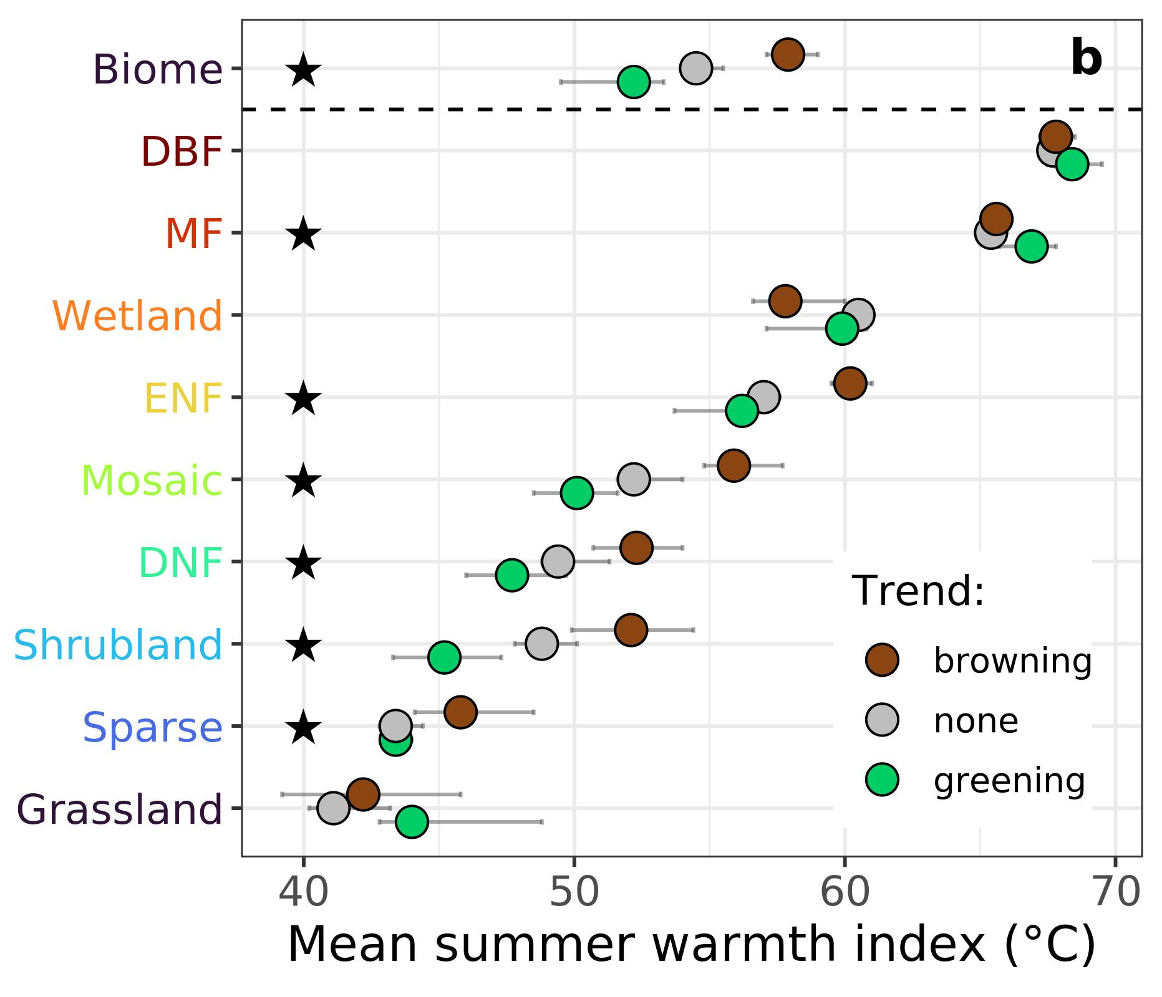
Satellite observations document trends consistent with a boreal forest biome shift
Logan Berner and Scott Goetz (2022) Global Change Biology, In Press
(a)
(b)
Consistent with a biome shift, the Landsat satellites show widespread greening in the forest-tundra ecotone from 2000-2019, along with browning in more southern regions (a)
(c)
Greening occurred in areas with lower tree cover (b) and mean summer temperatures (c)
Notes:
Notes: Annual maximum vegetation greenness increased (greened) at 38 [29, 42] % and 22 [15, 26] % of sample sites from 1985 to 2019 and 2000 to 2019, whereas vegetation greenness decreased (browned) at 13 [9, 15] % and 15 [13, 19] % of sample sites during these periods [95% CI].
Greening was about 3.0 and 1.5 times more common than browning during these periods
Greening primarily occurred in cold sparsely treed areas with high soil nitrogen and moderate summer warming, while browning primarily occurred in the climatically warmest margins of both the boreal forest biome and major forest types (e.g., evergreen conifer forests), especially in densely treed areas where summers became warmer and drier.
Full citation: Berner, L. T and Goetz, S. J.: Satellite observations document trends consistent with a boreal forest biome shift. Global Change Biology, In Press
Grants: This study was funded by the National Aeronautics and Space Administration (NASA) Arctic Boreal Vulnerability Experiment (ABoVE) and Carbon Cycle Science grants (NNX17AE44G, 80NSSC19M0112, and NNX17AE13G) to Scott Goetz.
Abstract: The boreal forest biome is a major component of Earth’s biosphere and climate system that is projected to shift northward due to continued climate change over the coming century. Indicators of a biome shift will likely first be evident along the climatic margins of the boreal forest and include changes in vegetation productivity, mortality, and recruitment, as well as overall vegetation greenness. However, the extent to which a biome shift is already underway remains unclear because of the local nature of most field studies, sparsity of systematic ground-based ecological monitoring, and reliance on coarse resolution satellite observations. Here, we evaluated indicators of a boreal forest biome shift using four decades of moderate resolution (30 m) satellite observations and biogeoclimatic spatial datasets. Specifically, we quantified inter-annual trends in annual maximum vegetation greenness using an ensemble of vegetation indices derived from Landsat observations at 100,000 sample sites in areas without signs of recent disturbance. We found vegetation greenness increased (greening) at 38 [29, 42] % and 22 [15, 26] % of sample sites from 1985 to 2019 and 2000 to 2019, whereas vegetation greenness decreased (browning) at 13 [9, 15] % and 15 [13, 19] % of sample sites during these respective periods [95% Monte Carlo confidence intervals]. Greening was thus 3.0 [2.6, 3.5] and 1.5 [0.8, 2.0] times more common than browning and primarily occurred in cold sparsely treed areas with high soil nitrogen and moderate summer warming. Conversely, browning primarily occurred in the climatically warmest margins of both the boreal forest biome and major forest types (e.g., evergreen conifer forests), especially in densely treed areas where summers became warmer and drier. These macroecological trends reflect underlying shifts in vegetation productivity, mortality and recruitment that are consistent with early stages of a boreal biome shift.

