Slide 1
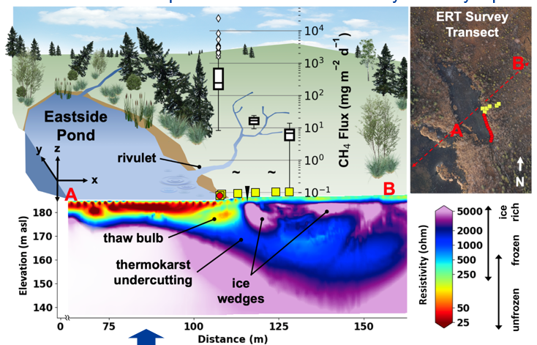
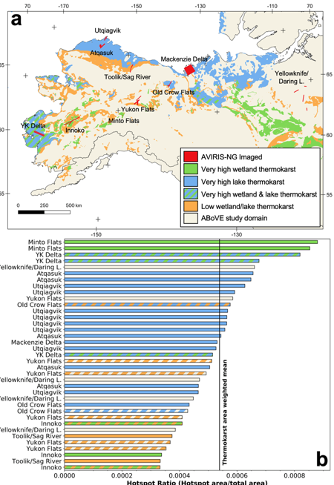
Characterizing methane emission hotspots from thawing permafrost
C.D. Elder, D.R. Thompson, A.K. Thorpe, H.A. Chandanpurkar, P.J. Hanke, N. Hasson, S.R. James,
B.J. Minsley, N.J. Pastick, D. Olefeldt, K.M. Walter Anthony, C.E. Miller. (2021),
Global Biogeochemical Cycles (2021). https://doi.org/10.1029/2020GB006922
Highlight: A combination of high-resolution airborne remote sensing and intensive ground-based observations quantified the link between extreme methane emission hotspots and actively thawing permafrost features. Leveraging a large methane hotspot dataset and existing thermokarst maps, we estimated that methane emissions from pan-Arctic thermokarst activity currently represent 4% of total Arctic wetland emissions.
Fig. 1. Electrical Resistivity Tomography (ERT) cross section identifies a thaw bulb directly beneath the easternmost shoreline of the Eastside Pond. Subsurface thermokarst features spatially align with extreme CH4 fluxes from the remotely sensed hotspot in the same area (white boxes). The red “A” and “B” correspond to the ERT transect extents in the x dimension.
Fig. 2. Highest CH₄ hotspot ratios correspond to regions with highest thermokarst activity. (a) Subset of 64 AVIRIS-NG flight lines mapped in relation to either “very high,” intermediate, or “low” thermokarst as classified by Olefeldt et al. (2016). (b) AVIRIS-NG-based CH₄ hotspot occurrence ratio ranked for each flight line. Bars are color-coded based on map legend.
Notes:
Kahru, M., Z. Lee, B.G.Mitchell1and C.D. Nevison (2016), Effects of sea ice cover on satellite-detected primary production in the Arctic Ocean, Biology Letters, 12: 20160223.
http://dx.doi.org/10.1098/rsbl.2016.0223.
Satellite Data:
OCTS - Ocean Color Temperature Scanner (NASDA)
SeaWiFS - Sea-Viewing Wide Field-of-View Sensor (NASA)
MERIS - MEdium Resolution Imaging Spectrometer (ESA)
MODIS-Aqua (NASA)
Primary productivity (NPP) in the Arctic Ocean has increased by 47% from the first half (1998-2006) to the 2nd half of the series (2007-2015) but changes after 2011 have been minor. NPP per open water area has actually decreased. Increased open water area is related to increased NPP in the summer with the strongest effect in June. In northern Barents Sea, sea ice retreat has become earlier at a rate of -4.5 day/year and the high-productivity season is starting earlier at a rate of -3.0 day/year. Freeze-up is occurring later but the timing of the end of the high NPP period has not changed.

Slide 2
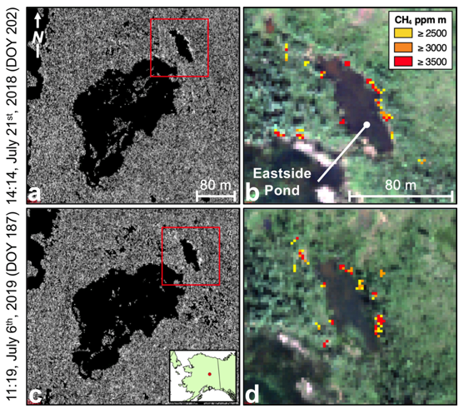
Characterizing methane emission hotspots from thawing permafrost
C.D. Elder, D.R. Thompson, A.K. Thorpe, H.A. Chandanpurkar, P.J. Hanke, N. Hasson, S.R. James,
B.J. Minsley, N.J. Pastick, D. Olefeldt, K.M. Walter Anthony, C.E. Miller. (2021),
Global Biogeochemical Cycles (2021). https://doi.org/10.1029/2020GB006922
Significance
Our observations combine ground-observed CH₄ hotspot emission rates with an unprecedented airborne survey of CH₄ hotspots over diverse permafrost environments. Bridging scales from individual pixels (25m²) to pan-Arctic thermokarst distributions, our survey provides a novel observation-based approach to estimating hotspot CH₄ emissions from thawing permafrost environments. Monitoring this extreme mode of CH₄ emission is critical for understanding the impact of climate warming on permafrost carbon cycling.
Background
Arctic CH₄ emissions from permafrost sources could accelerate a significant positive feedback to further climate warming.
Despite their potential impact, Arctic CH₄ emissions and their sources are highly uncertain due to our inability to observe, model, and forecast complex biogeochemical processes across heterogenous landscapes on large scales.
Analysis
Repeated airborne spectrometry using NASA’s Next Generation Airborne Visible/Infrared Imaging Spectrometer (AVIRIS-NG) revealed a consistent CH₄ emission hotspot at a site of actively thawing permafrost at Big Trail Lake near Fairbanks, AK (Fig 3). Ground-based investigations confirmed extreme CH₄ flux rates (often > 5,000 mg CH₄ m⁻² d⁻¹) from surfaces directly above a 15m-deep thaw bulb, as revealed by electrical resistivity tomography.
Hotspot emission rates were contextualized within the study site by estimating total site-scale emissions by applying surface-specific fluxes within a hyperspectral surface classification map.
Hotspot fluxes were extrapolated to pan-Arctic scales using broad-scale AVIRIS-NG-based CH₄ hotspot occurrence rates and existing permafrost thaw maps. Pan-Arctic thermokarst CH₄ hotspot emissions were estimated on the annual scale.
Findings
Repeat airborne spectral imaging geolocated a thermokarst CH₄ hotspot with ground validated emissions > 10,000 mg m⁻² d⁻¹.
Hotspot CH₄ emissions arose from <1% of our 10 ha thermokarst lake study area but comprised ~40% of the total diffusive emissions.
Ground-based and airborne observations suggest thermokarst hotspots emit roughly 1.1 Tg CH₄ yr⁻¹ or 4% of pan-Arctic wetland CH₄ emissions.
Fig 3. AVIRIS-NG remote detection of CH₄ hotspots at the Eastside Pond of Big Trail Lake (64.91932°N, −147.82200°W) in July 2018 (a) and (b) and July 2019 (c) and (d). 2019 image was taken 2 hr before the ground-validation. Greyscale panels (a) and (c) show surface-controlled matched filter spectrometer output for column CH₄ enhancement. Panels (b) and (d) show RGB channels overlaid with spectrometer output for spatially filtered CH₄ hotspots. Red outlines in the left images denote the extent of the RGB images. Local time of imagery is shown (Alaska Daylight Time).
Notes:
Kahru, M., Z. Lee, B.G.Mitchell1and C.D. Nevison (2016), Effects of sea ice cover on satellite-detected primary production in the Arctic Ocean, Biology Letters, 12: 20160223.
http://dx.doi.org/10.1098/rsbl.2016.0223.
Satellite Data:
OCTS - Ocean Color Temperature Scanner (NASDA)
SeaWiFS - Sea-Viewing Wide Field-of-View Sensor (NASA)
MERIS - MEdium Resolution Imaging Spectrometer (ESA)
MODIS-Aqua (NASA)
Primary productivity (NPP) in the Arctic Ocean has increased by 47% from the first half (1998-2006) to the 2nd half of the series (2007-2015) but changes after 2011 have been minor. NPP per open water area has actually decreased. Increased open water area is related to increased NPP in the summer with the strongest effect in June. In northern Barents Sea, sea ice retreat has become earlier at a rate of -4.5 day/year and the high-productivity season is starting earlier at a rate of -3.0 day/year. Freeze-up is occurring later but the timing of the end of the high NPP period has not changed.

Slide 3
Full Citation & Abstract
Elder, C. D., Thompson, D. R., Thorpe, A. K., Chandanpurkar, H. A., Hanke, P. J., Hasson, N., et al. (2021). Characterizing methane emission hotspots from thawing permafrost. Global Biogeochemical Cycles, 35, e2020GB006922. https://doi.org/10.1029/2020GB006922
Abstract
Methane (CH₄) emissions from climate-sensitive ecosystems within the northern permafrost region represent a potentially large but highly uncertain source, with current estimates spanning a factor of seven (11–75 Tg CH₄ yr⁻¹). Accelerating permafrost thaw threatens significant increases in pan-Arctic CH₄ emissions, amplifying the permafrost carbon feedback. We used airborne imaging spectroscopy with meter-scale spatial resolution and broad coverage to identify a previously undiscovered CH₄ emission hotspot adjacent to a thermokarst lake in interior Alaska. Hotspot emissions were confined to <1% of the 10 ha lake study area. Ground-based chamber measurements confirmed average daily fluxes from the hotspot of 1,170 mg CH₄ m⁻² d⁻¹, with extreme daily maxima up to 24,200 mg CH₄ m⁻² d⁻¹. Ground-based geophysical measurements revealed thawed permafrost directly beneath the CH₄ hotspot, extending to a depth of ∼15 m, indicating that the intense CH₄ emissions likely originated from recently thawed permafrost. Hotspot emissions accounted for ∼40% of total diffusive CH₄ emissions from the lake study site. Combining study site findings with hotspot statistics from our 70,000 km² airborne survey across Alaska and northwestern Canada, we estimate that pan-Arctic terrestrial thermokarst hotspots currently emit 1.1 (0.1–5.2) Tg CH₄ yr⁻¹, or roughly 4% of the annual pan-Arctic wetland budget from just 0.01% of the northern permafrost land area. Our results suggest that significant proportions of pan-Arctic CH₄ emissions originate from disproportionately small areas of previously undetermined thermokarst emissions hotspots, and that pan-Arctic CH₄ emissions may increase non-linearly as thermokarst processes increase under a warming climate.

