Slide 1
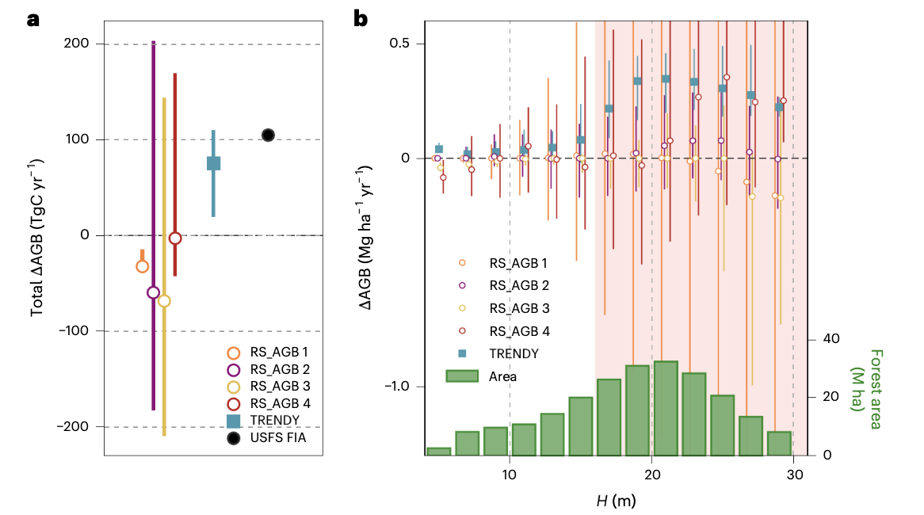
Widespread carbon accumulation in mature forests remains underestimated by satellite observations
Lei Ma, University of Maryland
Research Objectives and Context: Satellite-derived biomass products are widely used to monitor the terrestrial carbon sink and have suggested a weaker sink than previously thought. This project investigated whether these products adequately capture continued carbon accumulation in mature and tall forests across the contiguous United States.
Key Research Result: Using airborne lidar across 42 NEON sites, GEDI L2A, FIA plot measurements, and ecosystem models, we found widespread structural growth and carbon accumulation in mature forests. In contrast, widely used satellite biomass products increasingly underestimate biomass gains once forests exceed ~16 m in canopy height, preferentially detecting biomass losses over continued growth. This observational bias may contribute to underestimation of the terrestrial land carbon sink.
Significance: This study identifies an important challenge in monitoring carbon accumulation in mature forests using current satellite observations. It highlights the need for structure-sensitive observations from NASA missions, including GEDI, ICESat-2, NISAR, and EDGE, together with ecosystem modeling, to improve our understanding of the terrestrial carbon sink.
Figure 1. Four satellite biomass products underestimate carbon accumulation in mature forests. FIA and ecosystem models (TRENDY) show continued biomass accumulation, whereas satellite biomass products show little or no gain once forests exceed ~16 m in height (pink shade in b).
Acknowledgments: Supported by NASA CMS (80NSSC25K7221), GEDI CST (80NSSC24K0599), ECIP (80NSSC24K1632), and the GEDI contract (NNL15AA03C); Schmidt Sciences (CLARiTy, CALIPSO); the Singapore Ministry of Education (MOE-T2EP50122-0006); and the Maine Space Grant Consortium (SG-27-03).
Reference Publication: Ma, L., et al. (2026). Widespread carbon accumulation in mature forests remains underestimated by satellite observations. Nature Ecology & Evolution. DOI: 10.1038/s41559-026-03151-w.

