Slide 1
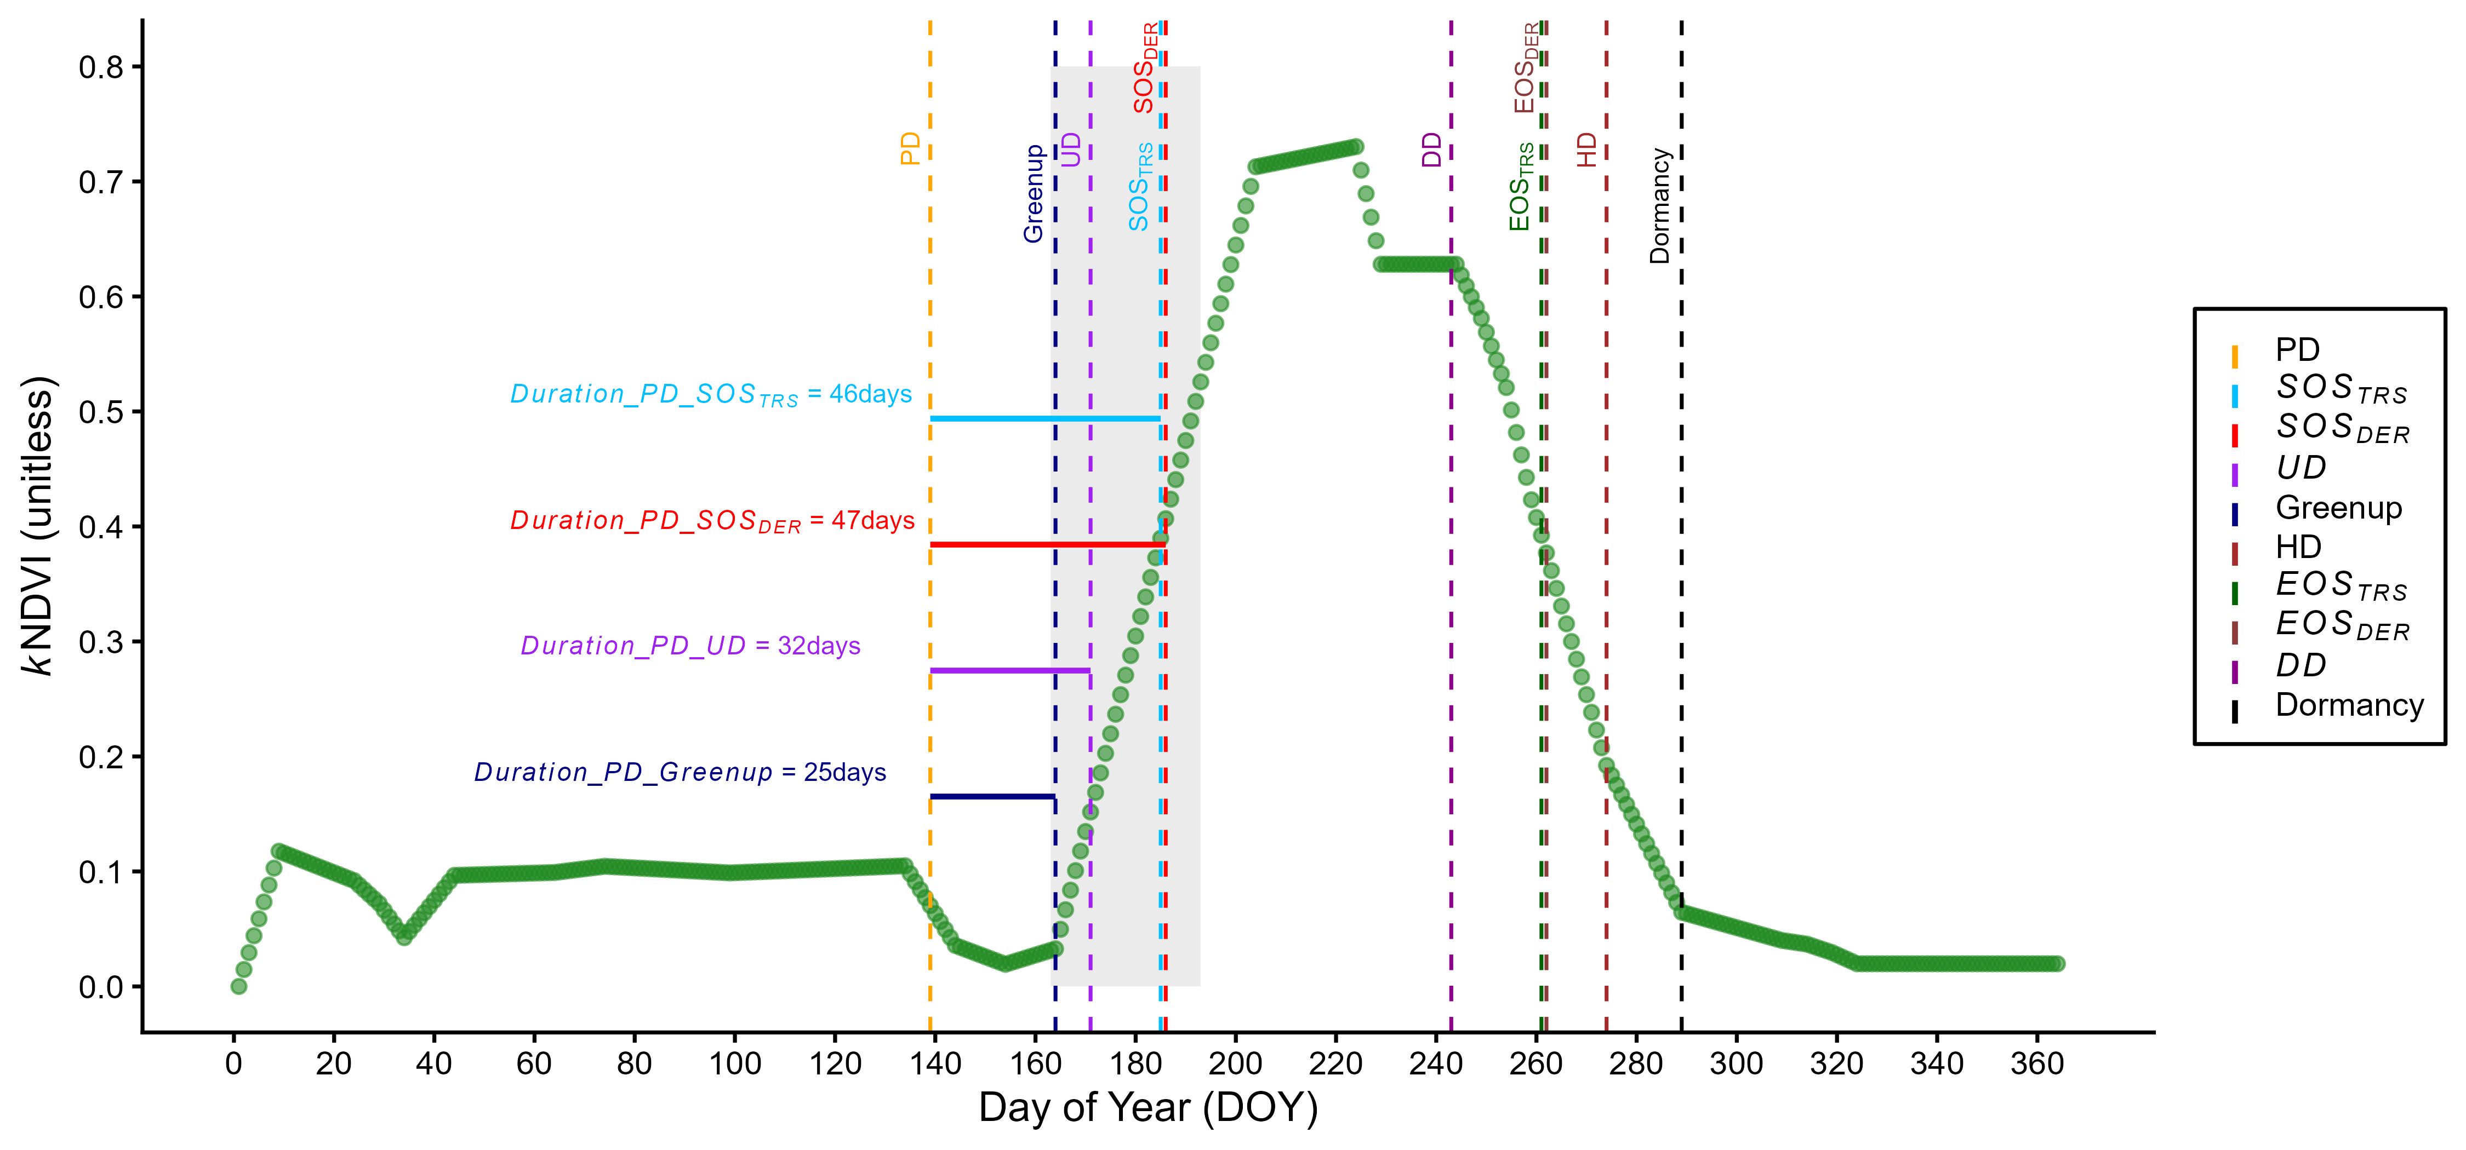
Phenological and Machine Learning Approaches for Estimating Field-Scale Rice Planting and Harvest Dates in Arkansas
Riasad Bin Mahbub¹, Rongyun Tang¹, Beatriz Moreno-García¹, Marc Gomez-Prats¹, Michele L. Reba², Brad G. Peter¹, Benjamin R.K. Runkle¹
1 University of Arkansas • 2 USDA-ARS
Research Objectives and Context:
  Rice fields are important carbon sinks and methane sources.
  Accurate planting (PD) and harvest dates (HD)define the growing season for estimating gross primary productivity and greenhouse gas emissions.
  We developed a satellite-based LIMP random forest (LIMP RF) model to predict field-scale rice planting and harvest dates across Arkansas.
Key Research Result:
  Compiled a large field-scale rice phenology dataset (662 planting dates, 500 harvest dates; 2015–2024).
  End-of-season metrics predicted harvest better than start-of-season metrics predicted planting (r = 0.79–0.82 vs. 0.49–0.75).
  LIMP RF achieved MAEs of 6.23 days (PD) and 4.93 days (HD).
  Prediction accuracy declined under unseen years, highlighting the influence of interannual climate variability.
Significance:
  Accurate crop calendars support improved estimates of crop productivity, greenhouse gas emissions, and climate impacts, enabling more informed agricultural management.
NASA Assets and Data:
  Landsat 7 & Landsat 8
  GLDAS (Global Land Data Assimilation System)
  The research was supported by the NASA CMS Grand (ROSES 2020) Award 80NSSC21K1002
PREFERABLY A SINGLE FIGURE OR IMAGE
Figure 1. Time-series extraction of field-scale rice phenology using the kernel Normalized Difference Vegetation Index (kNDVI). The plot displays the seasonal trajectory alongside satellite-derived metrics, such as Start of Season (SOS), Greenup, and End of Season (EOS), mapped directly against true field-observed Planting Dates (PD) and Harvest Dates (HD).
Reference Publication: Mahbub, R. B., Tang, R., Moreno-García, B., Gomez-Prats, M., Reba, M. L., Peter, B. G., & Runkle, B. R. (2026). Evaluating Phenological and Machine Learning Approaches for Estimating Field-Scale Rice Planting and Harvest Dates in Arkansas. Science of Remote Sensing, 100459.

