Slide 1
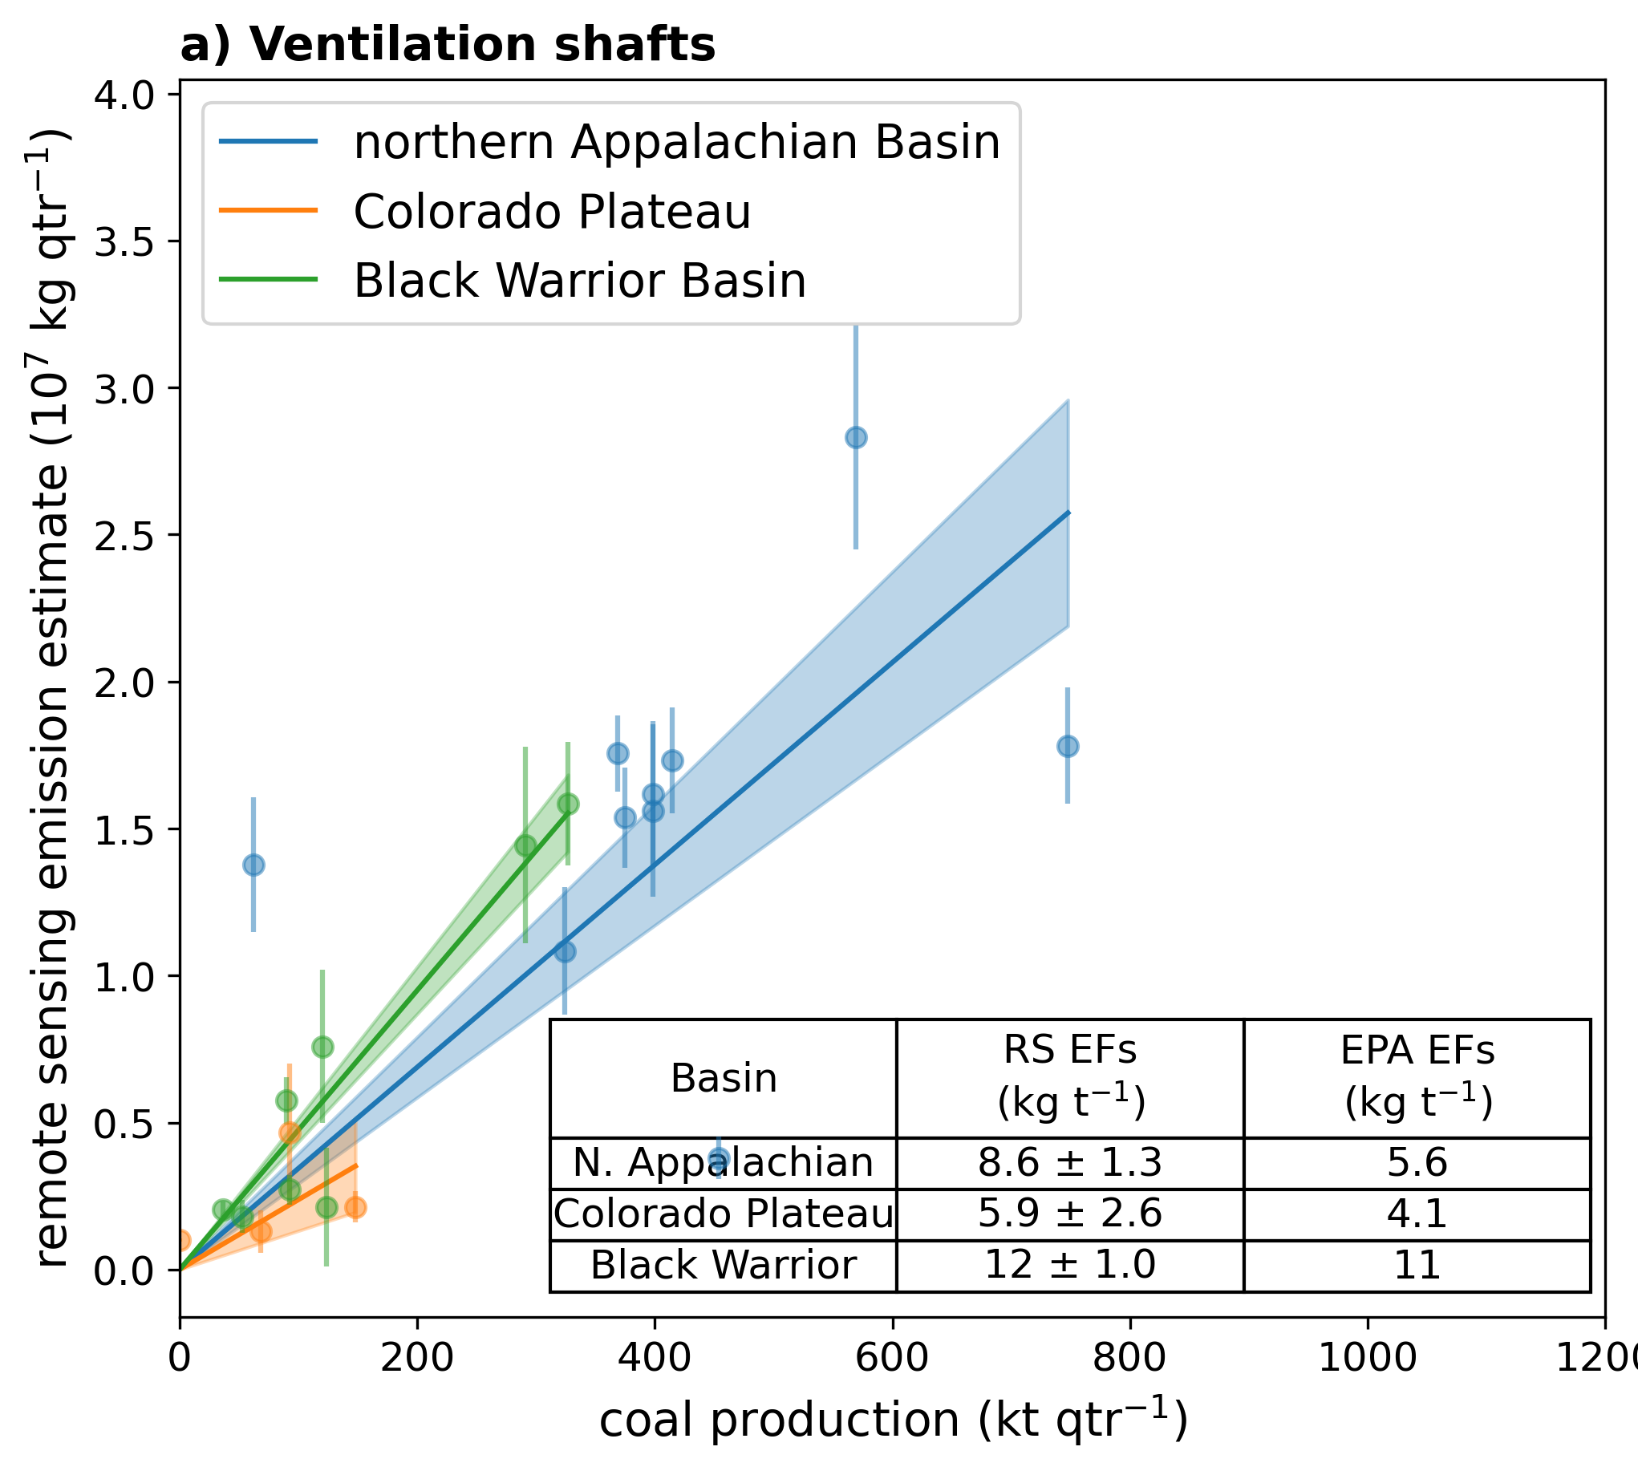
Remote sensing enables basin-scale inventories of coal mine methane
Elise Penn, Daniel J. Jacob, Harvard (PI); Daniel Cusworth, Carbon Mapper (PI)
Research Objectives and Context: Underground coal mines are important global sources of methane, but emissions estimates are uncertain.
Key Research Result: Inventories using depth to determine emission factors (IPCC T1) overestimate emissions by 3x. Using basin-wide emission factors (IPCC T2) instead results in a much better match (20%). Aircraft observations of individual mines are within 40% of ground truth, allowing us to develop emission factors from observations.
Significance: Aircraft (or satellite) surveys of a small sample of underground coal mines can be used to develop basin-wide emission factors for methane emissions.
NASA Assets and Data: AVIRIS-NG aircraft. This research was supported by the NASA Carbon Monitoring System (NNH16ZDA001N-CMS) as part of Jacob-CMS-2023 and Cusworth-CMS-2022 (80NSSC23K1244)
Emission factors estimated by aircraft remote sensing. Emission factors scale linearly with coal production, and are relatively stable within basins and over time. This allows us to estimate emission factors directly from remote sensing observations
Reference Publication: Penn et al., 2026, Environ. Sci. Technol. https://doi.org/10.1021/acs.est.5c14976

