Slide 1
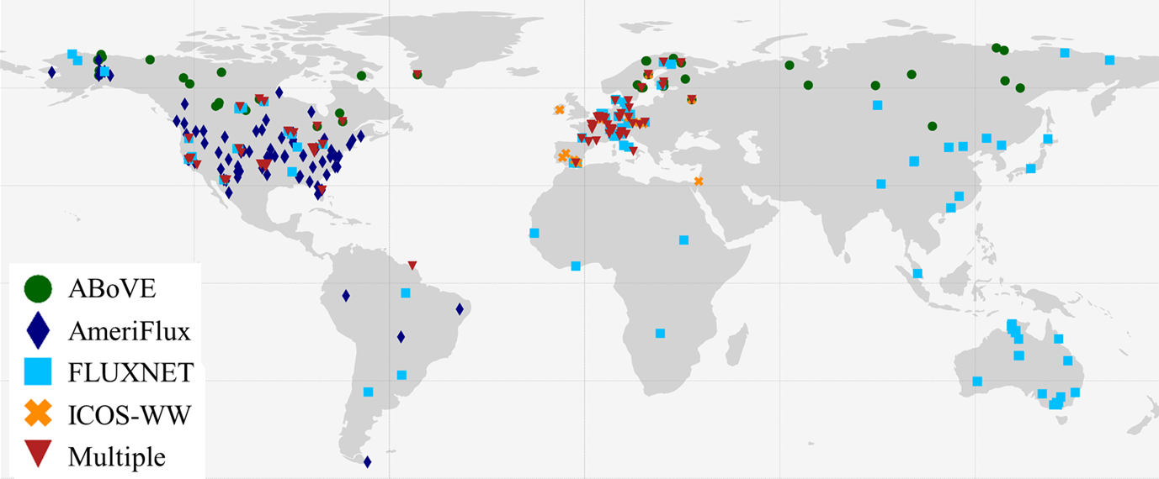
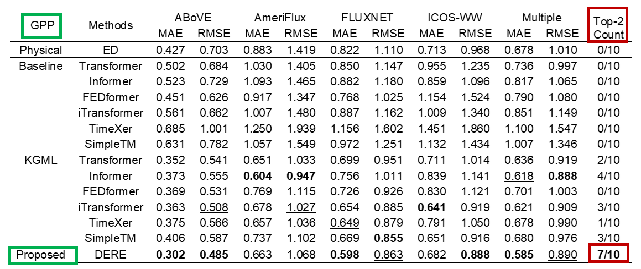
Knowledge-guided learning for global carbon flux prediction: Integrating high-level remote sensing with bottom-up physical modeling
Presenter: Shuo Xu, PI: George Hurtt
Research Objectives and Context
Develops a physics-guided ML framework that integrates satellite, in-situ, and simulation data to improve carbon estimation.
Key Research Result
Proposed method can use large-scale indirect satellite data.
Knowledge-guided training effectively uses multi-source data, improving estimation accuracy and robustness.
Experiments on global carbon datasets show the proposed method consistently outperforms state-of-the-art methods.
Significance
Provides a general and extensible pathway for improving Earth system monitoring under real-world conditions.
NASA assets and data
Ecosystem Demography model version 3 (EDv3)
Arctic-Boreal Vulnerability Experiment (ABoVE)
GPP test result (top results in bold; runner-ups with underlines).
Reference publication: Xu, Shuo, et al. “Knowledge-guided learning for global carbon flux prediction: Integrating high-level remote sensing with bottom-up physical modeling.” In Proceedings of the 32nd ACM SIGKDD Conference on Knowledge Discovery and Data Mining (KDD ’26), AI for Science Track.

