Slide 1
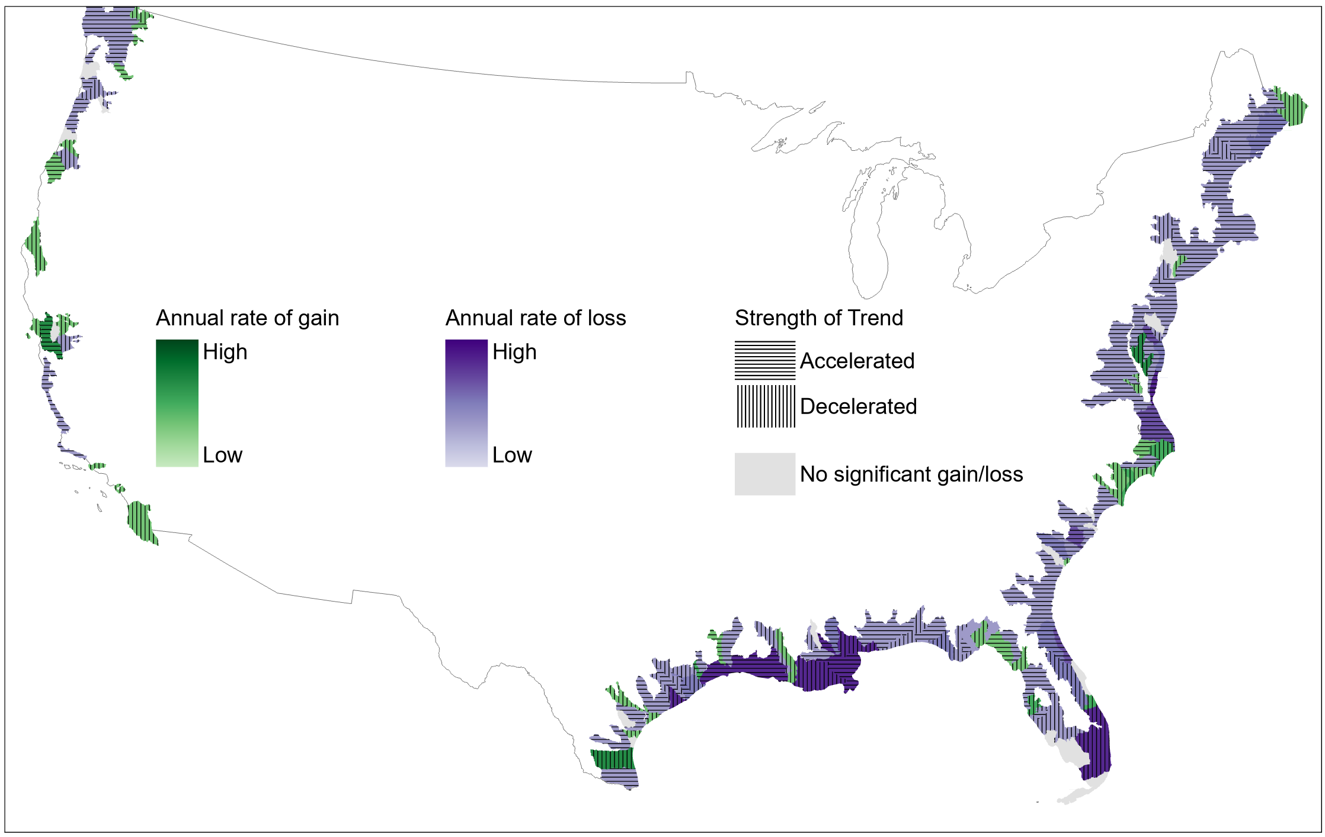
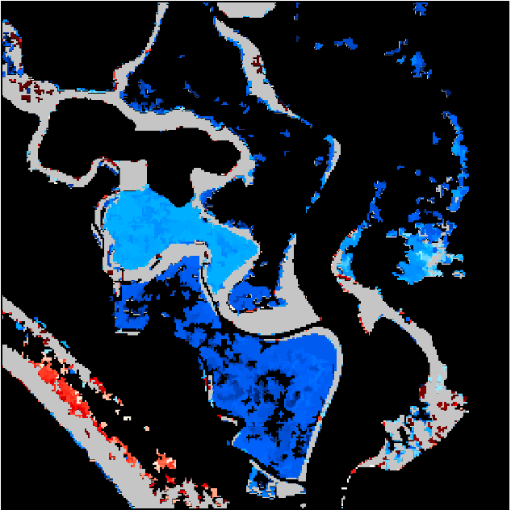
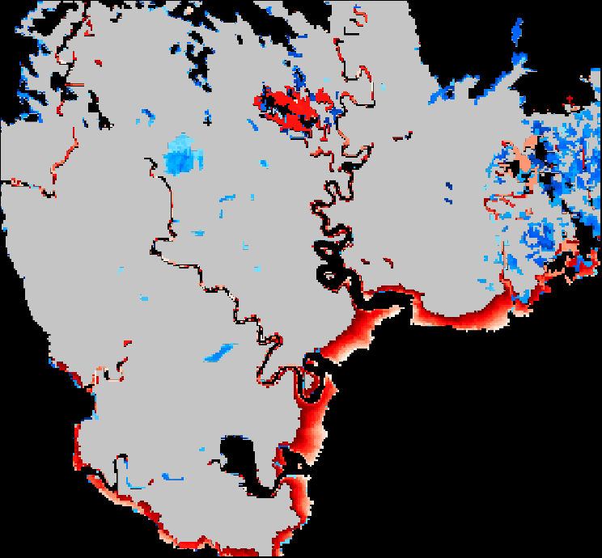
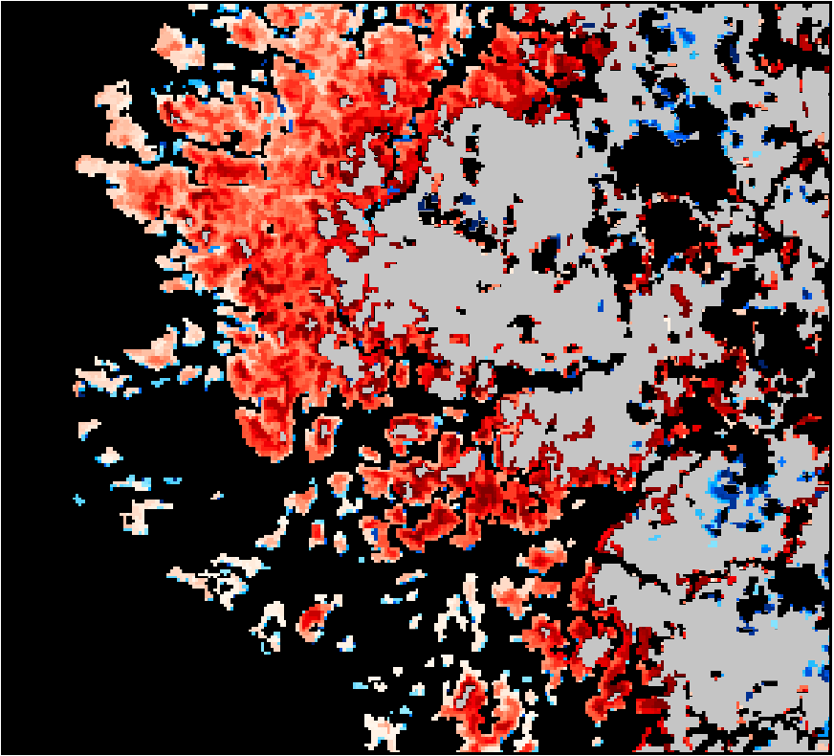
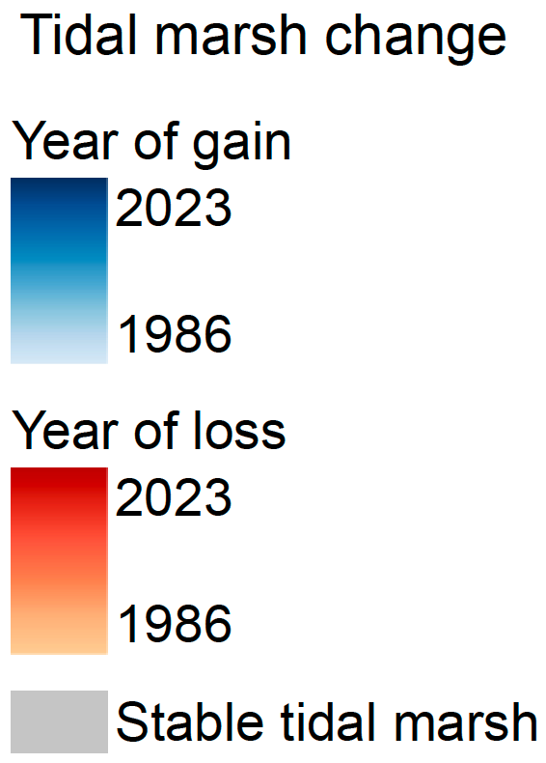
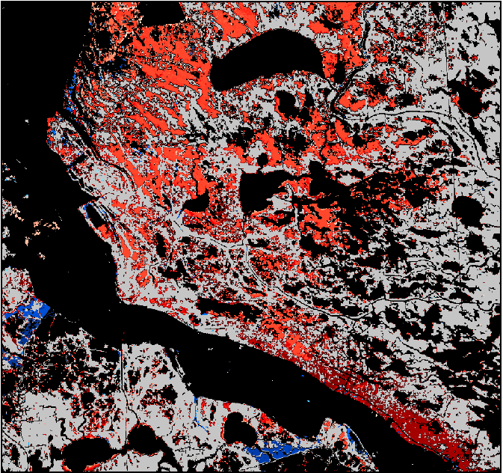
The accelerating loss and shifting dynamics of US tidal wetlands
Zhe Zhu, University of Connecticut
Research Objectives and Context: Long-term and high-frequency monitoring of US tidal wetlands
Key Research Result: U.S. tidal wetlands lost ~1,600 km² (7.5%) from 1985–2023; loss rate is accelerating; chronic stressors caused largest cumulative loss (60%), while extreme weather contributed 1.4 times as much to the acceleration as chronic stressors.
Significance: Current protection and restoration are not keeping pace with declining tidal wetland resilience; targeted restoration can still make a difference, as shown by gains along San Francisco Bay
NASA Assets and Data: ~176k Landsat 4-8 images, DECODE algorithm
San Francisco Bay
Delaware Bay
Florida
Mississippi River Delta
Annual trends in U.S. tidal wetland loss and gain, including acceleration and deceleration patterns. Insets highlight regional hotspots of tidal marsh cover change.
Interactive map: https://gers.users.earthengine.app/view/tidalwetlandcover
Reference Publication: Yang, X., Qiu, S., Kroeger, K. D., Zhu, Z.L., Covington, S. Murray, N. J., Zhu, Z. (2026) The accelerating loss and shifting dynamics of US tidal wetlands. Nature Communications, 10.1038/s41467-026-71464-2

