Slide 1
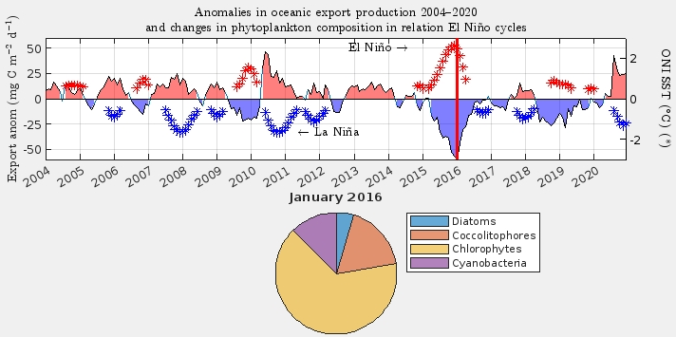
Extreme 2016 El Niño heatwave weakened carbon export and respiration in the Equatorial Pacific
Lionel Arteaga, NASA GSFC / UMBC
Research Objectives and Context: NASA’s ocean color observing and modeling capabilities were combined with AI-based reconstructions of ocean interior oxygen and particle backscatter to investigate the impact of the super 2016 El Niño on the biogeochemistry of the Equatorial Pacific.
Key Research Result: We estimate a major reduction of - 50 % in export production and - 30 % in ecosystem respiration driven by simulated ecosystem changes in phytoplankton community composition.
Significance: This major drop in productivity threatens fisheries collapse and inhibits Pacific Ocean sequestration of carbon during El Niño events.
NASA Assets and Data: Ocean color variables from NASA´s space-based MODIS and SeaWIFS sensors were assimilated into the NASA Ocean Biogeochemical Model (NOBM). AI-reconstructions are based of BGC-Argo autonomous profiling floats and ship observations.
Surface changes in export production. Anomalies in export are linked to upper ocean ecosystem alterations in response El Niño cycles. Largest productivity decline is observed in early 2016.
Respiration depth profile
Reference Publication: Arteaga, L.A., Rousseaux, C.S., Cetinić, I. et al. Extreme 2016 El Niño heatwave weakened carbon export and respiration in the Equatorial Pacific. Commun Earth Environ (2026). https://doi.org/10.1038/s43247-026-03441-y
Biogeochemical impacts propagate through depth. The decrease in particle flux to depth inhibits respiration of organic matter, affecting the flow of chemical energy to high-order organisms.

