Slide 1
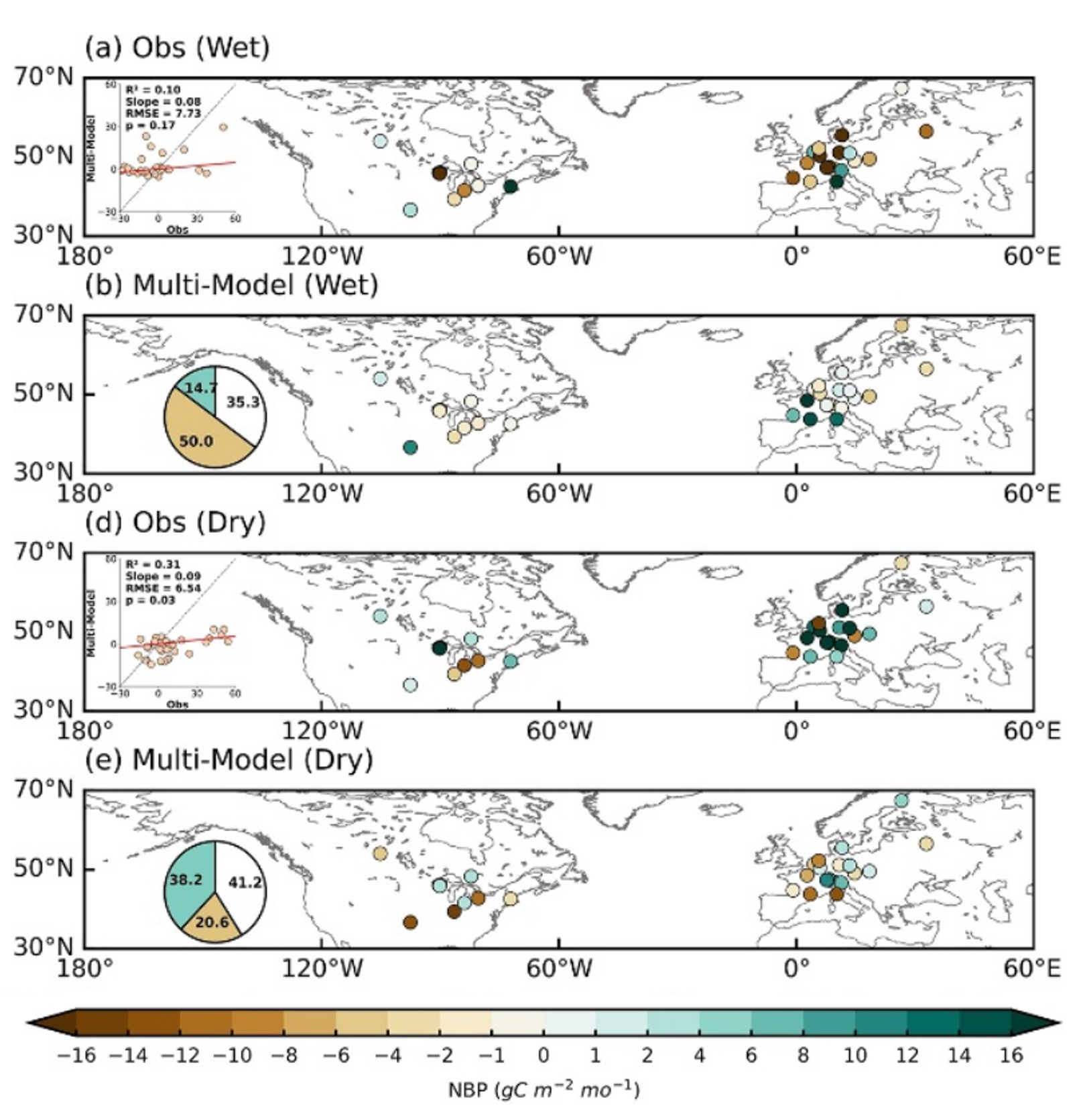
Pronounced inter-model uncertainties in TRENDY-simulated
terrestrial carbon sink responses to hydroclimatic extremes
Z. Wang, J. Wang, B. Poulter, G. Meyer, G. Hurtt, H. Zhou, L. Ma, P.C. McGuire, Q. Sun, W. Yuan, X. Wang-Faivre.
Environ. Res. Lett. (CMS special issue), DOI:10.1088/1748-9326/ae4b55
Context
Climate extremes intensify and threaten stability of the land carbon sink.
Systematic assessments of precipitation extreme impacts on terrestrial carbon dynamics remain limited.
Data
FLUXNET2015 (34 EC sites): GPP, Reco, NEE
TRENDY v12 S3 (EDv3, LPJwsl): GPP, NBP, Ra, Rh
CRU TS (1980–2022): monthly prcp
Method
Extreme hydroclimatic events defined by SPI-3 (>2 wet, <−2 dry)
Seasonal cycles and long-term trends removed from NBP, GPP, and Reco
Key result
Multi-model mean captures ~60% of NBP anomaly signs found in EC sites
Ensemble mean reproduces NBP in dry events but degrades in wet events
Model NBP uncertainty is primarily driven by GPP
Future development: enhance belowground trait representation strengthen suppressive effects of excessive soil water
Acknowledgement: NASA Carbon Monitoring System (80NSSC21K1059); NASA GEDI Competing Science Team (80NSSC24K0599); NASA Early Career Investigator Program in Earth Science (80NSSC24K1632)
Figure 1. Detrended NBP anomalies under hydroclimatic extremes. (a,d) EC NBP anomalies in wet and dry events. (b,e) TRENDY multi-model mean; insets show observed–modeled agreement and sign consistency.

