Slide 1
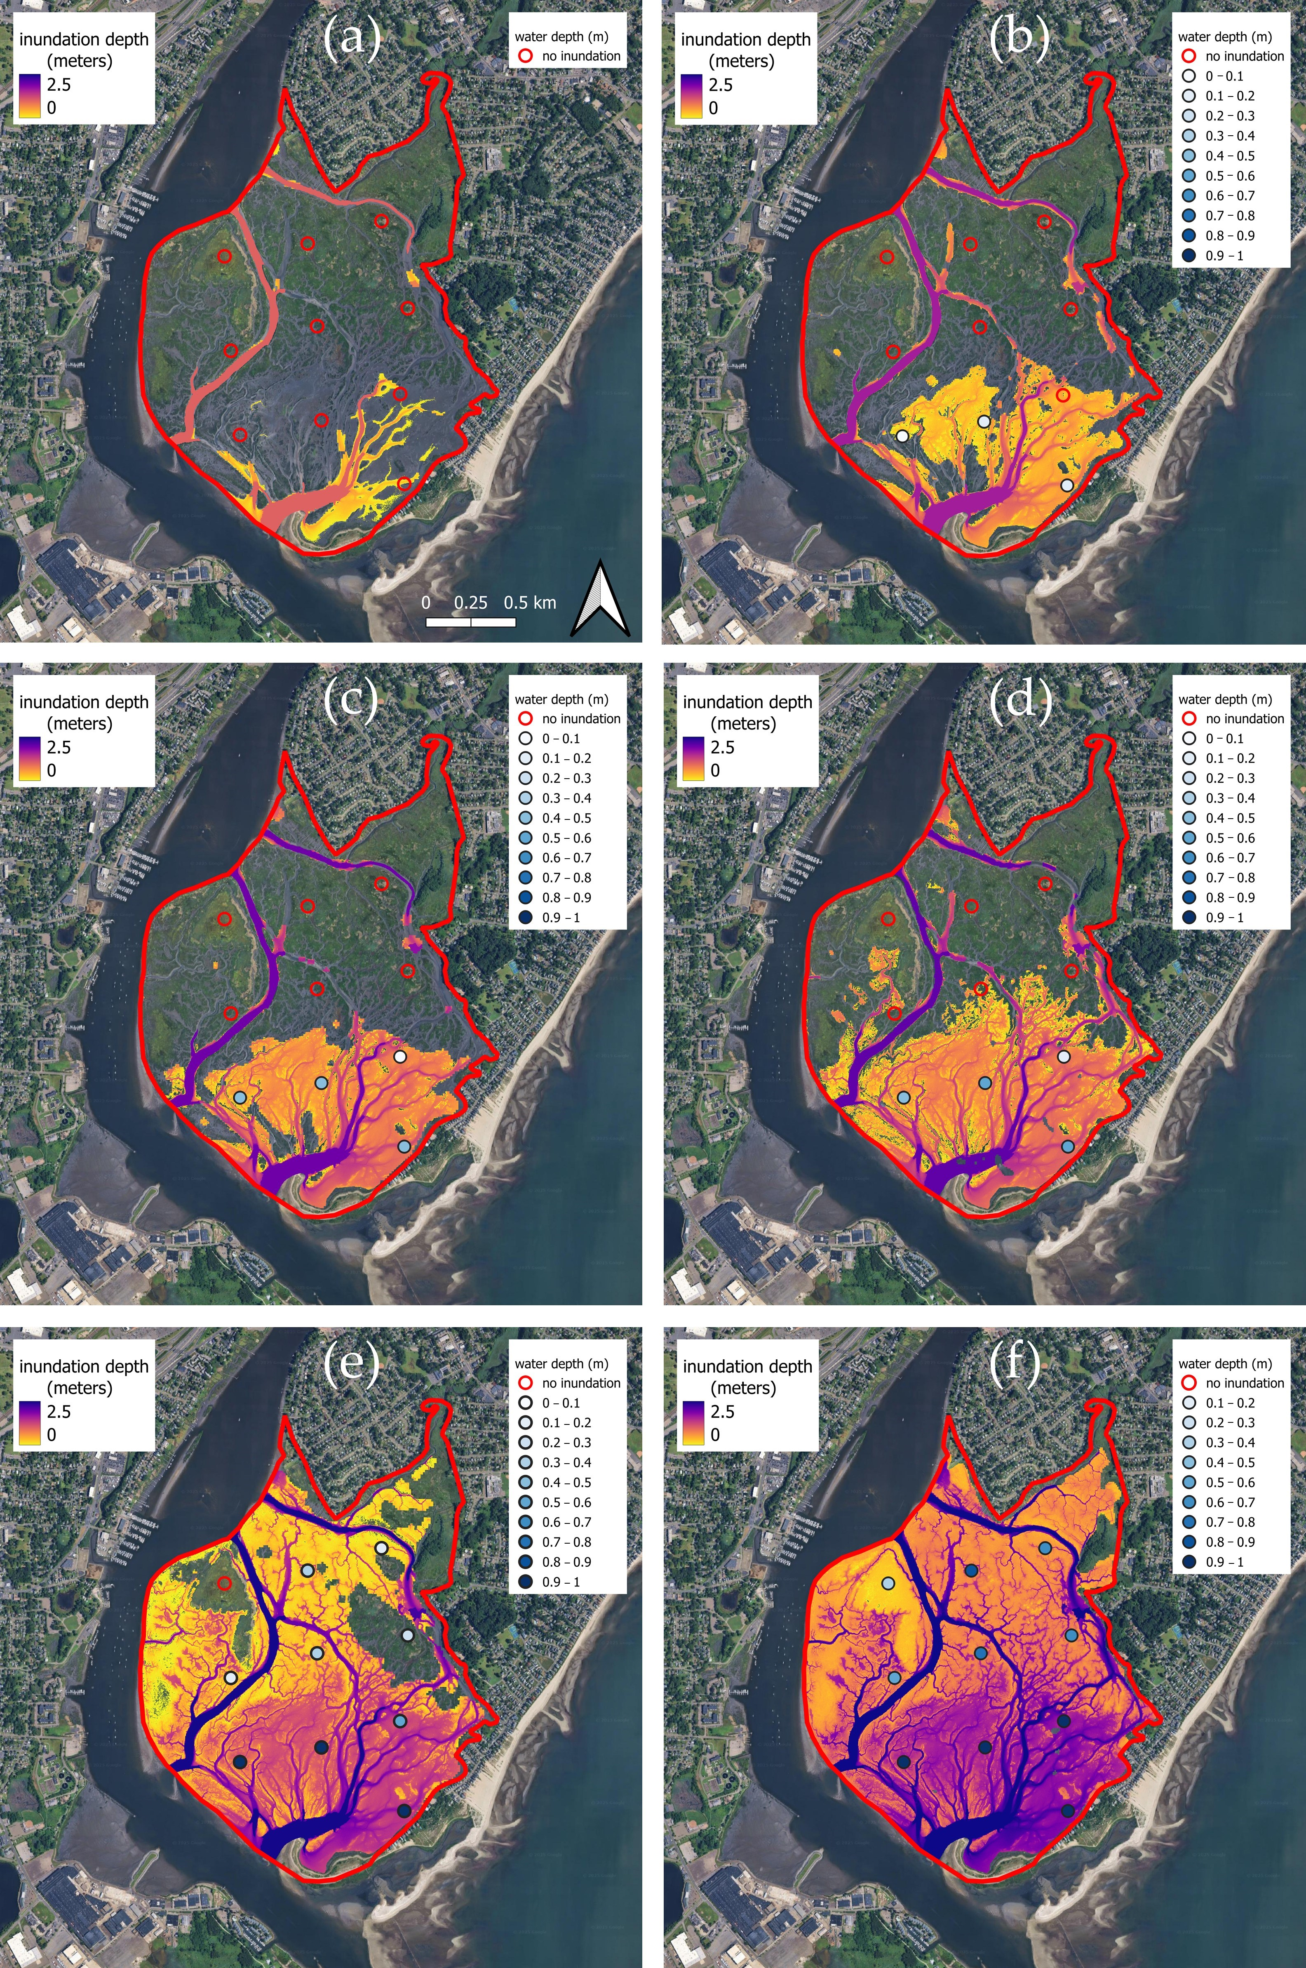
Characterization of tidal wetland inundation dynamics
Brian Lamb (USGS), Kyle McDonald (CCNY/JPL),
Maria Tzortziou (CCNY), Dorothy Peteet (LDEO, CMS PI)
Research Objectives and Context: Improved characterization of tidal wetland hydrology supporting lateral carbon flux estimation.
Key Research Result: In two CMS-funded studies, we demonstrate that L-band radar imagery accurately estimates wetland inundation state (90-96%) (Lamb et al. 2025) and pixel water depth (R² = 0.98; RMSE = 1.6 cm) (Lamb et al. 2026).
Significance: With the NASA-ISRO SAR (NISAR) mission providing L-band imagery at a 12-day revisit, the ability to characterize tidal hydrology increases greatly supporting biogeochemical flux estimation in future research efforts.
NASA assets and data: Supported by grants from NASA CMS (NNG23OB31A), NESSF (80NSSC17K0365), and the NISAR Science Team (80NSSC19K1513). UAVSAR imagery (NASA/JPL) was used for algorithm development. Portions of this work were conducted at the Jet Propulsion Laboratory, California Institute of Technology, under contract with the National Aeronautics and Space Administration.
Reference publications:
Lamb, McDonald, Tzortziou, Tesser (2025): https://doi.org/10.3390/rs17020263
Lamb, McDonald, Tzortziou, Steiner (2026): https://doi.org/10.3390/rs18081172
Tidal marsh inundation depth products derived from L-band imagery, from low tide (a) to high tide (f), with water level sensor observations (circles) for validation.

