Slide 1
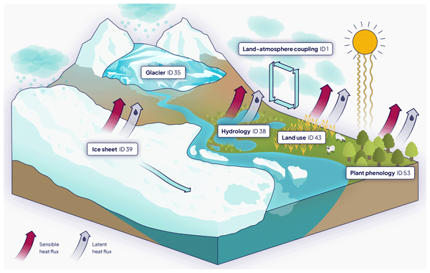
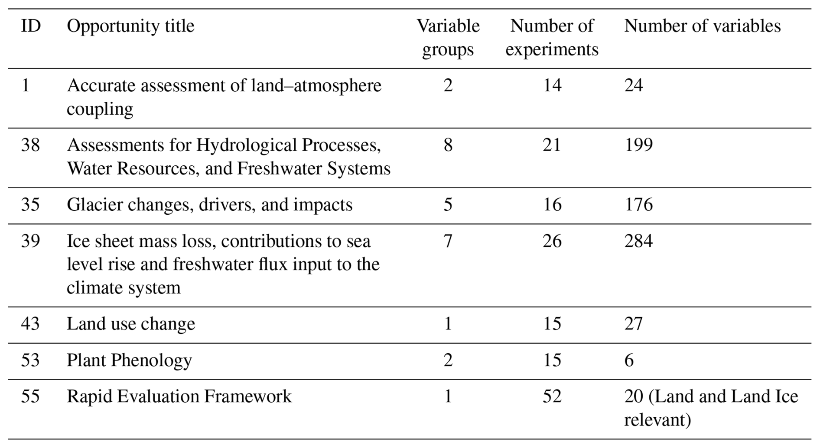
CMIP7 data request: land and land ice priorities and opportunities
George Hurtt - University of Maryland, College Park
Research Objectives and Context: Land and Land Ice processes are essential to the Earth system. The objective was to identify model output variables required for the physical Land and Land Ice analyses from Earth System Models.
Key Research Result: In this study, 25 variable groups that contain 716 variables were identified to be potentially available to the broad scientific audience for performing analysis in land–atmosphere coupling, hydrological processes and freshwater systems, glacier and ice sheet mass balance and their influence on the sea levels, land use, and plant phenology.
Significance: The CMIP7 Data Request for the Land and Land Ice Theme includes six refined Opportunities addressing distinct scientific questions. These Opportunities – focusing on land–atmosphere coupling, glacier changes, freshwater processes, ice sheet loss and sea level rise, land use change, and plant phenology – reflect the urgent needs of various research communities. This work serves as a valuable resource for modeling groups, guiding potential modifications or enhancements to their output to better align with evolving scientific priorities. NASA Assets and Data: This work was supported by the NASA Carbon Monitoring System (80NSSC25K7221), NASA Greenhouse Gas Earth Information System (80NSSC22K1733), and NASA Sea Level Change Team.
Figure 1. Diagram illustrating Land and Land Ice Theme Opportunities.
Reference Publication: Li, Y., Tang, G., O'Rourke, E., Minallah, S., Mas e Braga, M., Nowicki, S., Smith, R. S., Lawrence, D. M., Hurtt, G. C., Peano, D., Meyer, G., Hassler, B., Mao, J., Xue, Y., Juckes, M. 2026. CMIP7 data request: land and land ice priorities and opportunities. Geoscientific Model Development. 19(8), 3129-3155. doi: 10.5194/gmd-19-3129-2026
Table 1. The final list of Land and Land Ice Theme Opportunities.

