Slide 1
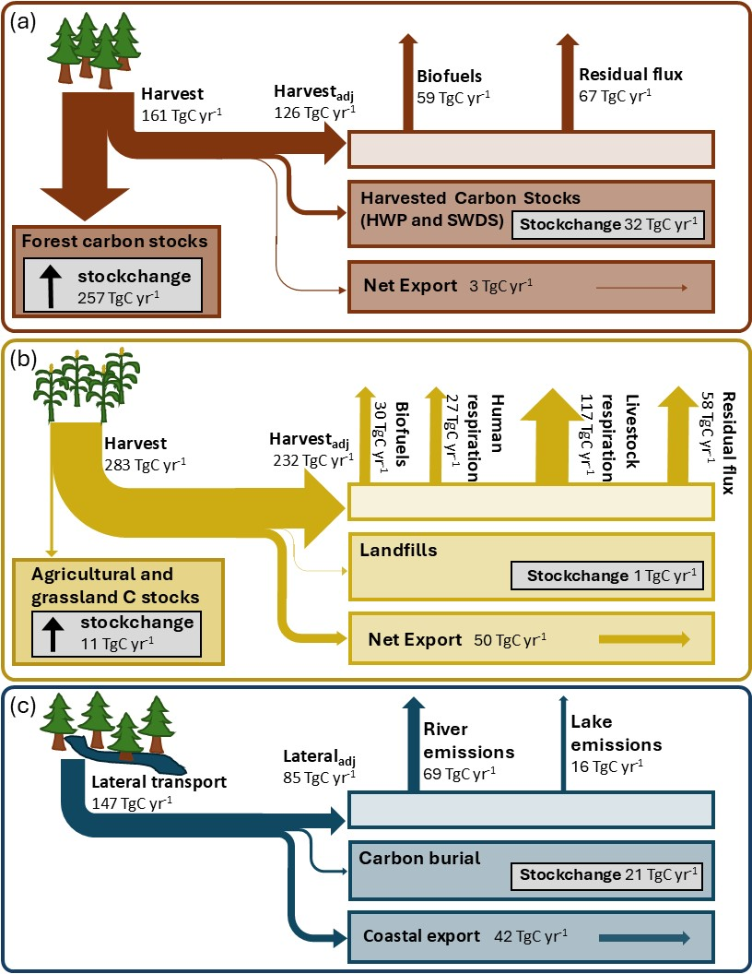
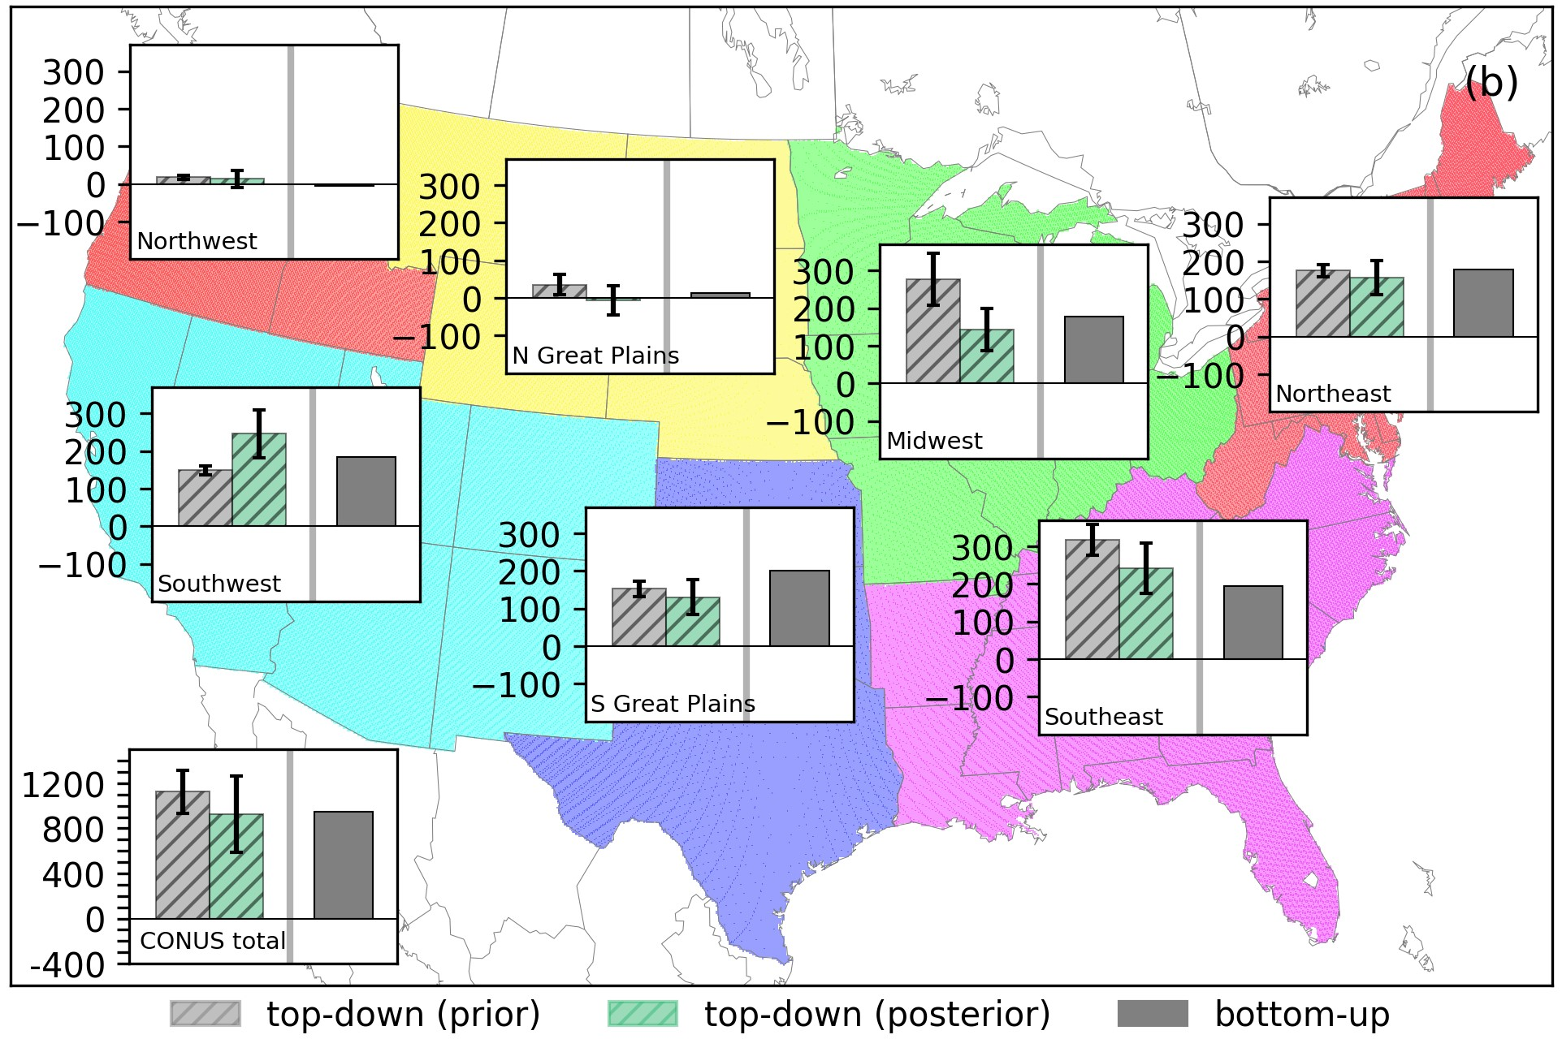
Significant Influence of Lateral Carbon Fluxes on Regional U.S. Carbon Budgets
Presenter: Junjie Liu (NASA JPL)
Key Research Result:
In this study, we construct a comprehensive regional carbon budget for seven National Climate Assessment regions of the contiguous United States (CONUS) over 2015-2020. Averaged over the seven regions, accounting for lateral transport and their endpoint carbon emissions improving the consistency between inventory and top-down estimates by 31%.
Significance:
Our study presents a roadmap for reconciling the inventories and top-down atmospheric inversions at sub-national scale that highlights the importance of accurate representation of lateral carbon flows for using top-down estimates with national inventories.
NASA assets and data:
This work was supported by the NASA High-End Computing, Orbiting Carbon Observatory Science Team, and Carbon Monitoring System programs.
Annual net carbon stock changes and lateral carbon flows for (a) forests, (b) croplands and grasslands, and (c) mediated by the water cycle
Regional net carbon exchange from prior (unoptimized) and posterior (optimized) compared with the inventory estimates across U.S. Climate Assessment Regions.
Reference publication: Byrne, B., et al. 2026. Significant influence of lateral Carbon fluxes on regional U.S. Carbon budgets. Global Biogeochemical Cycles, 40, e2025GB009020. DOI: 10.1029/2025GB009020

