Slide 1
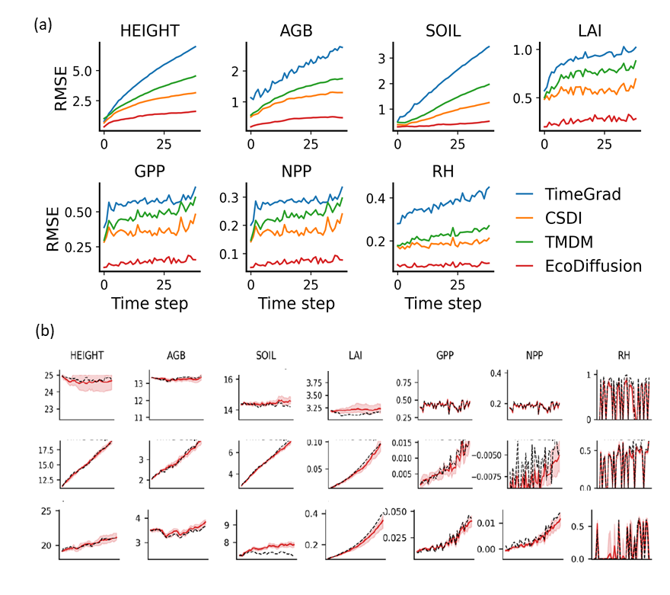

EcoDiffusion: Uncertainty-Aware Emulation of Ecosystem Processes
Presenter: ${Ruohan Li}^{1}$, PI: ${Yiqun Xie}^{1}$
1. University of Maryland
Key Research Result:
EcoDiffusion achieved the lowest and most stable RMSE across years, with RMSE values of 1.26, 0.38, 0.42, 0.27, 0.14, 0.07, and 0.09 for Height, AGB, Soil, LAI, GPP, NPP, and Rh, respectively.
EcoDiffusion generated reliable uncertainty estimates, as the empirical coverage of its 90% prediction interval reached 89%, which is close to the ideal calibrated value.
Significance:
EcoDiffusion further advances AI-based ecosystem emulation, making long-term predictions more accurate, stable, and reliable
Uncertainty estimates helps us judge how much confidence to place in emulator outputs under different environmental conditions and scenarios
NASA assets and data:
NASA Forest Carbon Monitoring System
• Ecosystem Demography model version 3 (EDv3)
(a) RMSE over forecasting time step (30 years) (b) Three examples of forecasted results. Black dashed lines denote ED-simulated reference, red lines denote EcoDiffusion predictions, and pink shaded regions denote the associated prediction intervals representing model uncertainty.
Reference publication: Ruohan, Li, et al. EcoDiffusion: Uncertainty-Aware Emulation of Ecosystem Processes with Conditional Diffusion for Long Sequences with Single-Step Initialization. Proceedings of the AAAI Conference on Artificial Intelligence. 40(45), 38880-38888. DOI:10.1609/aaai.v40i45.41233

