Slide 1
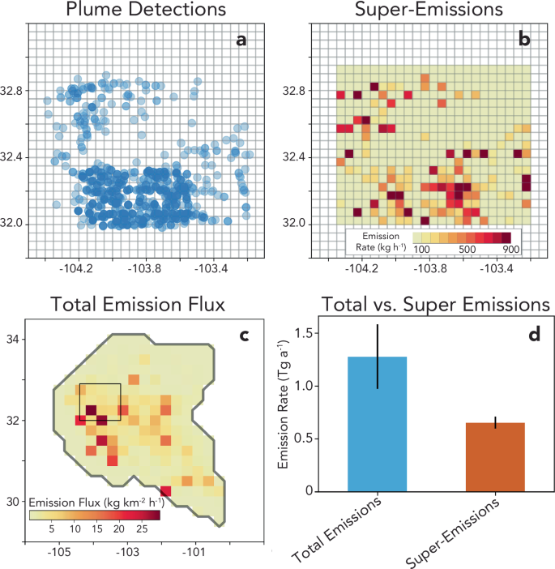
Duration of super-emitting oil and gas methane sources Daniel Cusworth, Carbon Mapper
Key Research Result: Intensive airborne surveys in New Mexico Permian in May 2024. Covered all of NM Permian oil&gas production. Flights were designed to revisit sites multiple times during campaign, sometimes up to 4 times per day. TROPOMI satellite observations were assimilated to estimate total-fluxes during same time period. Top findings: (1) 50% of total emissions from super-emitters. (2) Super-emission events lasted from hours to days – variable from source to source. (3) Evidence that the vast majority of super-emitter events last at least 2 hours. (4) A small but significant set of events lasted the entirety of the campaign, mostly from compressor stations. Clear target for near-term mitigation.
Significance: This study shows the need for frequent wide area monitoring to capture the true spatiotemporal distribution of super-emitters. In some basins, like the Permian, super-emitters are a very small fraction of infrastructure (<1%) but represent an outsized contribution to total emissions. Persistent super-emitters are a clear priority for near-term emissions reductions.
NASA assets and data: This research was supported by the NASA Carbon Monitoring System (NNH16ZDA001N-CMS) as part of Cusworth-CMS-2022 (80NSSC23K1244)
Figure 1. Aerial plume detections and emission quantification from 2024 airborne Carbon Mapper campaign compared to regional flux inversion derived from TROPOMI.
Cusworth et al., 2026, Nat Comm, 10.1038/s41467-026-68804-7

