Slide 1
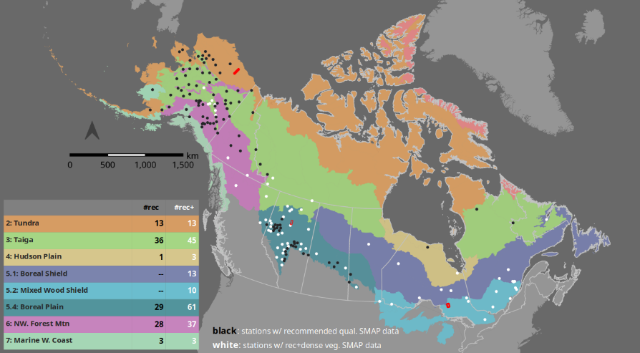
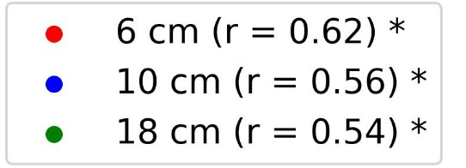
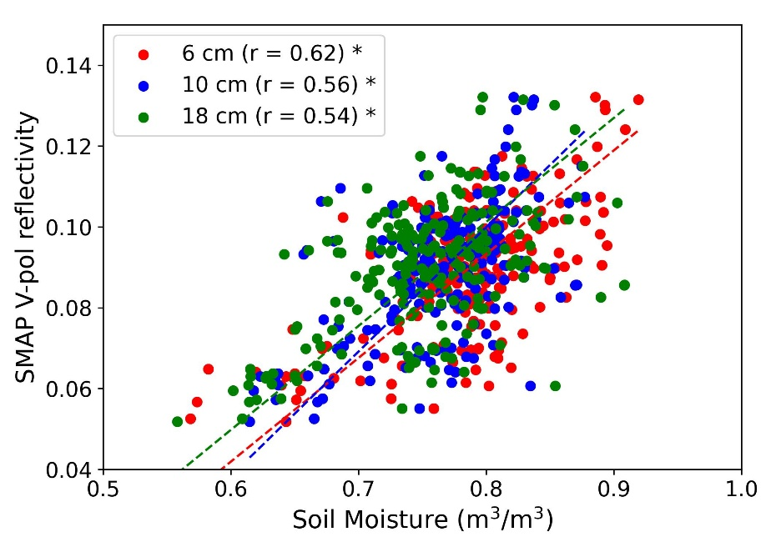
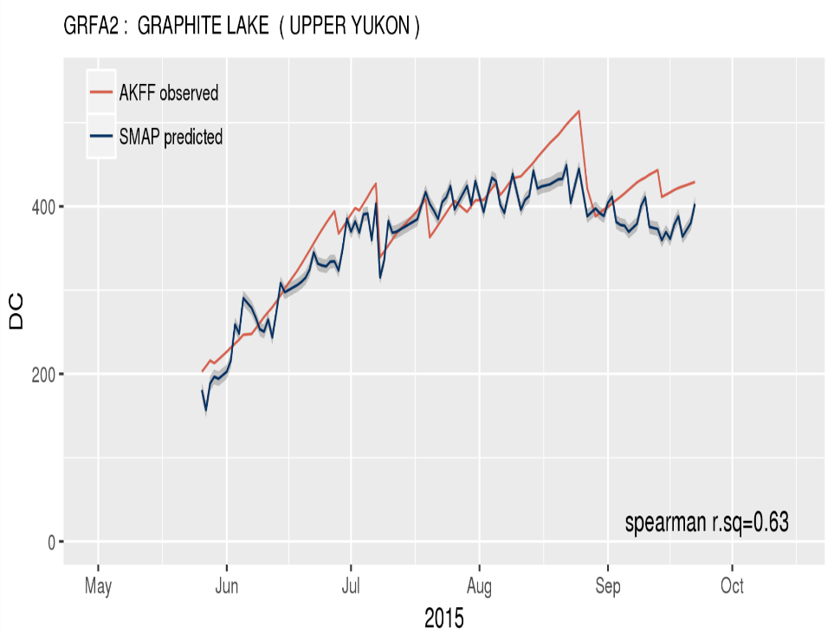

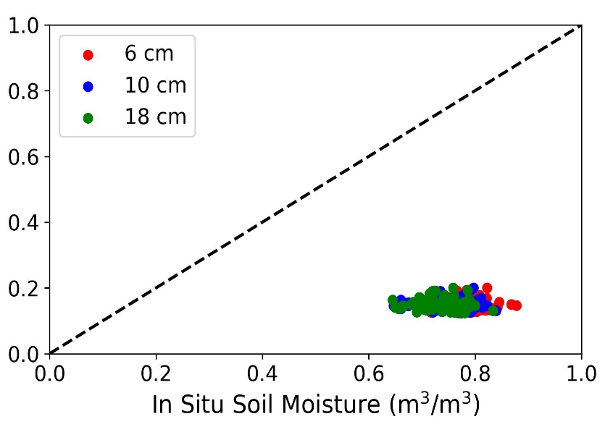
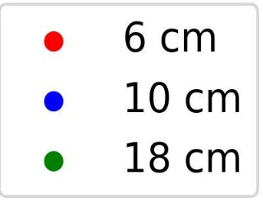
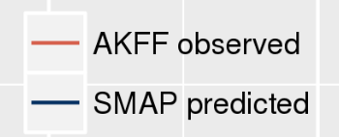
Assessing NASA’s SMAP for enhanced wildfire danger prediction in
boreal-arctic ecosystems
Bourgeau-Chavez LL , Hanes, C., Billmire, M., Bosse, K., Battaglia, M.J., Colliander, A., (Jan. 2026). Remote Sensing Applications:Society and Environment.
doi: 10.1016/j.rsase.2026.101881
Sparse network of weather stations (black and white dots) across arctic–boreal North America
Analysis: Statistical analyses were conducted with 2 years of field data at 3 depths (6 cm, 12 cm and 20 cm) in comparison to SMAP moisture product and apparent reflectivity for the first analysis. For the second broadscale analysis, a statistical model was generated to predict drought code from the SMAP and ancillary data.
Findings: In contrast, SMAP raw reflectivity data showed good relationships to in situ fuel moisture at 6 cm depth in the Alaska tundra site (r = 0.62), and 10–18 cm depth for the Alberta (r = 0.46) and Ontario (r = 0.62) boreal sites.
Significance:
Results indicate that an operational SMAP-derived deep organic fuel moisture (e.g. DC) product is feasible if future retrievals account for soil organic content. This would enhance fire danger monitoring and decision support across the boreal-arctic region.
The close relationship of SMAP with DC suggests that 10cm-18cm depths are important to target for field sampling in organic soils. Sampling multiple depths is optimal.
Background:
In boreal and arctic regions, where organic soils act as wildfire fuel, NASA’s SMAP soil moisture products offer strong potential to improve drought and fuel (organic soil) moisture assessment beyond sparse point-based weather station fire danger models.
Since SMAP is not calibrated for organic soils, we evaluated its suitability as a proxy for fuel moisture using:
a network of fuel moisture stations we established across three SMAP grid cells; and
fire weather station data across the North American boreal-arctic region.
Lastly, we assessed what depth of moisture SMAP was
most closely related given the low bulk density organic
soils of the boreal-arctic region.
Findings: Comparison of SMAP calibrated products with in situ fuel moisture revealed SMAP products to be dry-biased with low dynamic range (r = −0.03 to 0.40) across all three-36 km grid cells.
SMAP reflectivity
Alaska tundra grid cell
In situ soil moisture
Alaska Weather Station (AKFF)
Findings: The statistical model created using hundreds of weather stations across the boreal-arctic, explained 63% overall deviance and was most closely related to Drought Code (DC)- measure of fuel availability in deeper (10-20 cm) organic soil layers. Individual station data showed good agreement between SMAP-DC and weather based DC.
Alaska tundra grid cell
1:1 line
Drought Code
SMAP soil moisture
In situ soil moisture
Growing Season Month 2015
Notes:
Citation: Tourian, M. J., Reager, J. T., & Sneeuw, N. (2018). The total drainable water storage of the Amazon river basin: A first estimate using GRACE. Water Resources Research, 54, 3290–3312. https://doi.org/10.1029/2017WR021674

