Slide 1
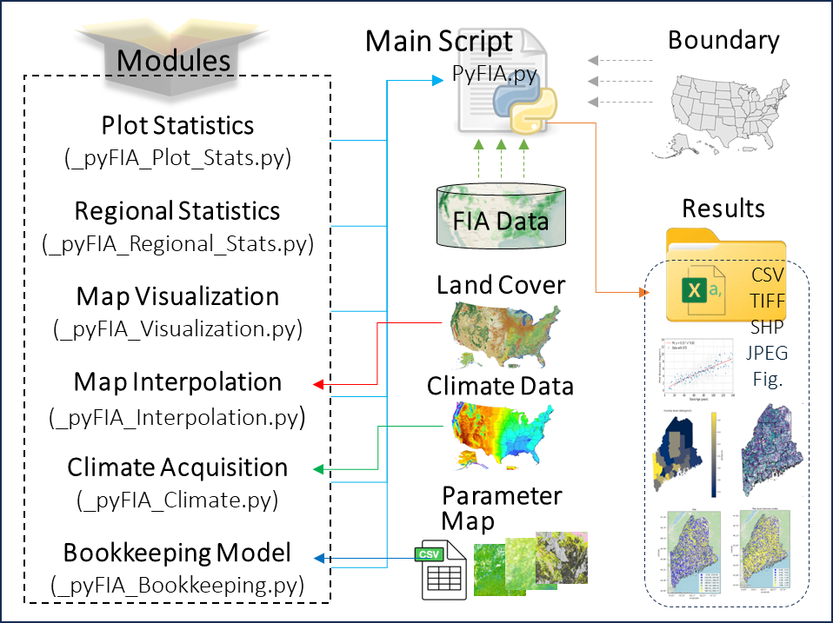
PyFIA: Analyzing and visualizing forest attributes using the United States Forest Inventory database
Key Research Result: To efficiently process, analyze, and visualize forest attributes using the FIA database, we developed PyFIA, an open-source Python-based tool. PyFIA provides a suite of functions, including statistical analyses, spatial mapping, and a bookkeeping model for tracking forest biomass dynamics at different scales. Additionally, it can acquire climate information for each inventory plot, enabling in-depth investigations of how climate conditions influence the spatial and temporal patterns of forest attributes.
Significance: This program enhances the use of FIA inventory data in forest related studies, particularly for forest carbon. It also incorporates raster datasets, providing a valuable resource for research on forest ecosystems.
NASA assets and data: https://github.com/xinyuanwylb19/PyFIA
A summary of the PyFIA program structure and the six modules (i.e., Plot Statistics, Regional Statistics, Map Visualization, Map Interpolation, Climate Acquisition, and Bookkeeping Model), key input dataset, and the outputs. Results and figures showed in this figure, along with the analysis workflow, are provided in the Jupyter Notebook.
Reference publication: Wei, X., Hayes, D., McHale, G. et al. PyFIA: analyzing and visualizing forest attributes using the United States Forest Inventory and Analysis database. Carbon Balance Manage 21, 18 (2026).
https://doi.org/10.1186/s13021-025-00364-7

