Slide 1
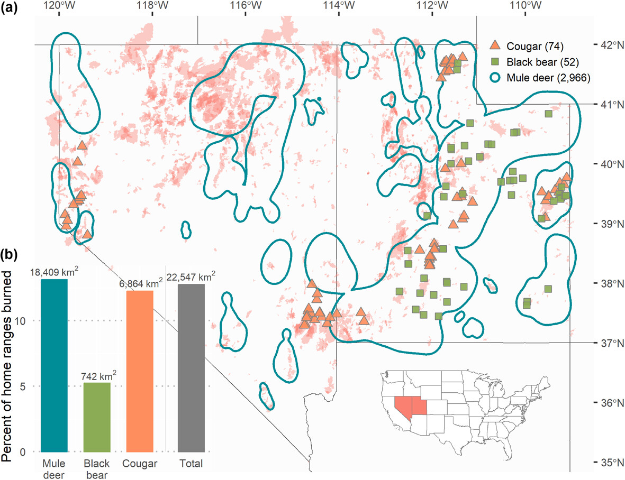
Long-term benefits of burns for large mammal habitat undermined by large, severe fires in the American West Dr. Neil H. Carter, University of Michigan
Key Research Result: This study examined how wildfires shape habitat quality for mule deer, black bears, and cougars in the American Southwest. Using >30 years of NASA satellite imagery to track vegetation productivity and fire severity, researchers found that low-severity wildfires and prescribed burns create long-lasting, high-quality habitat, improving forage and cover for herbivores like mule deer and supporting prey availability and movement options for carnivores. However, large, high-severity wildfires sharply reduce vegetation productivity and degrade habitat for all three species.
Significance: The work shows that bigger, more intense wildfires reduce beneficial habitat for species of high ecological and economic value, whereas low intensity fires may enhance habitats. NASA’s long-term satellite data were essential for tracking vegetation recovery, mapping fire severity, and revealing how fire regimes reshape western wildlife habitat at landscape scales.
NASA assets and data: GEDI, Landsat, and MODIS vegetation
The overlap of burned areas with wildlife telemetry data across the study area in Utah and Nevada, USA. (a) The distribution of collared animals across the study area from 2010–2022. Parentheses denote the number of individuals collared for each species. The red shaded areas are polygons representing fires in the Monitoring Trends in Burn Severity fire perimeter database since 1990. (b) The proportion (and total area) of wildlife home ranges that were impacted by burns.
Paper/Article Citation: Mills et al. 2025. Ecography http://doi.org/10.1002/ecog.08225
Notes:
Abstract: Escalating wildfire frequency and severity are altering wildland habitats worldwide. Yet investigations into fire impacts on wildlife habitat rarely extend to the macroecological scales relevant to species conservation and global change processes. We evaluate the effects of wildfire on habitat quality and selection by large mammals spanning three trophic levels in the Western United States. We analyze 12 years of GPS telemetry data for 2966 mule deer Odocoileus hemionus, 52 black bears Ursus americanus, and 74 cougars Puma concolor across Utah and Nevada, USA. Over 800 areas burned between 1990–2022 overlapped with the home ranges of 1892 animals, resulting in almost 23 000 km² of burned habitat and representing 12.8% of the total home range area for animals in our sample. Habitat suitability models for 664 mule deer, 14 black bears and 11 cougars indicated that burns improved summer home range quality for mule deer and black bears by 7% and 14%, respectively, highlighting the benefits of fires for nutrient cycling, understory herbaceous growth, and resultant caloric value for animal nutrition. When making fine-scale movement decisions, however, mule deer avoided burned habitats, and all three species generally avoided high-severity burns for up to 30 years post-fire. Thus, the effects of burns on wildlife habitat selection appear to be dependent on spatial scale. Given projected increases in large, severe fires, our results suggest potential reductions in beneficial habitat for wildlife in the long term. However, our results also suggest that prescribed burns, because of their smaller spatial footprints and lower severity relative to wildfires, can benefit wildlife habitat quality through improvements in forage, cover, and other vegetation characteristics. Therefore, managing for low-severity burns and limiting large, severe wildfires, e.g. via prescribed burns or fire control policies, could positively impact the habitat quality of these three common species and, therefore, the economic and ecosystem services they provide.

