Slide 1
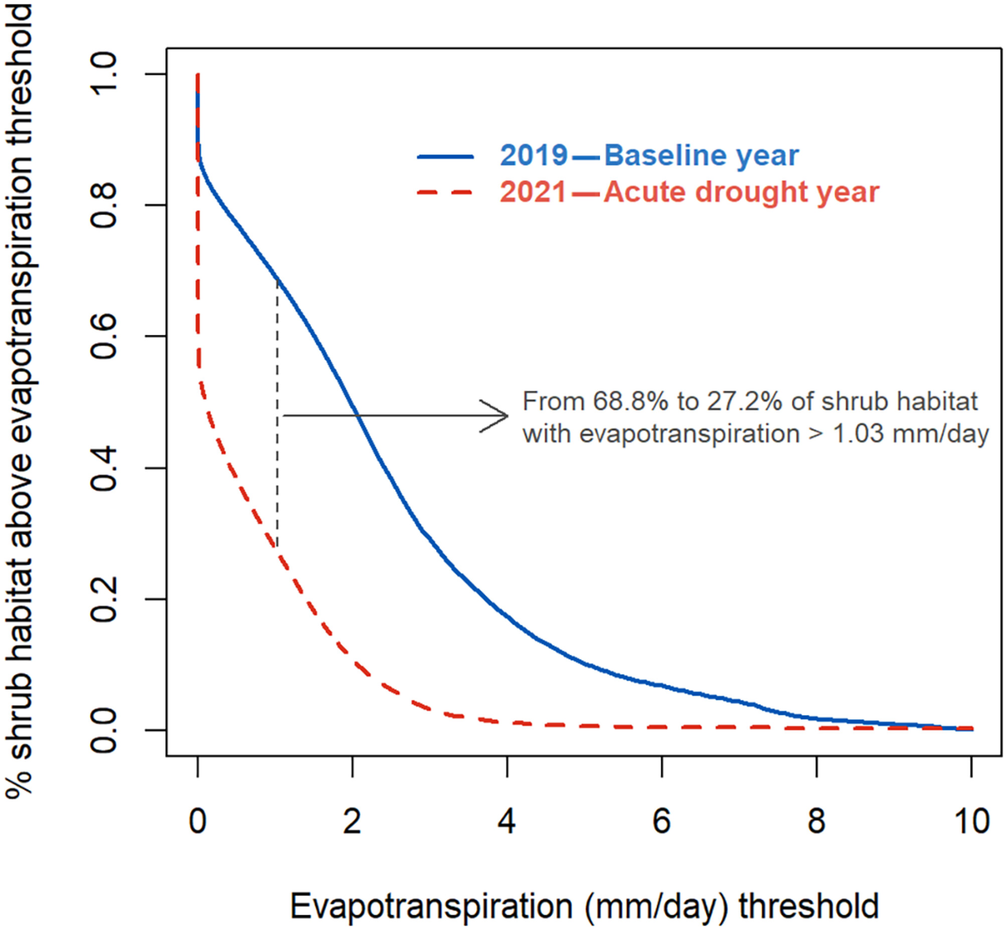
Acute drought desiccates highly used habitat and drives herbivores into irrigated croplands Dr. Neil H. Carter, University of Michigan
Key Research Result: This study shows how extreme drought reshapes wildlife behavior in arid landscapes. Researchers tracked 41 mule deer in Utah during normal and severe drought summers to see how water stress changed their habitat use. Using NASA’s ECOSTRESS sensor aboard the International Space Station—which measures evapotranspiration, or water loss from plants—they found that when shrublands dried out, mule deer left their natural habitats and moved into irrigated croplands. During drought, the share of shrubland with enough plant moisture dropped by over 40% (see figure), while deer use of cropland nearly doubled.
Significance: These findings reveal how wildlife respond to rapid environmental change and highlight the growing risk of human–wildlife conflict as animals seek resources in agricultural areas. NASA’s ECOSTRESS and MODIS satellite data provided critical, high-resolution insights into how water availability drives animal movements—information vital for climate adaptation and wildlife management in drying regions.
NASA assets and data: ECOSTRESS and MODIS vegetation
Proportion of shrub habitat in three mule deer study areas (Utah) in relation to the amount of evapotranspiration (in millimeters per day) quantified from ECOSTRESS. The proportion of shrub habitat having evapotranspiration above 1.03 mm/day (when crop is preferred to shrub in the baseline year, Figure 4A) decreased from 68.8% to 27.2% between the baseline (2019) and the acute drought year (2021) in Utah, USA..
Paper/Article Citation: Leclerc et al. 2025. Ecological Applications https://doi.org/10.1002/eap.70126
Notes:
Abstract: In arid and semiarid regions, extreme, extended droughts are becoming more frequent due to climate change. Drought is driving wildlife to seek out food or water resources where they are not as limited, such as in irrigated croplands. We collected GPS locations from 41 mule deer, a generalist herbivore reliant on primary productivity, within three study areas in Utah, USA, during a summer without drought conditions and a summer with extreme drought. This natural experiment provided an opportunity to assess how mule deer shifted their habitat selection, specifically whether drought increased mule deer's use of anthropogenic resources. We integrated remotely sensed estimates from ECOSTRESS, an instrument mounted on the International Space Station that measures evapotranspiration, to characterize a shift in resource use. Mule deer resource use was strongly influenced by the amount of evapotranspiration. In the drought year, shrub habitats lost succulence and mule deer avoided them (57.0% shrub habitat use in baseline vs. 44.6% during drought) and sought out agricultural croplands (increase from 6.2% to 11.8% from baseline to drought). Critically, this behavioral switch from shrub to crop was mediated by the rate of evapotranspiration and we identify the shift when evapotranspiration was >1.03 mm/day. We estimated that the proportion of shrub habitat in the study area with evapotranspiration >1.03 mm/day dropped from 68.8% to 27.2% between the baseline and the acute drought year. Evapotranspiration measured by ECOSTRESS provides complementary information to normalized difference vegetation index (NDVI), a commonly used metric of vegetative greenness, and offers a mechanistic understanding of ungulate resource use that increases the performance of habitat selection models for herbivores. As the impacts of climate change become more acute, wildlife will be drawn from natural areas to locations with anthropogenic resources, elevating the risk of human–wildlife conflict and mortality. Our study points to the need for the use of new data streams, like data derived from ECOSTRESS, into adaptive wildlife management and climate change adaptation planning to minimize human–wildlife risk and damages to humans.

