Slide 1
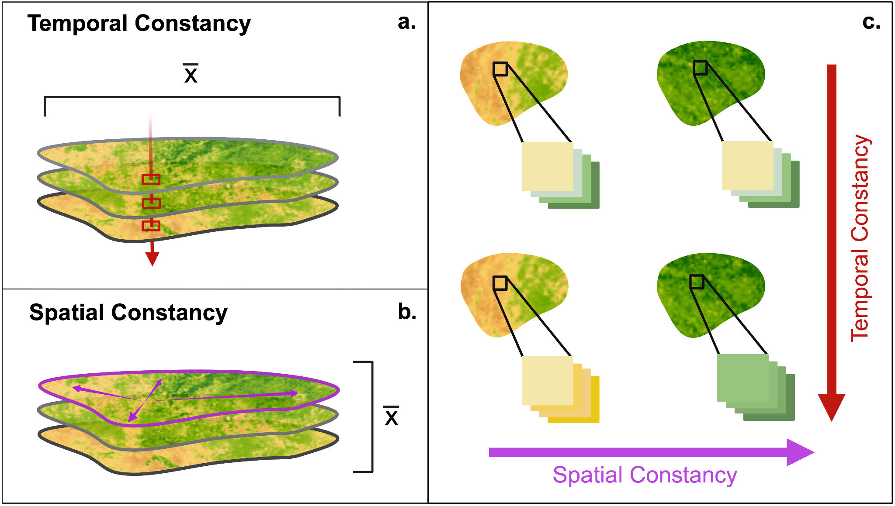
Differential effects of environmental predictability on ungulate movement behavior in disparate ecosystems Dr. Neil H. Carter, University of Michigan
Key Research Result: This study examined how predictable food and water resources shape the daily movements of mule deer in Utah. Using GPS tracking data from 225 deer and NASA satellite imagery, the team measured how consistent forage was across space and time. They found that predictability matters differently depending on the environment: in productive mountain ranges, deer moved less when resources were predictable, conserving energy for harsh winters, while in arid regions, deer moved more in predictable but poor-quality landscapes to meet nutritional needs.
Significance: These results highlight that changing climate and land use, which alter the reliability of resources, can strongly affect deer energetics, space use, and ultimately population health. By leveraging NASA’s Earth observation data, the study provides new insight into how wildlife adapt to shifting environments. This knowledge is critical for forecasting the impacts of global change on ecosystems and managing iconic species like mule deer
NASA assets and data: MODIS vegetation and snow cover
Metrics of environmental predictability which represent temporal and spatial constancy of vegetation productivity. In diagrams of temporal and spatial constancy calculation, X-bar represents the final average taken (a) across all pixels of an animal’s home range or (b) across all composites included in a given season to produce the final temporal and spatial constancy values for each individuals' seasonal home range. In (c), spatial constancy increases moving from left to right and temporal constancy increases moving from top to bottom.
Paper/Article Citation: Standen et al. 2025. Wildlife Biology https://doi.org/10.1002/wlb3.01484
Notes:
Research Impetus: While research has furthered our understanding of how environmental predictability (EP) both underlies and directs animal movement, studies have mainly focused on relationships between EP and large-scale movement behaviors (e.g. migration) at the species level, neglecting the mediating influence that environmental context has on the behavior of wide-ranging species. Methods: We investigated how two metrics of environmental predictability (EP), representing spatial and temporal constancy of vegetation productivity, within mule deer (Odocoileus hemionus) seasonal home ranges (HR) relates to average daily movement distance, focusing on two populations inhabiting disparate ecoregions in Utah (n = 225, 2015–2022). We also explored how home range (HR) area, forage availability, and season modulate the relationships between EP and daily movement distance. (Predictability Metrics) To quantify metrics for predictability and forage availability, we used normalized difference vegetation index (NDVI) composite images derived from MODIS satellite imagery (MOD13Q1.061 product). Temporal constancy, which here represents the average variance in the NDVI value of an individual pixel throughout a given season, was calculated on a pixel basis, using a pixel's values from all 16-day NDVI composites included within a given season (clipped to the HR bounds), and then averaged across all pixels included in the HR (Panel a). Spatial constancy, which here represents the ‘instantaneous homogeneity' of NDVI across a HR, was calculated for each 16-day NDVI composite (clipped to the HR bounds) using NDVI values from all pixels in that clipped composite, and then averaged across all composites included within a given season (Panel b). Both spatial and temporal constancy ranged from 0 to 1, representing increasing predictability. We accounted for the inherent positive relationship between area and environmental heterogeneity by using third-degree polynomial regressions between log-transformed HR area and both spatial and temporal constancy, regressing both EP metrics separately for each season and population (see the Supporting information). We then extracted the residuals of each regression which served as our final predictability metrics, representing the relative EP of a HR given its size. Positive EP values indicate a more predictable HR area, and negative values represent a less predictable HR area. (Modeling) We employed linear mixed-effects models for each combination of population and season to test for relationships between log-transformed average daily movement distance and predictability and assess how these relationships vary under contrasting forage availability and HR area. Results/Interpretation: 1) We found spatial constancy of an individual's HR significantly impacted movement during the summer. Interestingly, individuals inhabiting spatially constant HRs moved more in resource-limited seasonal environments (i.e., the SW of Utah, “Pine Valley”), and less in non-limiting environments (i.e., the NW of Utah, “North Slope”). For deer inhabiting more productive North Slope summer ranges, the benefits of movement in spatially predictable HR areas – access to forage which may be only minimally better than in their current location – may not outweigh the cost of expending energy. Greater daily movement of deer in spatially predictable HRs in Pine Valley might reflect a strategy for dealing with this arid environment whereby individuals move greater distances across spatially ‘homogeneous', poor quality resource landscapes and select for nutritional quality at the plant or bite level to reduce digestive processing capacity limitations from poor-quality forage. 2) Temporal constancy was a significant predictor of movement in non-limiting seasonal environments, resulting in shorter daily movements of deer with temporally constant HR areas. High temporal constancy of HRs may be indicative of landscape features such as water sources that support continued plant growth and quality throughout the season and influence plant succulence.
3) We found antagonistic interactions between forage availability and spatial constancy, which functioned to reduce the effects of EP as average forage availability increased. While deer had significantly shorter daily movements in spatially predictable HRs in North Slope during summer, as forage availability increases in spatially predictable HRs, energetic constraints on foraging may be relaxed, and individuals may forage more selectively in spatially predictable HR areas by searching for high-quality or rare species that confer the greatest benefit, increasing their average daily movement distance in the process. In contrast, in Pine Valley, increased forage availability likely functions to release individuals from selective foraging requirements imposed by their arid environment. 4) As HR area increased, individuals inhabiting HRs that were spatially or temporally predictable had increasingly shorter daily movements than those inhabiting unpredictable HRs. The size of mule deer HRs is negatively correlated with growing season productivity, and so the establishment of a larger HR is likely indicative that an individual has higher energetic costs to acquire sufficient resources. In this context, our findings suggest that EP may be a larger drive of movement decisions in lower quality habitats.

