Slide 1
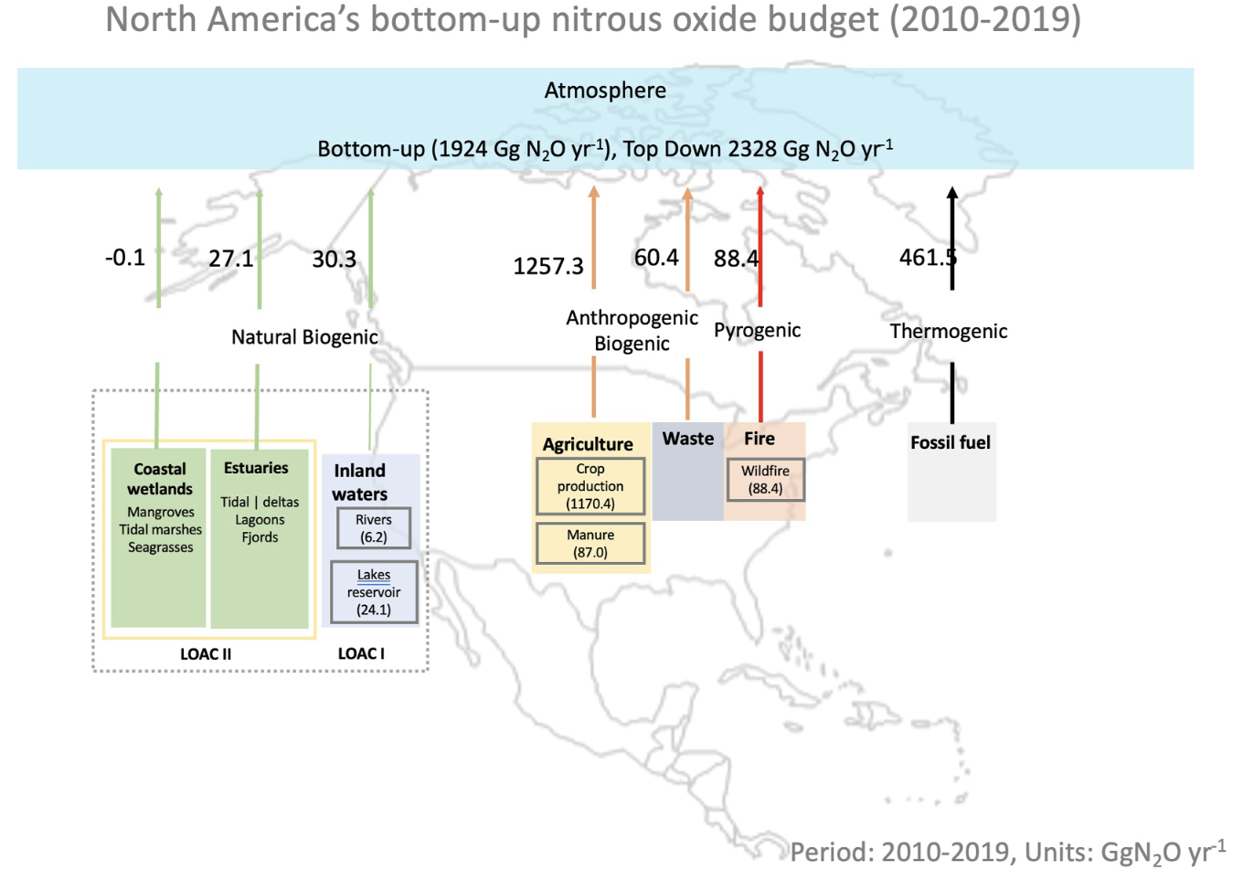
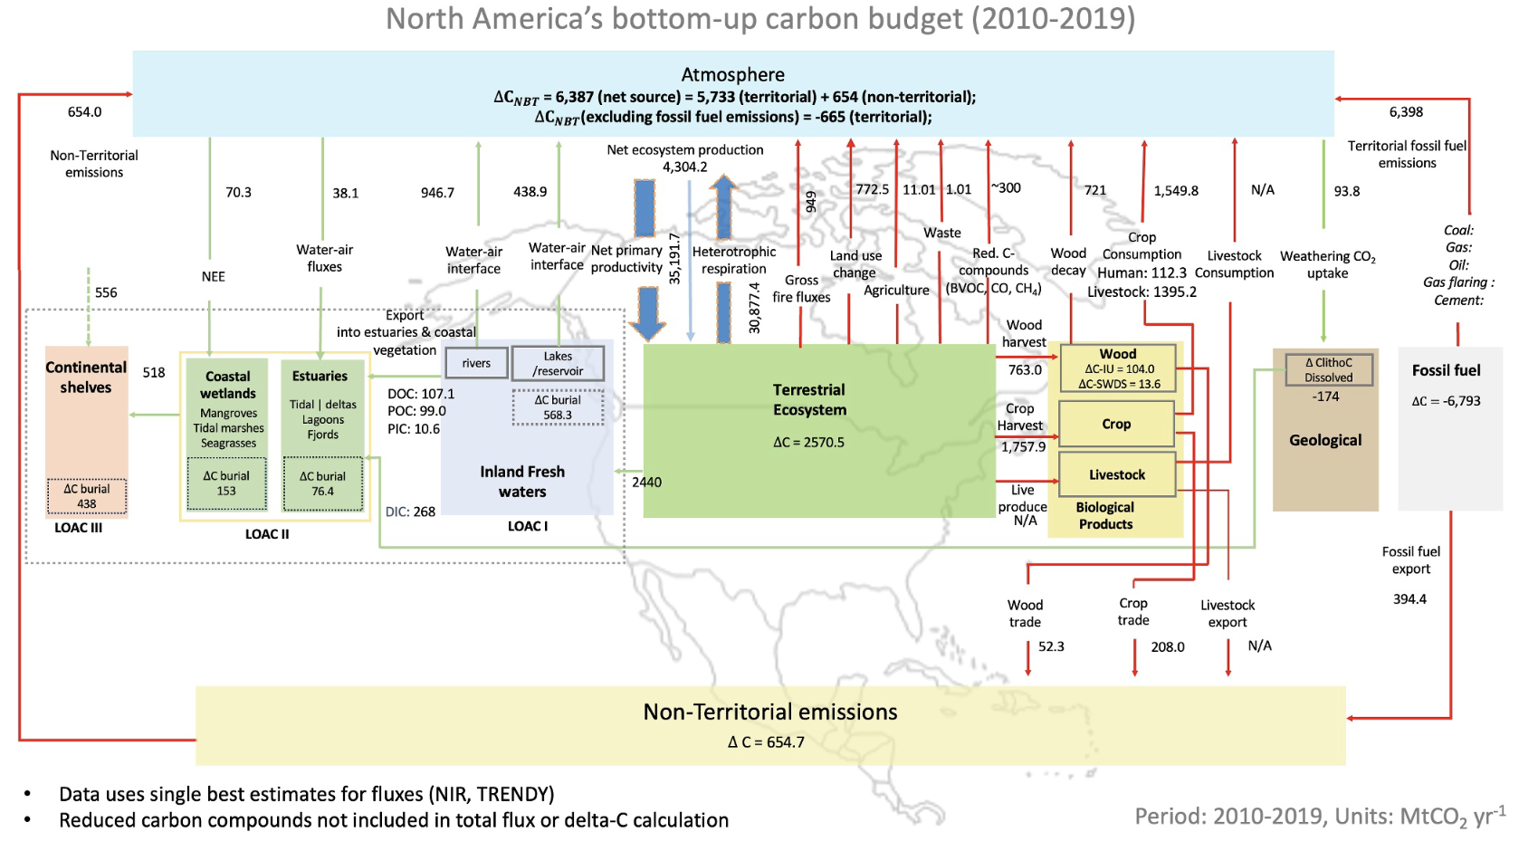
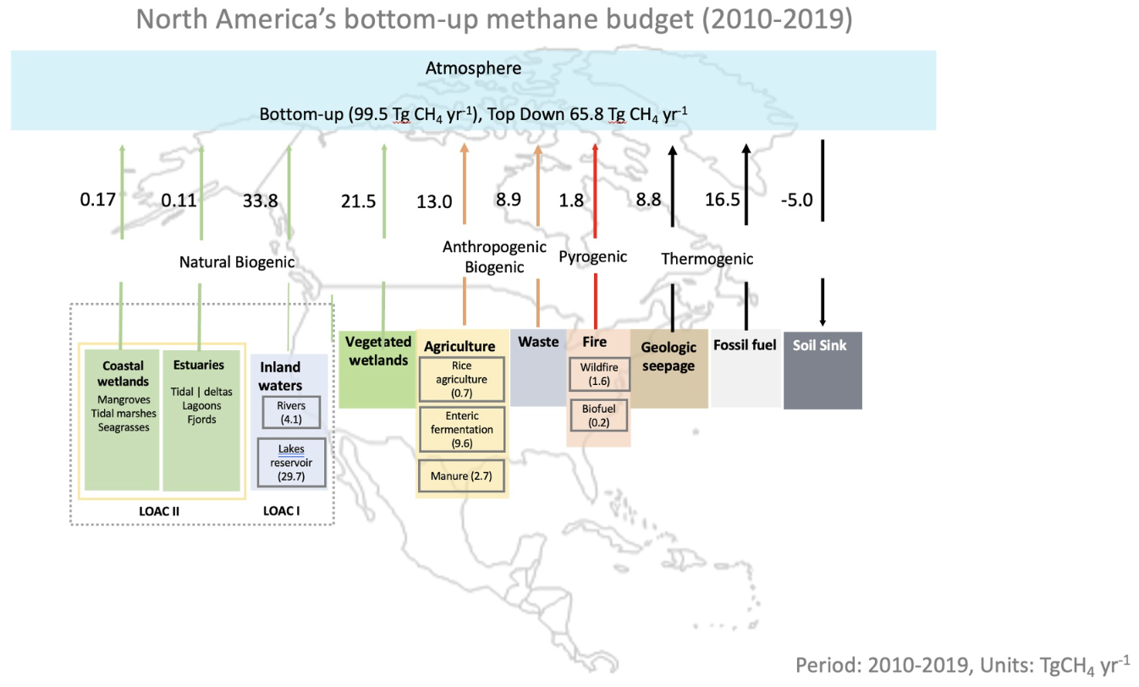
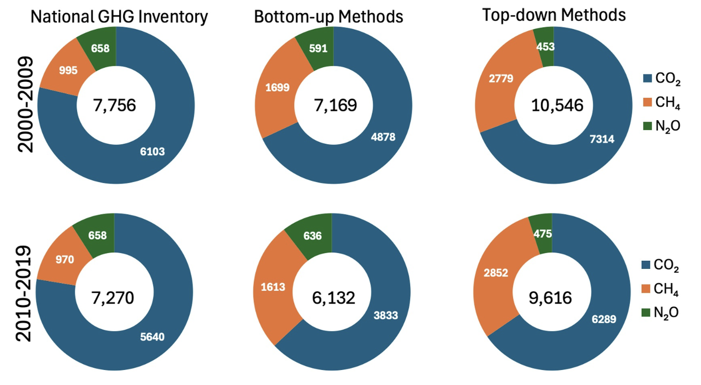
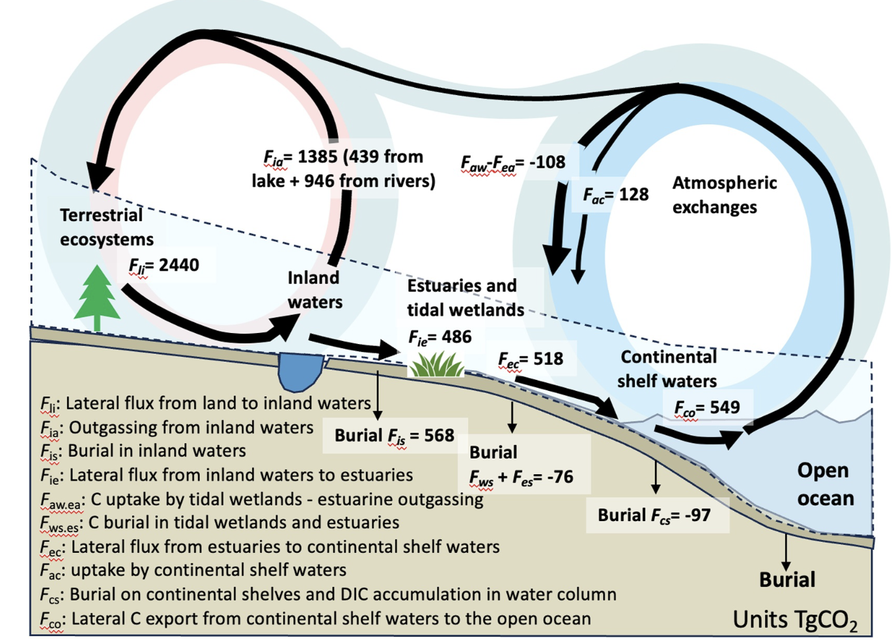
Declining Net Greenhouse Gas Emissions over North America; Reconciling Top Down and Bottom Up Methodologies with Lateral Aquatic and Trade Fluxes
Poulter, Ben, et al. (2025). The North American Greenhouse Gas Budget: Emissions, Removals, and Integration for CO₂, CH₄, and N₂O (2010–2019): Results From the Second REgional Carbon Cycle Assessment and Processes Study (RECCAP2). Glob. Bio. Cyc., https://doi.org/10.1029/2024GB008310
Science Questions
What are the total greenhouse gas emissions and removals for CO₂, CH₄ and N₂O for North America (Canada, USA, Mexico, Central America and Caribbean)?
What is the role of lateral fluxes in reconciling top-down and bottom-up methodologies?
Can definitions be reconciled to quantify the role of land management and the land carbon sink to accurately estimate removals?
Analysis
Uses data following IPCC Methodologies and submitted to the National Greenhouse Gas Inventories (i.e., National Inventory Reports and Biennial Update Reports), and data from land-surface models (i.e., TRENDY), data-driven models (i.e., FluxCom, GFED), and atmospheric inversions (i.e., OCO2-MIP)
Datasets for the land-ocean-aquatic continuum (LOAC) developed as four special topic papers for the REgional Carbon Cycle Assessment and Processes study (RECCAP2)
Follows GHG budget terminology proposed by Ciais et al., (2021) for carbon, Saunois et al., (2020) for methane, and Tian et al. (2022) for nitrous oxide
Results/Significance
For 2010-2019, North American net GHG emissions ranged from 6,132 to 9,616 Tg CO₂e yr⁻¹, a decline from 7,169 to 10,546 Tg CO₂e yr⁻¹ in 2000-2009. This is a 6-14% decrease in net GHG emissions.
The USA, then Canada, Mexico, Central America and Caribbean are largest net emitters, with CO₂, then CH₄ and N₂O the main contributing GHGs
Carbon removals by natural and managed lands increased slightly over the past two decades. Aquatic and trade flows account for ~500 Tg CO2e yr-1, helping to close gap between TD and BU methods.
RECCAP2 Special Collection includes ~30 papers on land, LOAC, ocean, polar and permafrost GHG budgets.
Acknowledgements
This research was supported by the NASA Carbon Monitoring System and Terrestrial Ecology Program.
Figures: 1-3, wiring diagrams for N. America CO₂, CH₄, N₂O budgets, (4) LOAC fluxes, (5) CO₂e budgets

