Slide 1
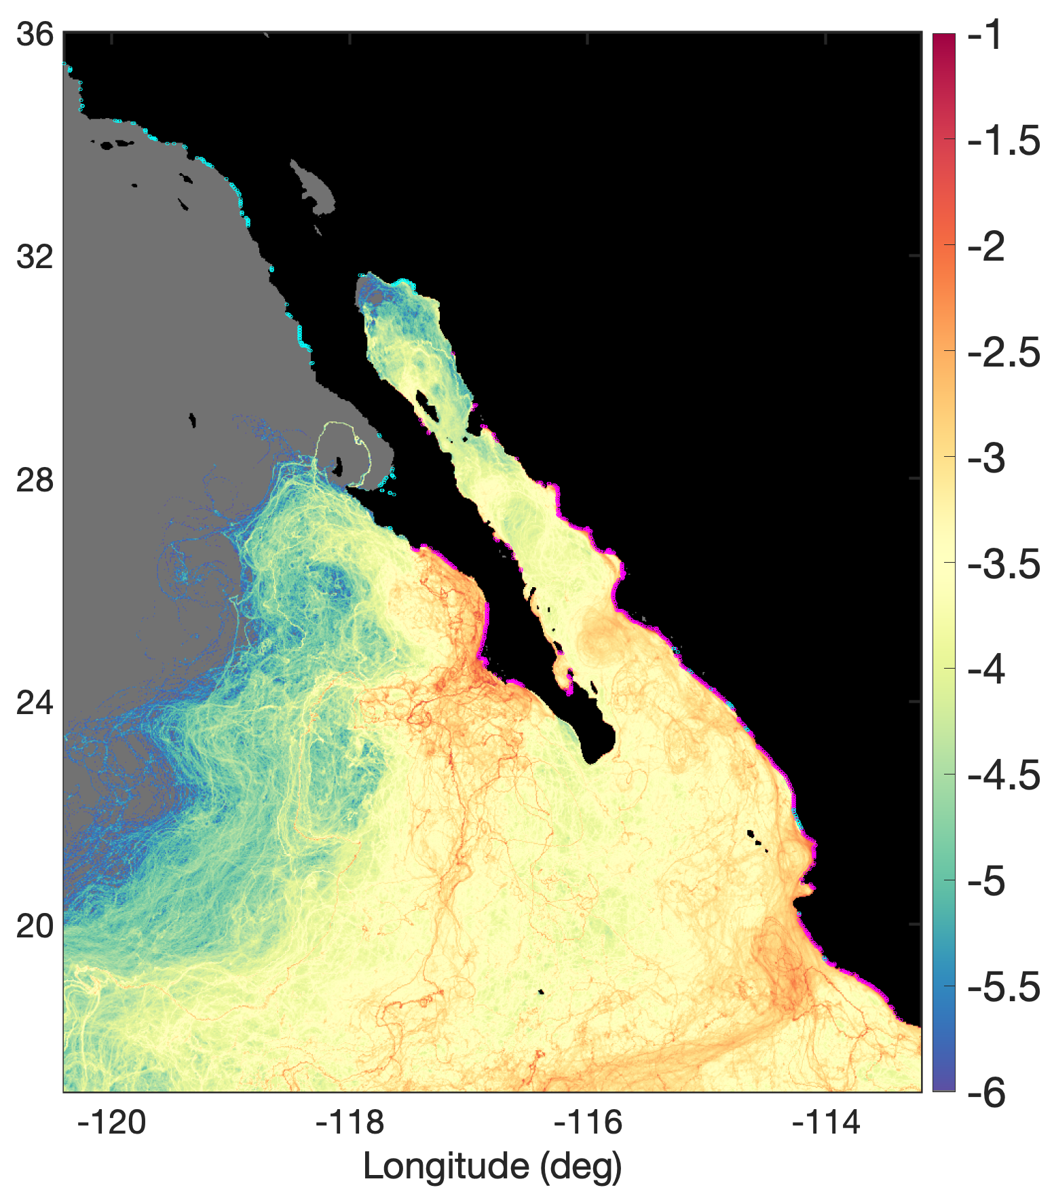
Dispersal limits poleward expansion of
mangroves on the west coast of North America
Cavanaugh, K., Carroll, D., Bardou, R., and T. Stocken (2024). Dispersal limits poleward expansion of mangroves on the west coast of North America. Ecography, e07288. https://doi.org/10.1111/ecog.07288
Science Question
Mangroves provide critical nurseries for species and stabilize coastlines from sea-level rise and storm surges. Mangrove seeds, called propagules, float and disperse across vast regions of the ocean.
We seek to understand: how do climate and dispersal limitation control mangrove populations across Baja California, Mexico?
Analysis
We combined a species distribution model with a high-resolution oceanographic transport model (based on ECCO) to quantify the roles of climate and dispersal limitation in controlling mangrove distributions.
Results
Mangrove limitation in Baja California is due in part to ocean currents and a lack of suitable habitats for establishment. Prevailing ocean currents flow from north to south, restricting mangrove dispersal north of their current range.
Significance
Our findings underscore the importance of considering climate and dispersion in managing blue carbon ecosystems, essential for biodiversity, ecosystem services, and human communities.
Acknowledgements
This research was supported by the NASA Carbon Monitoring System (NNH22ZDA001N-CMS) under NASA Award number 80NSSC23K1232.
Gulf of California Present-day Range Limit
Pacific Coast Present-day Range Limit
Latitude (deg)
Propagule Density in Log Scale
Figure 1: Heat map showing density of simulated mangrove propagules. Floating propagules were released hourly for two months along the coast of Baja/Mainland Mexico.

