Slide 1



Assessing the Broadscale Effects of Wildfire Under Extreme
Drought Conditions to Boreal Peatlands
Bourgeau-Chavez LL, Graham JA, Vander Bilt DJL, and Battaglia MJ (Dec. 2022). Frontiers in Forests & Global Change.doi.org/10.3389/ffgc.2022.965605
What we did
Why it matters
To address the overarching research question: Are peatlands as vulnerable to burning as upland areas during the extreme drought of 2014–2015? We geospatially assessed the broadscale effects of wildfire on the landscape during extreme drought in terms of exposure (what burned?) and sensitivity (how severely did it burn?), as well as understanding where and when we find fire refugia.
This study provides insight into what to expect in boreal peatlands under extreme drought
Peatlands store large amounts of C belowground and a changing climate could make them more vulnerable to burning
Understanding fire effects in peatlands on the Taiga shield and plains allows us improve models to predict effects of future fire regimes and effects on the global C budget
Above: The study domain is the 14.6 M ha area around Great Slave Lake that was affected by extreme drought and 3.4 M ha of wildfire in 2014-15. It crosses gradients of ecoregions, permafrost zones, uplands-wetlands and has an abundance of peatlands
Notes:
Bourgeau-Chavez, L., J.A. Graham, D.J.L. VanderBilt, and M.J. Battaglia. 2022. Assessing the broadscale effects of wildfire under extreme drought conditions to boreal peatlands. Frontiers in Forests and Global Change, Vol 5, DOI=10.3389/ffgc.2022.965605

Slide 2
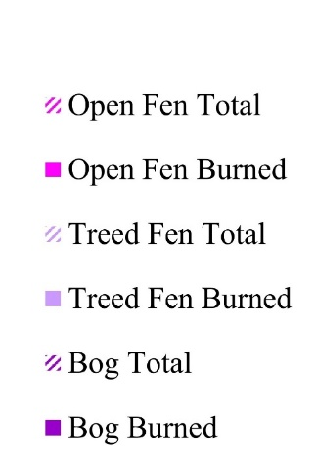
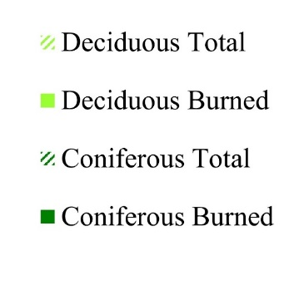
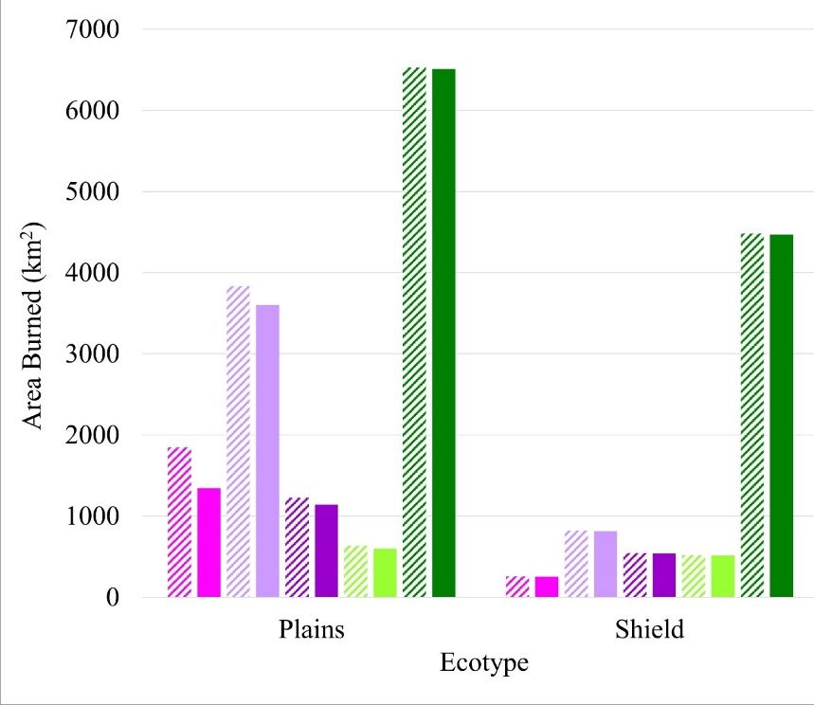
Approach
Assess broadscale wildfire effects across 136 wildfires from drought years 2014-15
Statistical (Chi-Squared) Analysis
Intersect maps of ecotype, burn severity to the organic soil layers (peat), ecoregion, fire seasonality and year
Chi-squared goodness of fit tests were used to statistically compare actual and expected areas of fire exposure (did it burn?) and fire sensitivity (how severely did it burn?) by ecotype, ecoregion, year, and season.
Exposure was assessed by converting the severity product into a binary burned (BSI>0.5) or not burned (BSI<0.5) map
Severity was assessed using each of the 5 BSI severity levels.
Expected values were derived by assuming equal probability of burning using the ratio of the total area available for each ecotype per wildfire by the total area of all ecotypes available within each wildfire perimeter.
Above: Actual area within fire perimeters (hashed bars) and area burned (solid bars) in km² by ecotype for the Taiga plains and shield.
Notes:
We focused on 136 wildfires in and around Great Slave Lakes and to address the research question we created maps of:
Burn severity to the organic soil layers (peat) which is where vulnerable C stores are located
Maps of peatland and upland ecotypes; and
MODIS hotspot maps of fire seasonality

Slide 3
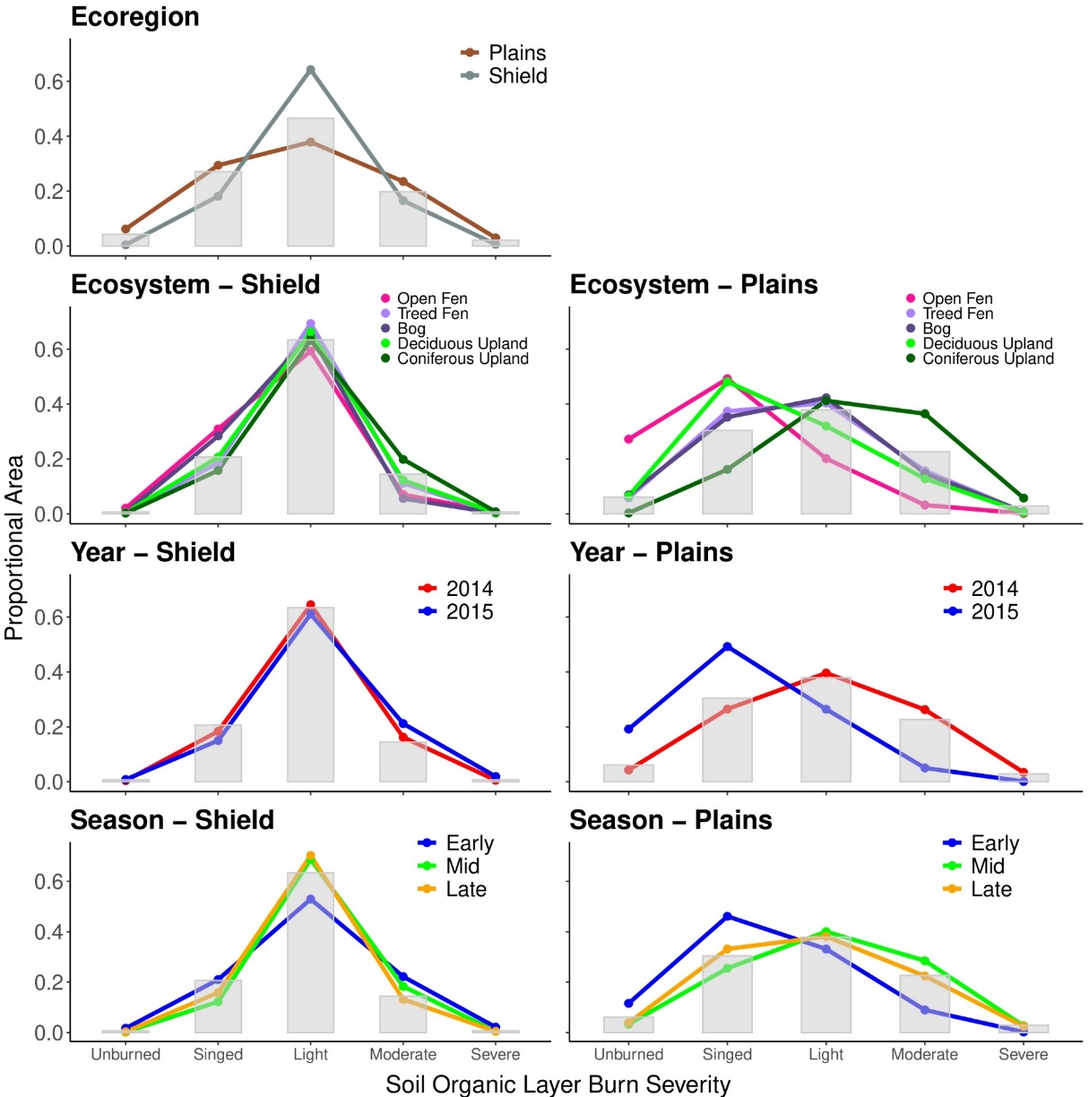
Taiga Shield Results Taiga Plains
For the Taiga shield, peatlands had low variability in exposure to wildfire (did it burn?) and sensitivity (how severely did it burn?)
  More than 90% of all ecotypes burned within fire perimeters on the shield and all showed the same pattern of burn severity.
Year of burn (2014 vs 2015) did not influence burn severity patterns
Severity of burn was not significantly different in season of burn
Overall peatlands were found to be more susceptible to wildfire on the Taiga shield where they are smaller and hydrologically isolated by the rocky landscape and abundance of lakes
For the Taiga plains, peatlands had high variability in exposure to wildfire (did it burn?) and sensitivity (how severely did it burn?) , with more moderate and high severity burning, as well as a greater abundance of unburned islands
Here peatlands are hydrologically well-connected to both ground water systems and larger peatland complexes
Upland conifer and treed fens had more area burning and at higher severity than expected, while bogs and open fens had less area and severity of burn
Overall peatlands were less vulnerable to wildfire on the plains than the shield. The wetlands acted to fragment the landscape despite drought
Aquatic vegetation emits ~6x more methane than open water per unit area
Above: Expected (gray bars) and actual proportional area (colored lines and points) showing sensitivity to wildfire (burn severity) by ecoregion (top) by ecosystem type, year and season for Taiga shield (left) and Taiga plain (right).

