Slide 1
Surface roughness and wave slope statistics from the multi-spectral polarimetric imaging of the ocean surface M. Malinowski, A. Gilerson, E. Herrera, R. Foster, J. Agagliate, M. Ondrusek, Opt. Exp. 2024
Background
Cox-Munk (CM) wave slope variance dependence on wind speed (WS) was established from measurements in clear waters in the Hawaii region (Cox, Munk, 1954). The relationship is used in OC atmospheric correction, other applications and requires validation in various water and atmospheric conditions.
Analysis
Previously developed Polarimetric Slope Sensing (PSS) technique (Zappa, et al., 2008) assumed the estimation of two components of wave slopes Δθ and φ from the degree of linear polarization (DoLP) and angle of linear polarization (AoLP) determined from polarimetric observations of the skylight reflected from the ocean surface.
The technique did not properly consider the impact of polarization of the water leaving radiance and did not work in sunny conditions.
A modified PSS technique called PSSm is developed, which properly isolates reflected skylight polarization from upwelling light and is applicable to typical clear sky OC measurements.
A novel polarimetric imaging video camera, which has 2400x2000 pixels and each 2x2 pixel area has two subpixels with 0, 90, 45, and -45 deg polarization is used in observations. The camera is attached to the filter wheel with 4 different color filters with center wavelengths at 442, 494, 550, and 665 nm.
The geometry of slope observations
The system with the imaging polarimetric camera and hyperspectral imager (only camera data is presented)
Notes:
NASA OBB program , grant 80NSSC21K0562, PI – Alex Gilerson
Authors affiliations:
Mateusz Malinowski¹, Alexander Gilerson^{1,2}, Eder Herrera –Estrella¹, Robert Foster³, Jacopo Agagliate¹ and Michael Ondrusek⁴
¹Optical Remote Sensing Laboratory, The City College of New York, New York, NY, USA, ²Earth and Environmental Sciences, The Graduate Center, New York, NY, USA
³Remote Sensing Division, Naval Research Laboratory, Washington, DC, USA, ⁴NOAA/NESDIS/STAR, College Park, MD 20740, USA
Full citation
M. Malinowski, A. Gilerson, E. Herrera-Estrella, R. Foster, J. Agagliate, and M. Ondrusek, “Surface roughness and wave slope statistics from the multi-spectral polarimetric imaging of the ocean surface ,”
Optics Express, 2024. doi: 10.1364/OE.521650
Abstract
The polarization of light in Ocean Color (OC) applications provides important information about atmospheric parameters, water composition, and the ocean surface. The Stokes vector components and the degree of linear polarization of light contain useful information about the air-water interface, including ocean surface roughness. We present polarimetric measurements and analysis of the ocean wave slopes at several bands. Data is acquired with a Teledyne DALSA camera, which uses a polarizer-on-chip focal plane of 1232 × 1028 super-pixels, where each pixel is made of four subpixels with 0-, 90-, 45- and 135-degrees orientation of polarization. We present a modified version of the Polarization Slope Sensing (PSS) technique [Zappa et al., 2008] for the non-contact detection of wave slopes and demonstrate a good performance of the updated algorithm in several conditions where the original technique was not applicable. Derived wave slopes are presented for various aquatic and atmospheric environments, including during VIIRS Cal/Val cruises and at a near-shore pier. The results are shown to be consistent with theoretical wave slope models.

Slide 2
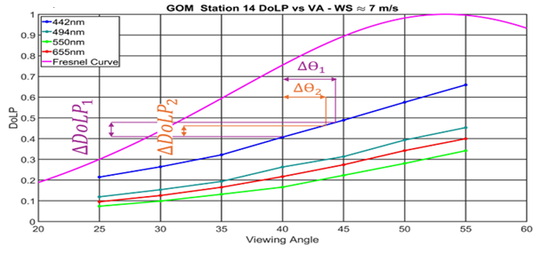
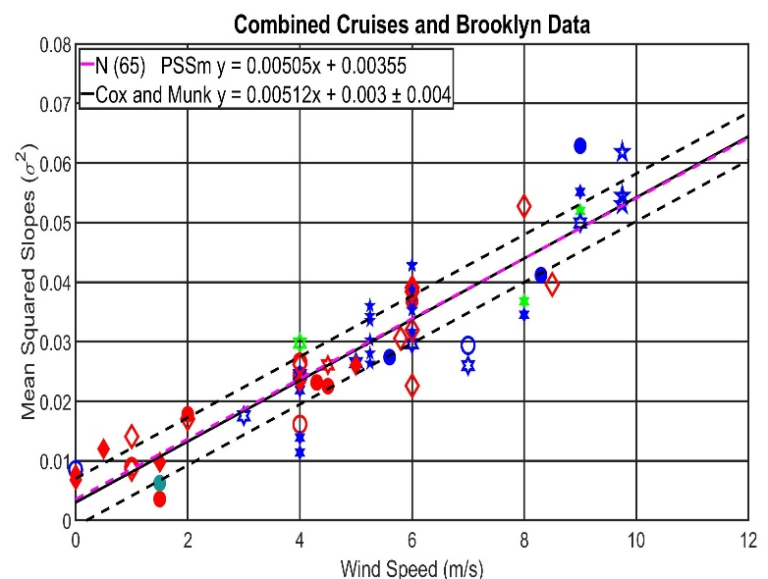
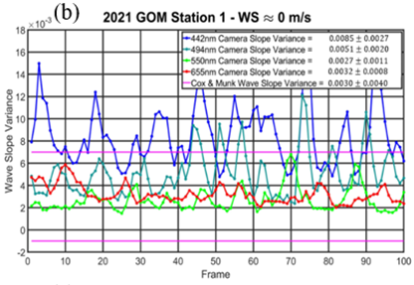
Surface roughness and wave slope statistics from the multi-spectral polarimetric imaging of the ocean surface (cont.)
Measurements were carried out from the ships in 3 NOAA VIIRS validation cruises (Gulf of Mexico, Hawaii, and Newport, OR) and the nearshore platform (Brooklyn, NY).
Instead of the Fresnel DoLP curve the actual DoLP vs viewing angle (VA) curve is used from the color filter with higher DoLP (red in clear waters and blue in coastal waters).
The impact of polarization of the water leaving radiance was eliminated and the technique was applied to the reflected skylight only.
It is demonstrated that for measurements in all 3 cruises and from the nearshore platform wave slope variances followed Cox-Munk dependence on wind speed.
Theoretical (magenta) and measured DoLP curves for the GOM station.
Combined DoLP vs. VA mean squared slope data from Hawaii (blue), Gulf of Mexico (cyan), Brooklyn (green), Newport (red), and best-fit line using those data points (magenta).
Wave slope variances over 100 camera frames from Hawaii and GoM stations with WS 5 and ~0 m/s
Notes:
NASA OBB program , grant 80NSSC21K0562, PI – Alex Gilerson
Full, formal citation
M. Malinowski, A. Gilerson, E. Herrera-Estrella, R. Foster, J. Agagliate, and M. Ondrusek, “Surface roughness and wave slope statistics from the multi-spectral polarimetric imaging of the ocean surface ,”
Optics Express, 2024. doi: 10.1364/OE.521650
Award Information:
This research was supported by the NASA Ocean Biology and Biochemistry Program (NNH20ZDA001N-OBB-Task 2.5.) under NASA Award number 80NSSC21K0562

Slide 3
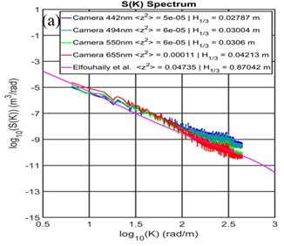
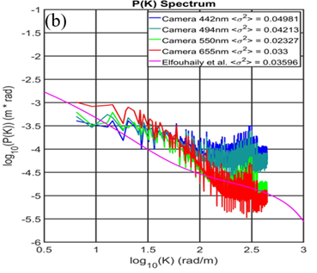
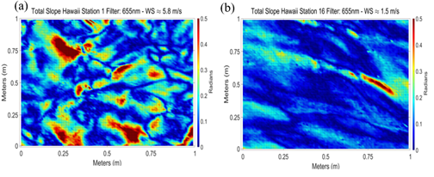
Surface roughness and wave slope statistics from the multi-spectral polarimetric imaging of the ocean surface (cont.)
The omnidirectional wave slope spectra P(k) and wave elevation spectra S(k) of the ocean surface are considered, where k = 2π/Λ is the wavenumber in radians/m and Λ is the wavelength in m and compared with the Elfouhaily et al., 1997 model at different sea states demonstrating consistency and the range of wave numbers and types of waves (mostly gravity-capillary waves) from which wave slopes are generated.
Significance:
The Cox-Munk relationship can be efficiently used in modeling of the wave slope variances at the ocean surface in various open ocean and coastal waters and atmospheric conditions.
Omnidirectional a) S(k) and b) P(k) spectra derived from the camera with comparison to Elfouhaily et al. model for the Hawaii station with data from all filters
Instantaneous slopes derived from the pair of angles (Δθ, φ) from camera observations for the Hawaii cruise (WS = 5.8 and 1.5 m/s)
Notes:
NASA OBB program , grant 80NSSC21K0562, PI – Alex Gilerson
Full, formal citation
M. Malinowski, A. Gilerson, E. Herrera-Estrella, R. Foster, J. Agagliate, and M. Ondrusek, “Surface roughness and wave slope statistics from the multi-spectral polarimetric imaging of the ocean surface ,”
Optics Express, 2024. doi: 10.1364/OE.521650
Award Information:
This research was supported by the NASA Ocean Biology and Biochemistry Program (NNH20ZDA001N-OBB-Task 2.5.) under NASA Award number 80NSSC21K0562

