Slide 1
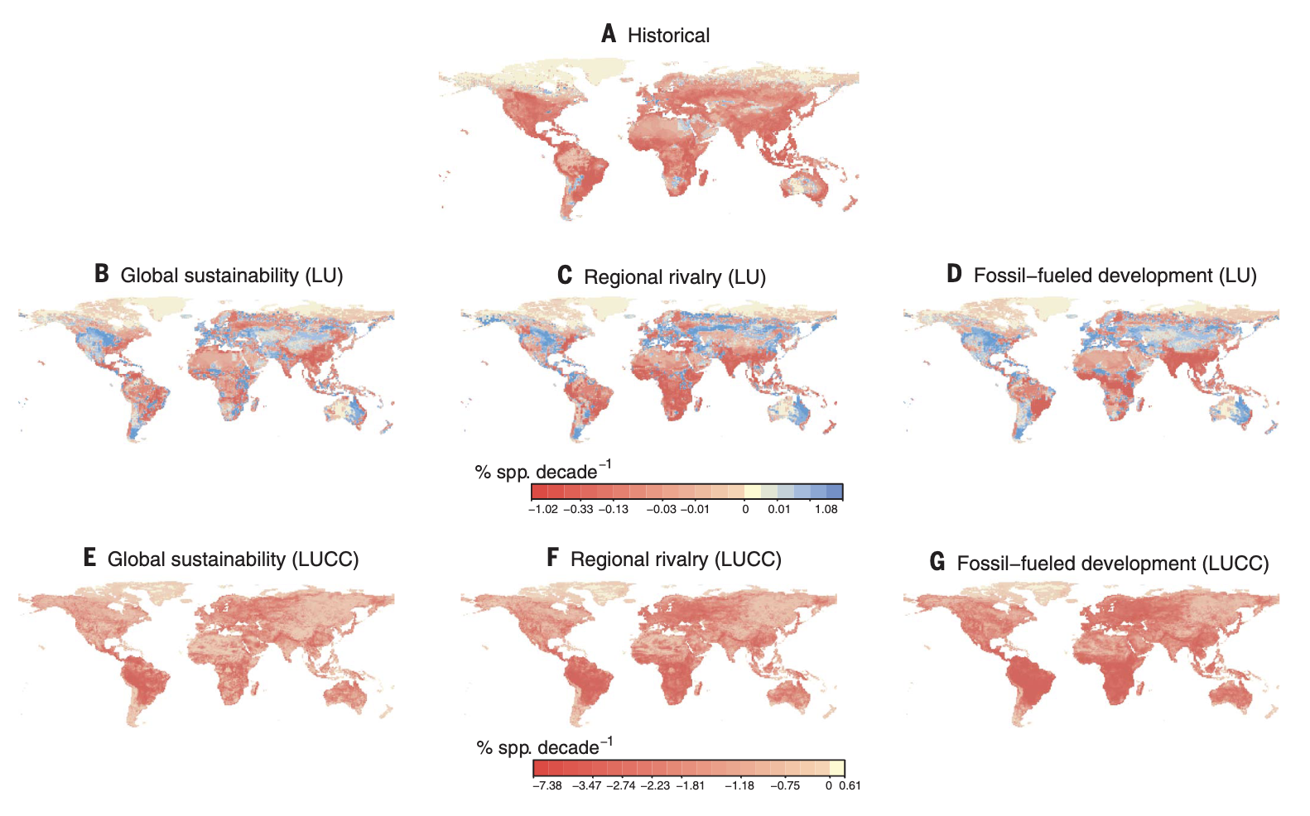
Global trends and scenarios for terrestrial biodiversity and ecosystem services from 1900 to 2050
Pereira et al. (2024). Global trends and scenarios for terrestrial biodiversity and ecosystem services from 1900 to 2050. Science 384:458-465. https://doi.org/10.1126/science.adn3441
Science Question
What are the major trends in global biodiversity and ecosystem services and their causes?
What are the predicted global impacts of land use and climate change on multiple facets of biodiversity and ecosystem services over the coming decades compared with their impacts during the 20th century?
How much of the variation in projected impacts can be attributed to differences of development pathways in scenarios versus differences between models?
How can NASA CMS products be used to help address the threats to both climate, carbon, and biodiversity?
Analysis
A model intercomparison of projections of biodiversity and ecosystem services using a set of land-use and climate change reconstructions from 1900 to 2015, and three future scenarios from 2015 to 2050.
  8 models of biodiversity, 5 models of ecosystem services, 3 future climate/land-use scenarios
Utilized NASA Global Land-Use Harmonization (LUH) data as input to both climate/carbon and biodiversity/ecosystem service models (Hurtt et al. 2020).
Results/Significance
During the 20th century, biodiversity declined globally by 2 to 11%, as estimated by a range of indicators, primarily due to land-use change.
Going forward, policies toward sustainability have the potential to slow biodiversity loss resulting from land-use change and the demand for provisioning services while reducing or reversing declines in regulating services.
However, negative impacts on biodiversity due to climate change appear poised to increase, particularly in the higher-emissions scenarios.
Our assessment identifies remaining modeling uncertainties but also robustly shows that renewed policy efforts are needed to meet the goals of the Convention on Biological Diversity.
Acknowledgements
This research was supported by the NASA Carbon Monitoring System grant 80NSSC21K1059 to G.H. and L.C.
Figure 2. Spatial distribution of diversity-weighted changes in local species richness (DSSa). (A) Historical DSSa changes from 1900 to 2015 (number of models, N = 5). (B to G) Future species richness changes from 2015 to 2050 driven by land-use (LU) change alone in each scenario [(B) to (D); N = 5] and by land-use change and climate change combined (LUCC) [(E) to (G); N = 2]. All values are based on intermodel means. Diversity-weighted changes in local species richness were calculated as the absolute change in species richness in each cell divided by the mean species richness across cells. Color scale is based on quantile intervals and differs for (A) to (D) and (E) to (G). Maps are in equirectangular projection.

