Slide 1
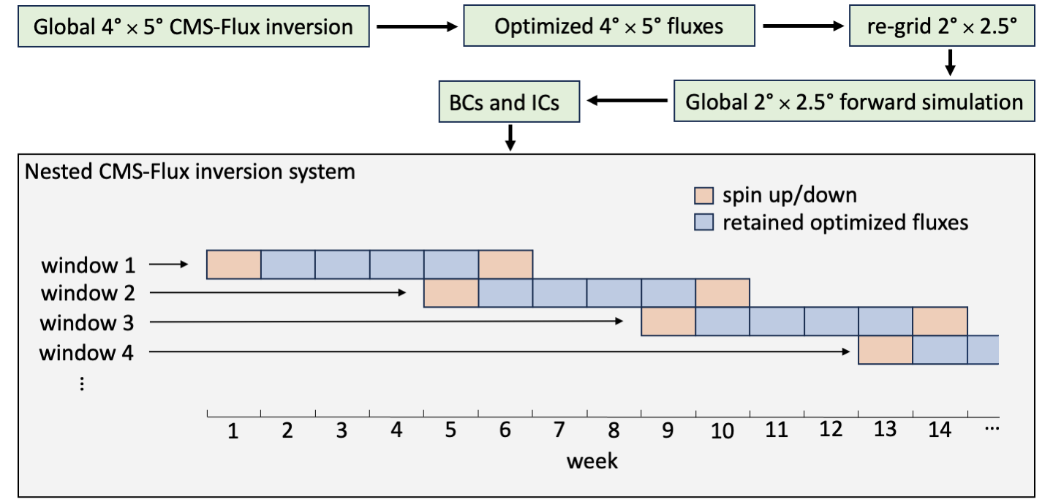
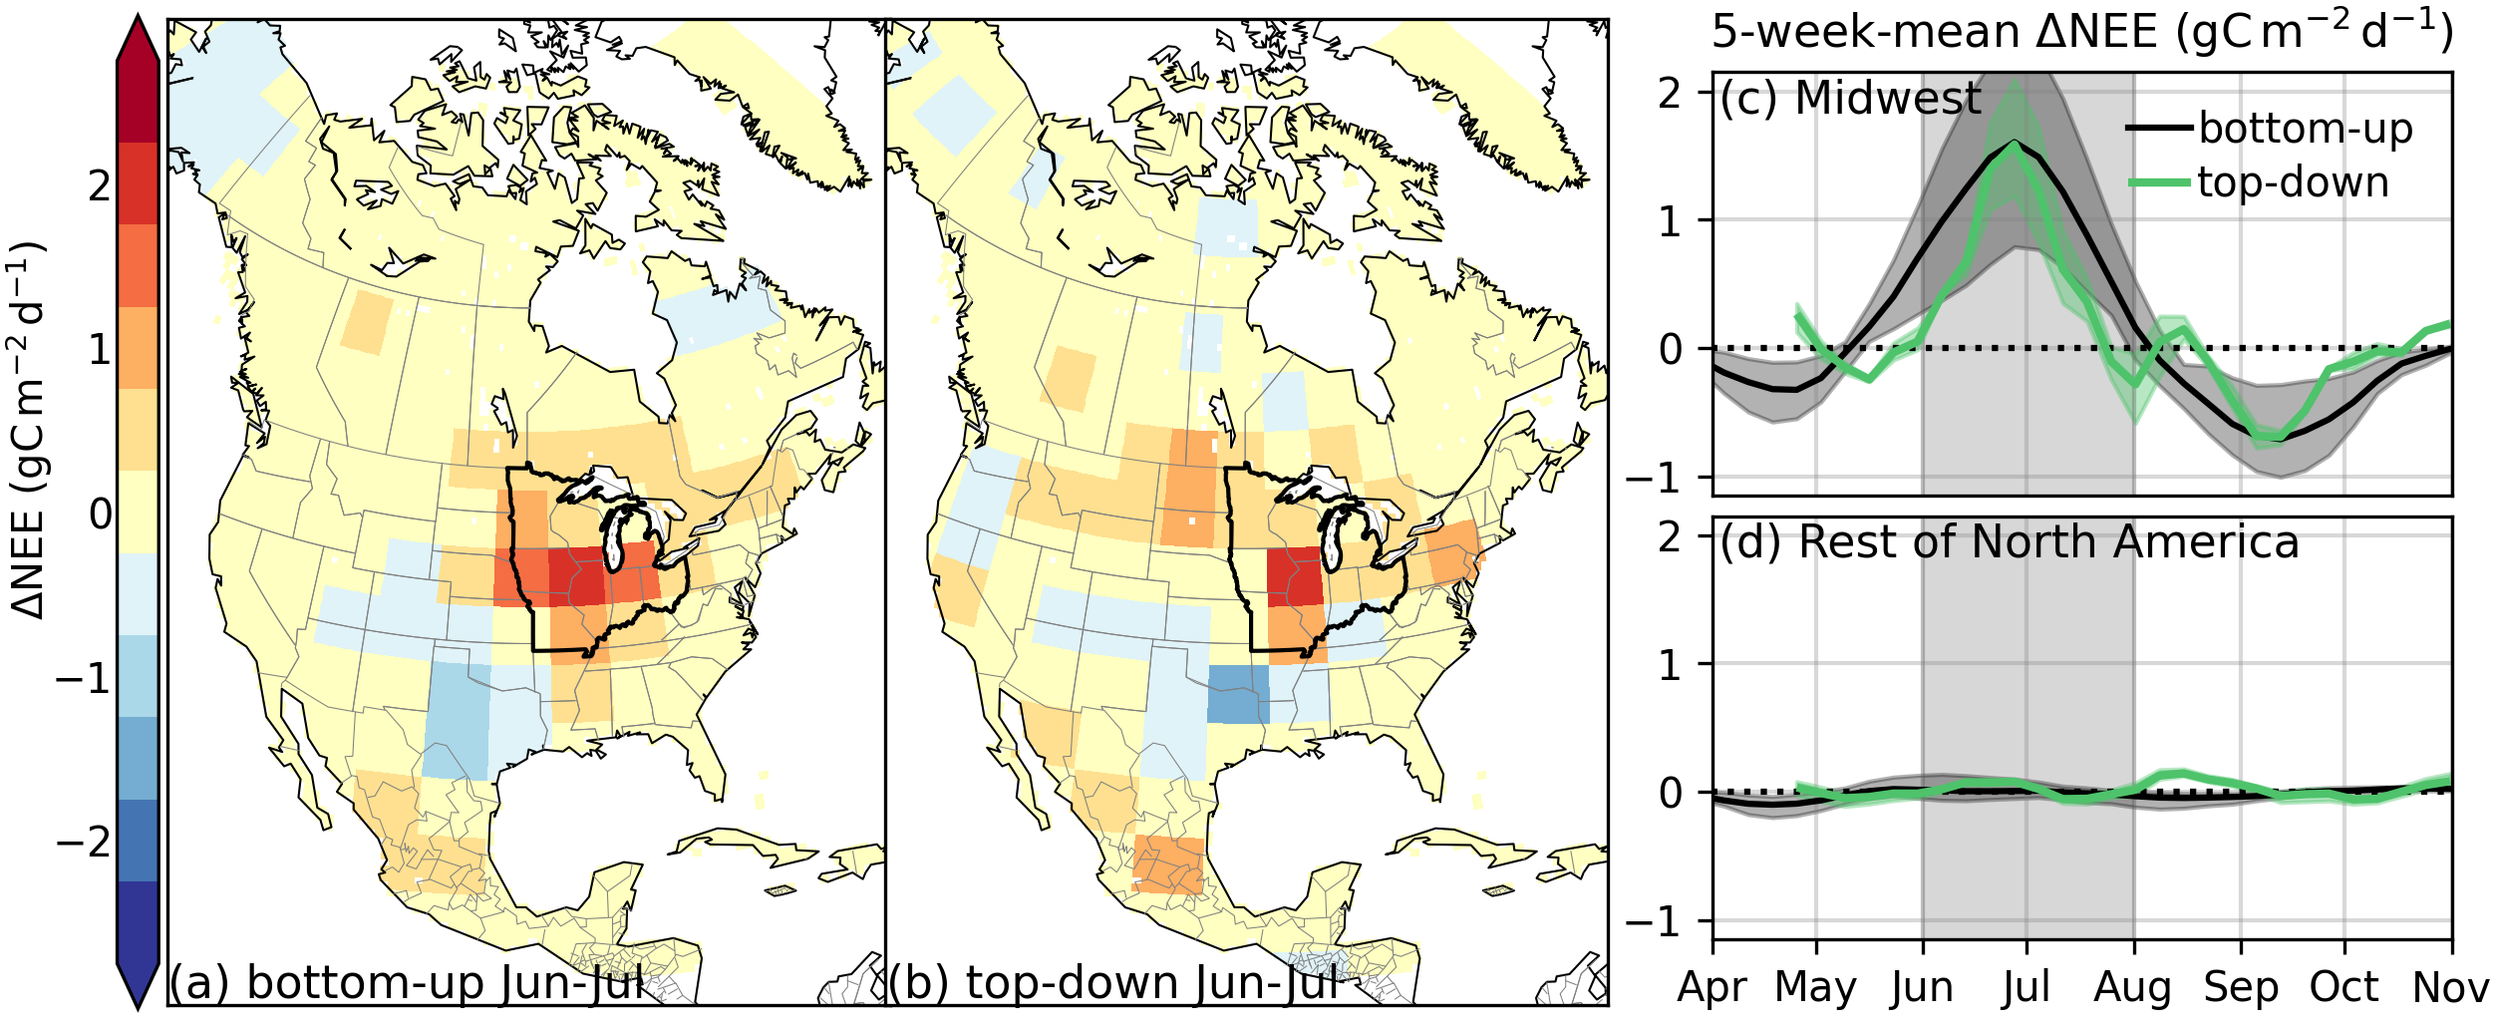
Regional inversion shows promise in capturing extreme-event-driven CO₂ flux anomalies but is limited by atmospheric CO₂ observational coverage
Byrne et al. (2024), J Geophys. Res.-Atmos., https://doi.org/10.1029/2023JD040006
National Aeronautics and Space Administration
Jet Propulsion Laboratory
California Institute of Technology
Science Question: Global CO₂ inversion models have coarse (4º x 5º) spatial resolution. Can a nested higher resolution model better quantify carbon cycle variability over North America?
Data: OCO-2 X_{CO2} and in situ CO2 measurements are assimilated in flux inversions to estimate net ecosystem exchange (NEE).
Results:
We develop a new one-way nested version of CMS-Flux for North America (CMS-Flux-NA) with high-resolution atmospheric transport over North America (see Fig 1 for schematic diagram).
CO₂ inversion analyses recover reduced CO2 uptake over the U.S. Midwest during spring 2019 relative to 2018, coinciding with the 2019 Midwest floods. Demonstrating skill at isolating regional CO2 fluxes.
We show that current data density from OCO-2 strongly under constrain regional CO2 fluxes, but that a daily repeat cycle, possibly from a constellation of LEO satellites would significantly reduce uncertainties.
Significance: This study develops a new nested version of CMS-Flux for North America (CMS-Flux-NA) that can be employed in future studies. It also demonstrates the value of this model for studying the regional carbon cycle.
Figure 1. Schematic diagram of the CMS-Flux-NA inversion implementation. Green boxes and arrows show the process for generating ICs and BCs for CMS-Flux-NA. The beige box then shows how a number of inversions with eight week windows are performed using CMS-Flux-NA to generate continuous flux estimates.
Figure 2 (a) Bottom-up and (b) top-down (LNLGOGIS) spatial patterns of June–July mean ∆NEE (NEE2019 − NEE2018) at 4◦ × 5◦ spatial resolution. (c) US Midwest and (d) rest of North America 5-week-mean ∆NEE. The US Midwest is defined as the area within Illinois, Indiana, Iowa, Michigan, Minnesota, Missouri, Ohio, and Wisconsin and is indicated by the black outline in panels (a) and (b). The shading shows the range around the mean estimate for the inversions using three different priors and for the five bottom-up GPP datasets.
Notes:
1
You may add comments here to clarify the work or the results.

Slide 2
Regional inversion shows promise in capturing extreme-event-driven CO₂ flux anomalies but is limited by atmospheric CO₂ observational coverage
Byrne et al. (2024), J Geophys. Res.-Atmos., https://doi.org/10.1029/2023JD040006
National Aeronautics and Space Administration
Jet Propulsion Laboratory
California Institute of Technology
Contact:
Brendan Byrne, 233-208F, Jet Propulsion Laboratory, Pasadena, CA 91109
brendan.k.byrne@jpl.nasa.gov
Citation:
Byrne, B., Liu, J., Bowman, K. W., Yin, Y., Yun, J., Ferreira, G. D., Ogle, S. M., Baskaran, L., He, L., Li., X., Xiao, J., and Davis, K. J. (2024). Regional inversion shows promise in capturing extreme‐event‐driven CO2 flux anomalies but is limited by atmospheric CO2 observational coverage. Journal of Geophysical Research: Atmospheres, 129, e2023JD040006. https://doi.org/10.1029/2023JD040006
Scientific significance, societal relevance, and relationships to future missions:
This study develops a new nested version of CMS-Flux for North America (CMS-Flux-NA) that can be employed in future studies. It also demonstrates the value of this model for studying the regional carbon cycle.

