Slide 1
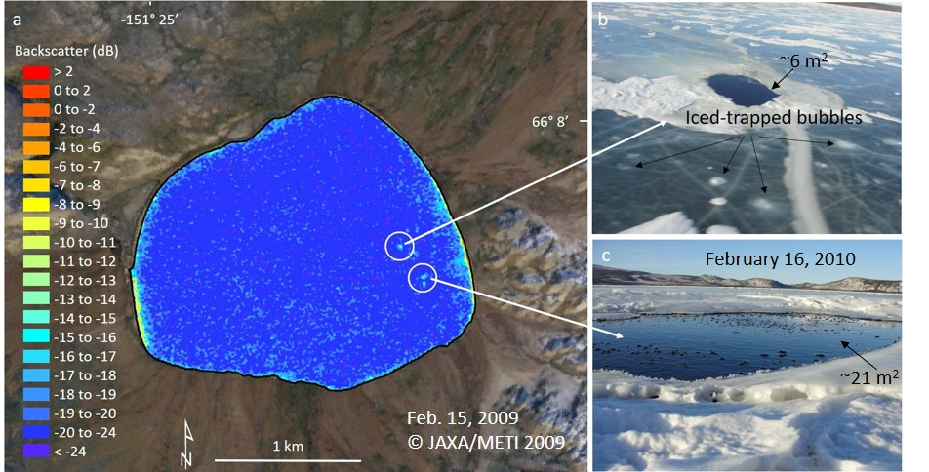
Synthetic Aperture radar (SAR) detects large gas seeps in Alaska lakes Engram, M. and K.M. Walter Anthony (2024), Environ. Res. Lett., doi:10.1088/1748-9326/ad2b2a
Science Question/Background
Reservoirs of old,¹⁴C-depleted methane residing beneath permafrost are vulnerable to escape where permafrost thaw creates open-talik conduits. While little is known about the magnitude and variability of this methane source or its response to climate change, it is of twofold interest: ¹⁴C-depleted methane seeps cause a positive feedback to climate warming, and a solid knowledge of natural ¹⁴C-depleted methane emissions is vital to an accurate estimate of anthropogenic methane emissions from fossil fuel industries.
Analysis
The research team used SAR remote sensing data from the Alaska Satellite Facility,
Perennial high backscatter from lake ice in L-band SAR image (a), shows the location of sub-permafrost methane seeps (b, c) in Sithylementkat Lake in Alaska.
including ALOS PALSAR-1, JERS-1, Sentinel-1. Single-polarization intensity images as well as fully-polarimetric decomposed parameters were used at the location of ground-truthed seeps. Gas samples were collected during field work for ¹⁴C dating.
Results
Large ¹⁴C-depleted methane seeps in interior Alaska, the Brooks Range, and Alaska North Slope created high perennial backscatter from lake ice, indicating that L-band SAR detects large gas seeps in lakes that freeze, even when a thin layer of snow or ice obscures seeps from appearing in optical/multispectral imagery.
Significance
This work lays the foundation for the upcoming NISAR mission, with the potential to use its continuous, all-weather, pan-Arctic L-band mapping and 12-day repeat cycle (much shorter at high latitudes) to remotely sense large gas seeps occurring in northern high latitude lakes, contributing to improved knowledge of the magnitude and change of naturally occurring ¹⁴C-depleted methane seeps.
Notes:
Abstract
Reservoirs of ¹⁴C-depleted methane (CH₄), a potent greenhouse gas, residing beneath permafrost are vulnerable to escape where permafrost thaw creates open-talik conduits. However, little is known about the magnitude and variability of this methane source or its response to climate change. Remote-sensing detection of large gas seeps would be useful for establishing a baseline understanding of sub-permafrost methane seepage, as well as for monitoring these seeps over time. Here we explored synthetic aperture radar’s (SAR) response to large sub-permafrost gas seeps in an interior Alaskan lake. In SAR scenes from 1992 to 2011, we observed high perennial SAR L-band backscatter (σ⁰) from a ~90m-wide feature in the winter ice of interior Alaska’s North Blair Lake (NBL). Spring and fall optical imagery showed holes in the ice at the same location as the SAR anomaly. Through field work we 1) confirmed gas bubbling at this location from a large pockmark in the lakebed, 2) measured flux at the location of densest bubbles (1,713 ± 290 mg CH₄ m⁻² d⁻¹), and 3) determined the bubbles’ methane mixing ratio (6.6%), radiocarbon age (18,470 ± 50 years BP), and δ¹³C_{CH4} values (-44.5 ± 0.1 ‰), which together may represent a mixture of sources and processes. We performed a first order comparison of SAR σ⁰ from the NBL seep and other known sub-permafrost methane seeps with diverse ice/water interface shapes in order to evaluate the variability of SAR signals from a variety of seep types. Results from single-polarized intensity and polarimetric L-band SAR decompositions as well as dual-polarized C-band SAR are presented with the aim to find the optimal SAR imaging parameters to detect large methane seeps in frozen lakes. Our study indicates the potential for SAR remote sensing to be used to detect and monitor large, sub-permafrost gas seeps in Arctic and sub-Arctic lakes.

Slide 2
Notes
Citation:
Engram, M and K.M. Walter Anthony . “Synthetic aperture radar (SAR) detects large gas seeps in Alaska lakes." Environmental Research Letters 19, no. 2 (2024): 044034. doi: 10.1088/1748-9326/ad2b2a
Award Information:
This research was supported by the NASA Terrestrial Ecology Program (NNH18ZDA001N-TE.) under NASA Award number 80NM0018D0004
This research supported the NASA Terrestrial Ecology Arctic-Boreal Vulnerability Experiment

