Slide 1
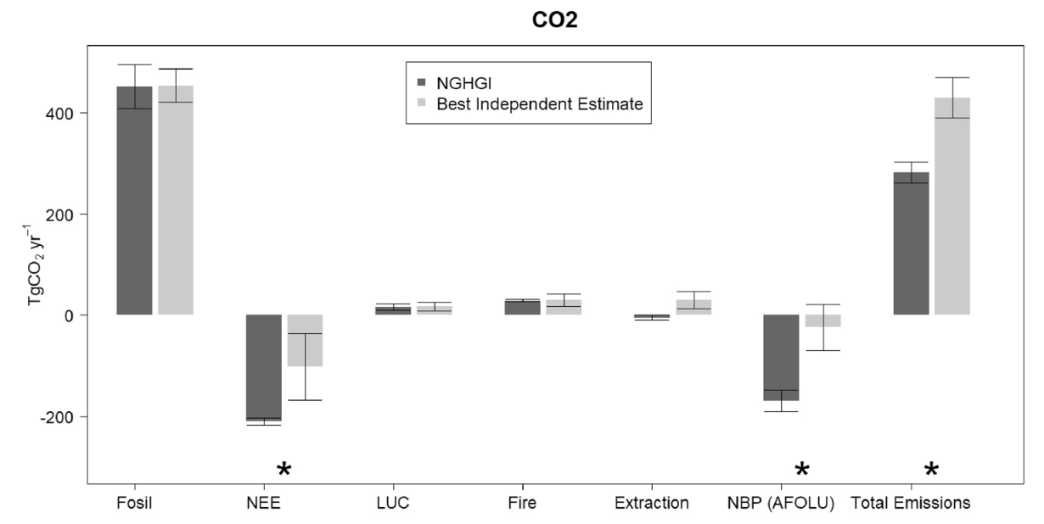
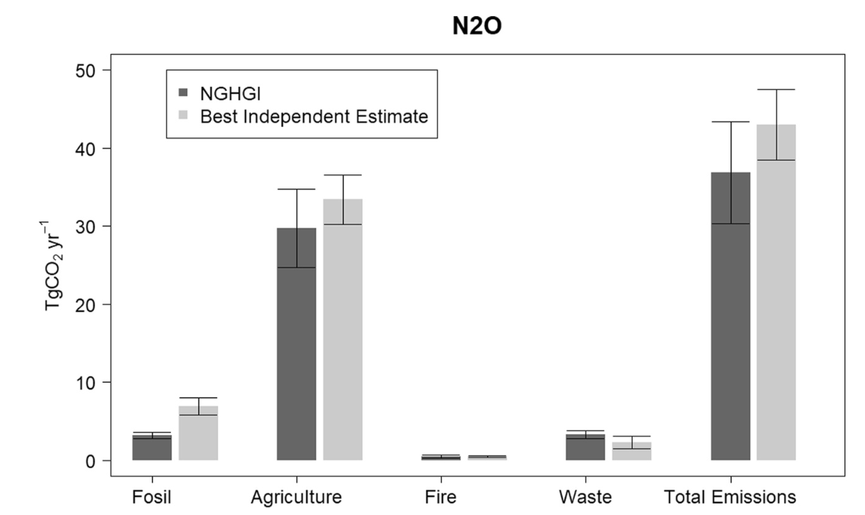
A Greenhouse Gas Budget for Mexico During 2000–2019 Murray-Tortarolo, G, et al. (2024). A Greenhouse Gas Budget for Mexico During 2000–2019. JGR Biogeosciences, 129(1), e2023JG007667. https://doi.org/10.1029/2023JG007667
Science Question
What is the greenhouse gas budget for Mexico over the past two decades (2000-2019)?
What are the emissions and removals of CO₂, CH₄ and N₂O by natural and anthropogenic sectors?
Where are main discrepancies and uncertainties in datasets and integration?
The work is carried out as part of the REgional Carbon Cycle and Processes study (RECCAP2).
Analysis
Data from the Mexico National Greenhouse Gas Inventory (NGHGI), land-surface models, and atmospheric inversions were combined to estimate greenhouse gas emissions and removals.
The data included estimates for natural sources (i.e., terrestrial ecosystems and wetlands) and anthropogenic sectors (fossil fuels, agriculture, waste, land-use and land cover change).
Results/Significance
Mexico is a source of GHG emissions, ranging from 695-910 TgCO₂-eq yr⁻¹.
Seventy percent of emissions are attributed to CO₂, 23% to CH₄ and 5% to N₂O.
There is good agreement across anthropogenic sectors and less agreement for the land carbon sink.
NGHGI estimates were much larger removals than other modeled estimates.
Lateral fluxes and outgassing processes from aquatic systems remain problematic for double counting and for helping reconcile bottom-up and top-down budgets
Acknowledgements
This research was supported in part by the NASA Carbon Monitoring System and includes co-authors Rodrigo Vargas, Abhishek Chatterjee, Jonathan Wang and Ben Poulter.
Figure 1: Emissions and removals of CO₂ (top), CH₄ (middle) and N₂O (bottom) by natural and anthropogenic sectors.

