Slide 1
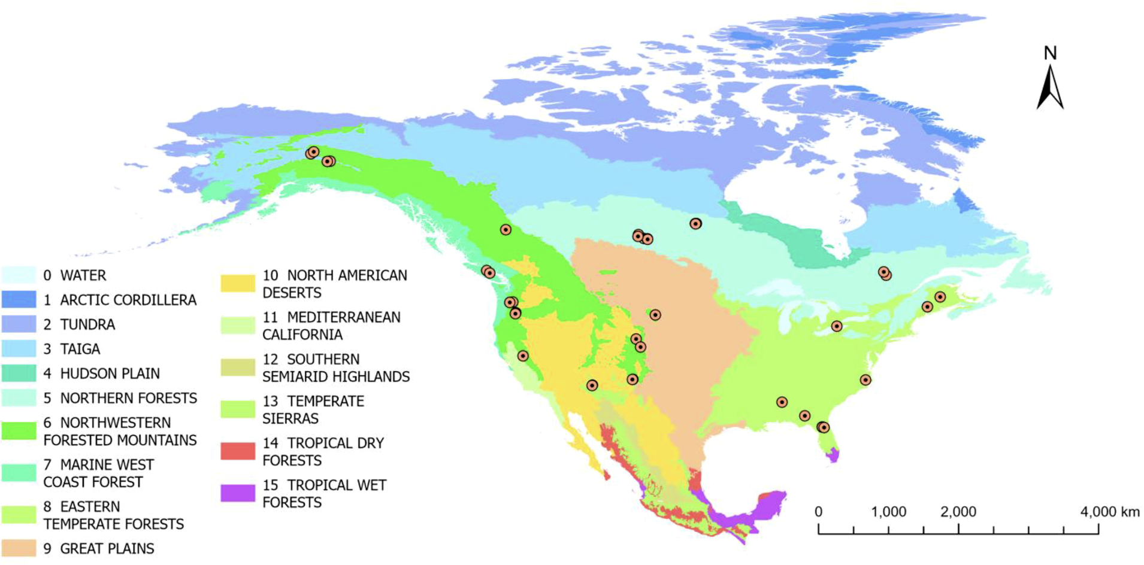
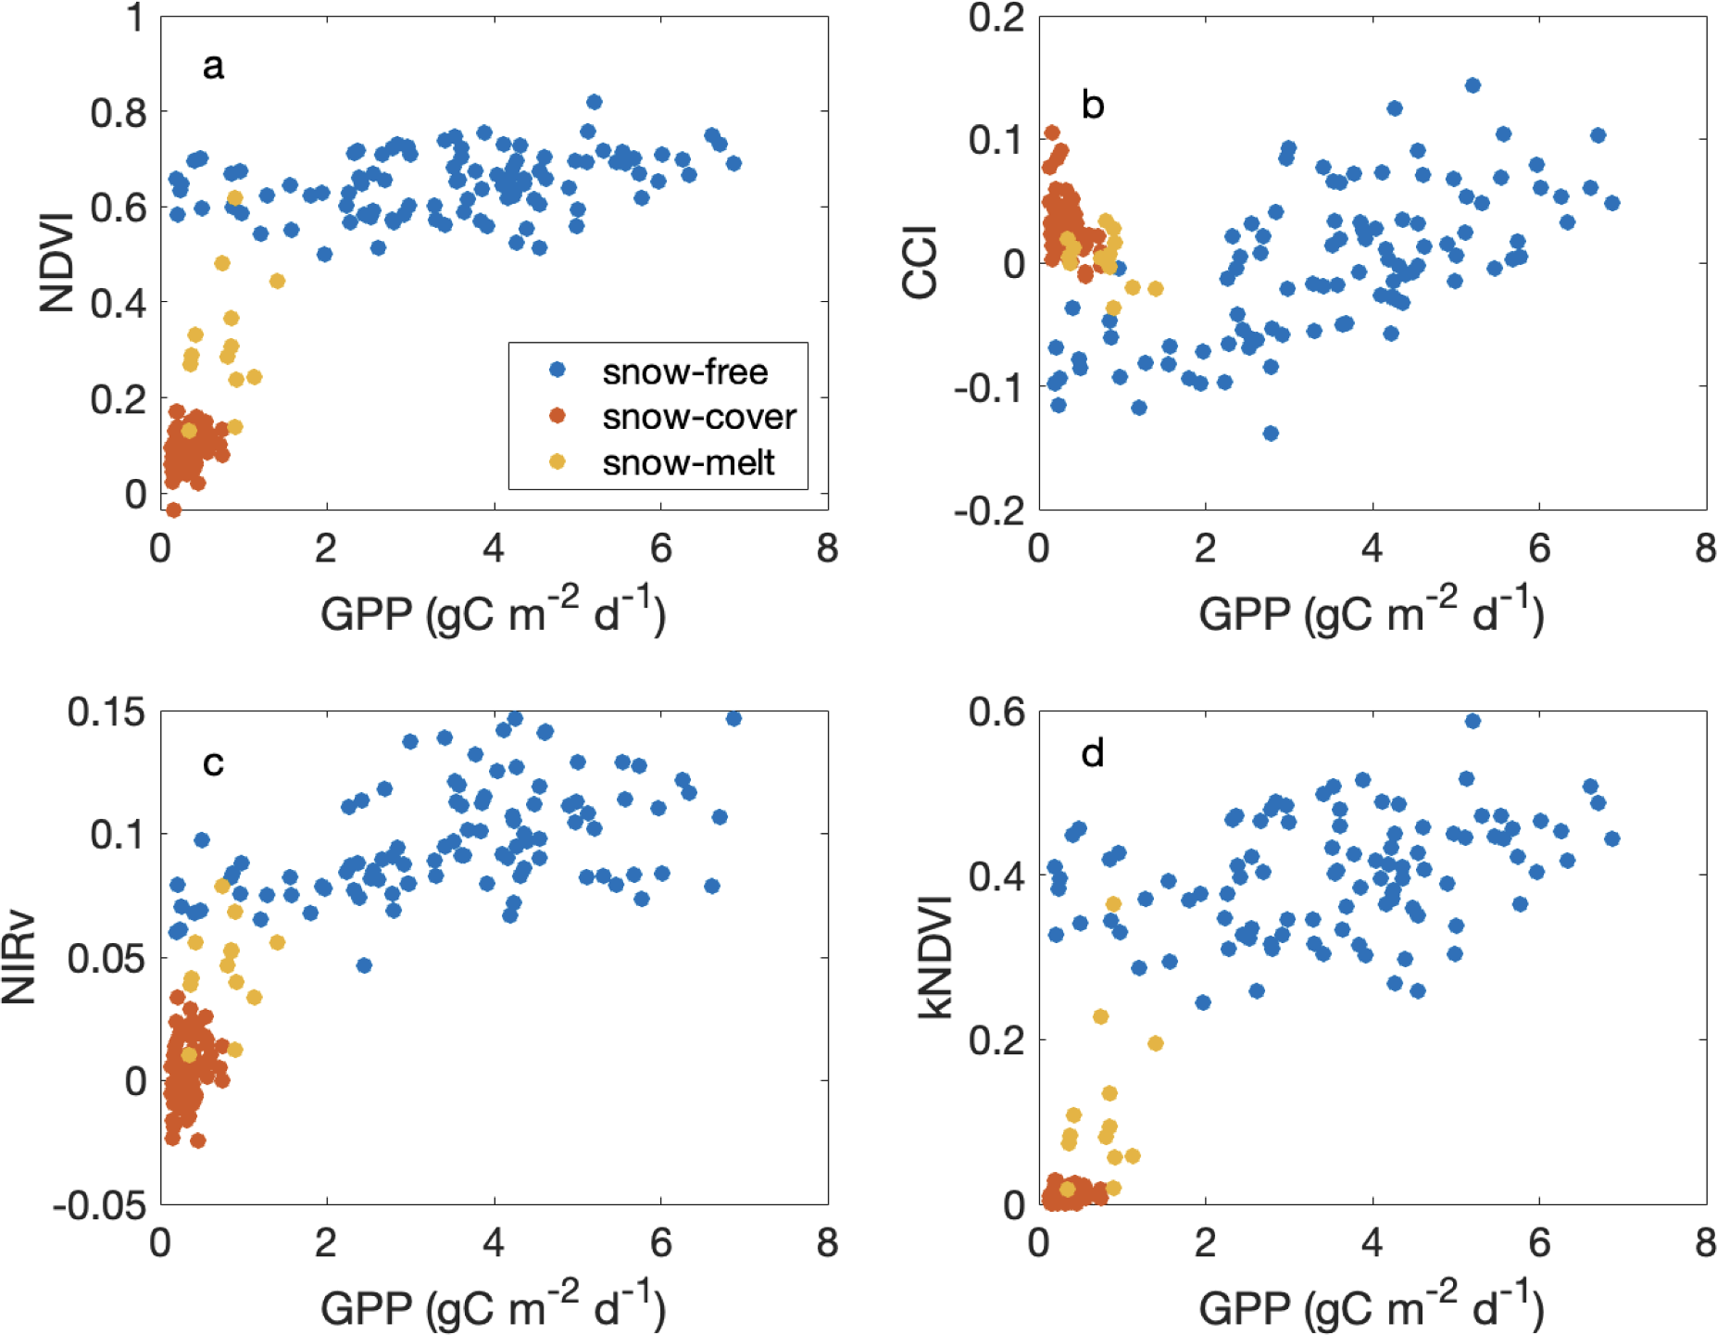
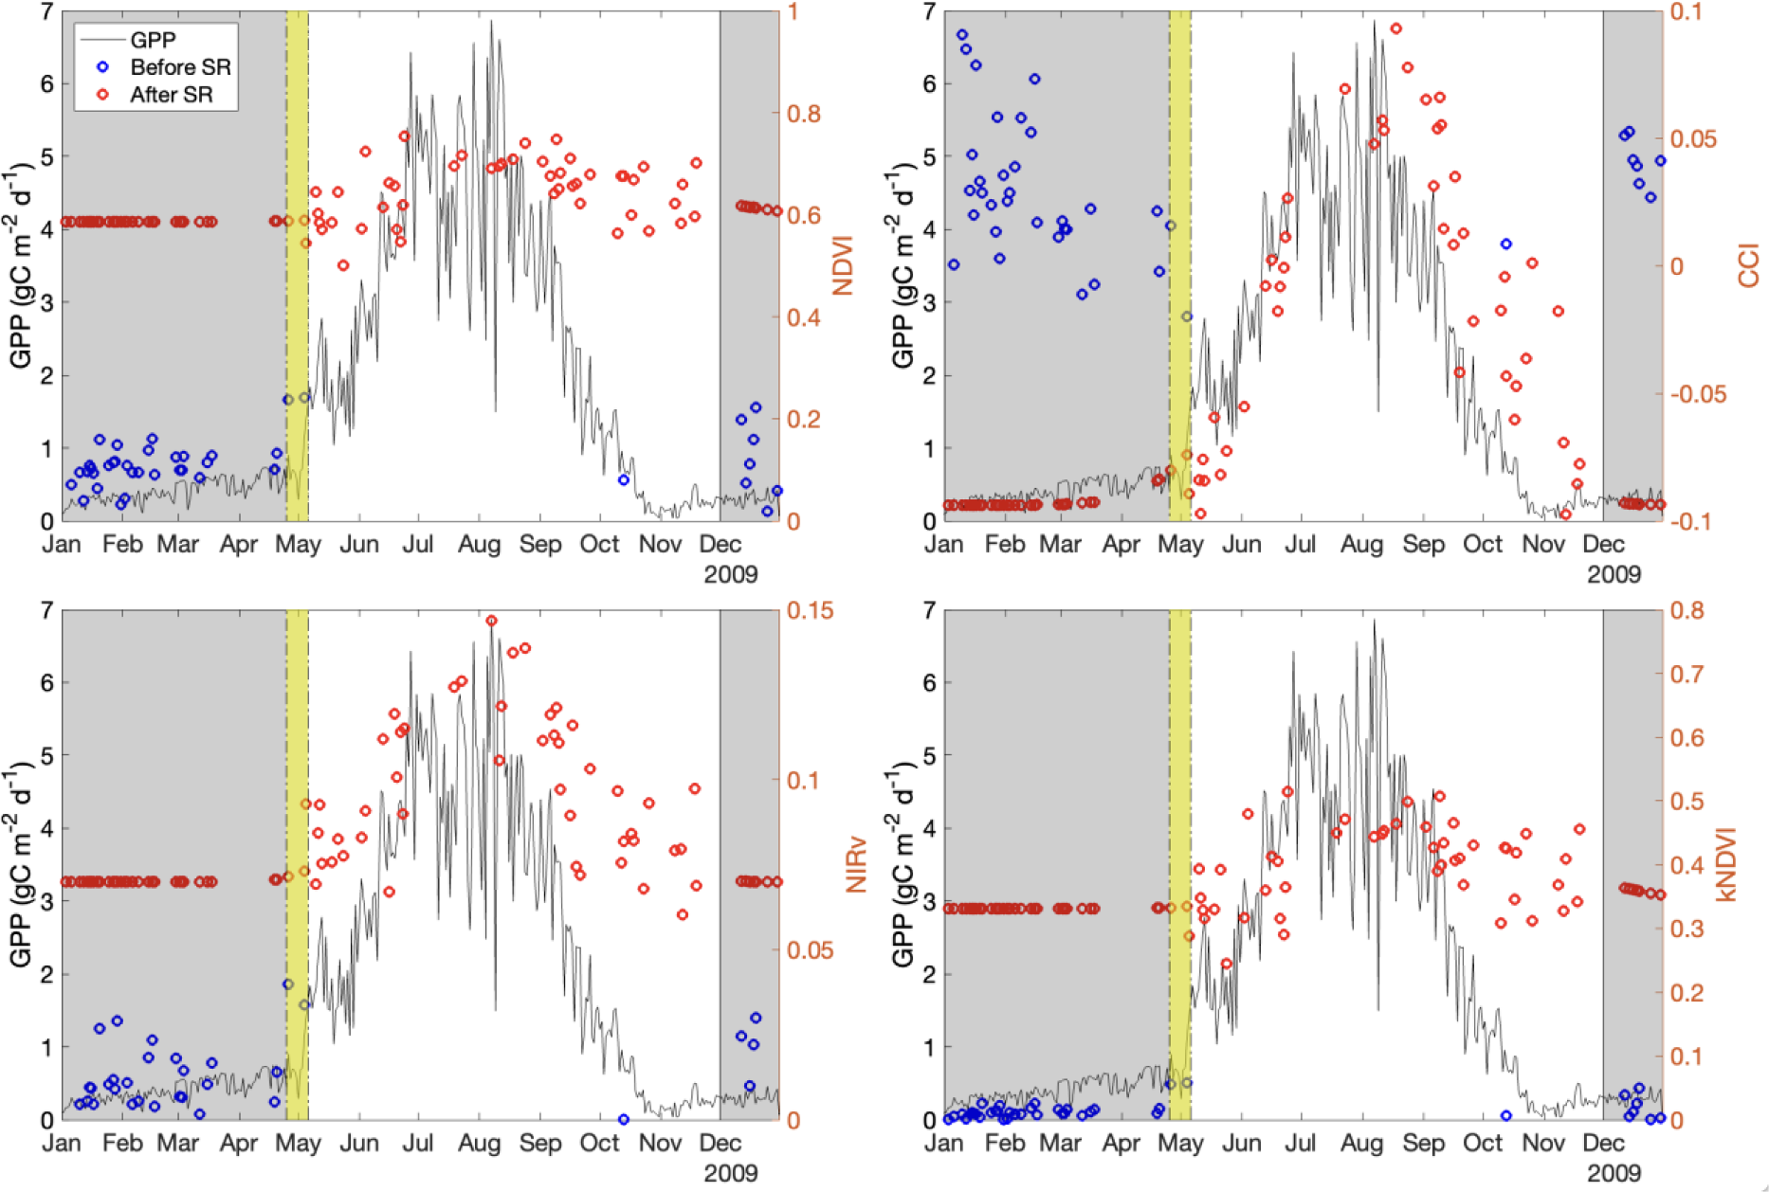
Snow-corrected vegetation indices for improved gross primary productivity assessment in North American evergreen forests Wang R, Bowling DR, Gamon JA, Smith KR, Yu R, Hmimina G, Masahito U, Noormets A, Kolb TE, Richardson AD, Bourque CPA, Bracho R, Blanken PD, Black TA, Arain MA (2023). Agricultural and Forest Meteorology. 340:109600. https://doi.org/10.1016/j.agrformet.2023.109600.
Method: MODIS MAIAC data were used to derive vegetation indices (NDVI, NIRv, kNDVI, and CCI) and evaluate snow effects on both indices and their relationship with GPP (derived from 47 Ameriflux sites in North America).
Results:
Fig. 1. Geographic scope of study, showing locations of 47 evergreen forest flux tower sites used in the analysis.
Background: Numerous satellite studies have shown trends in vegetation indices that are also used to infer changing vegetation productivity. Interpretation of these indices can be problematic for evergreen forests leading to alternative indices, however independent studies suggest that all reflectance indices can be also confounded by snow, reducing their utility for GPP assessment.
Research Question: How do different vegetation indices perform as indicators of GPP in evergreen forests? To what extent are these indices confounded by snow, and how well can snow correction improve GPP assessment?
Fig. 3. Snow cover (orange points) led to significant artifacts in relationships between vegetation indices and GPP. Snow-free points (blue) altered the correlations between vegetation indices and GPP. Snow removal improved the correlation between GPP and CCI, leading to an improved result for this pigment index. Snow removal reduced the correlation between GPP and greenness indices (NDVI, NIRv and kNDVI), indicating that much of the seasonal correlation with GPP was an artifact of snow cover, not a true biological effect.
Fig. 2. All vegetation indices were strongly affected by snow (grey periods), and snow removal (SR) altered the index values. Snow enhanced the seasonal contrasts of greenness-based indices (NDVI, NIRv and kNDVI) and suppressed the seasonal contrasts of the pigment index (CCI)
Significance: This study demonstrates that vegetation index-GPP correlations can be confounded by snow. Snow removal reveals the underlying biological relationships with GPP.
Acknowledgement: Supported by the Macrosystems Biology and NEON-Enabled Science (award 1926090) and Division of Environmental Biology programs (award 1929709) to DRB and JAG and NASA Arctic-Boreal Vulnerability Experiment grant (NNX15AT78A) to JAG.

