Slide 1
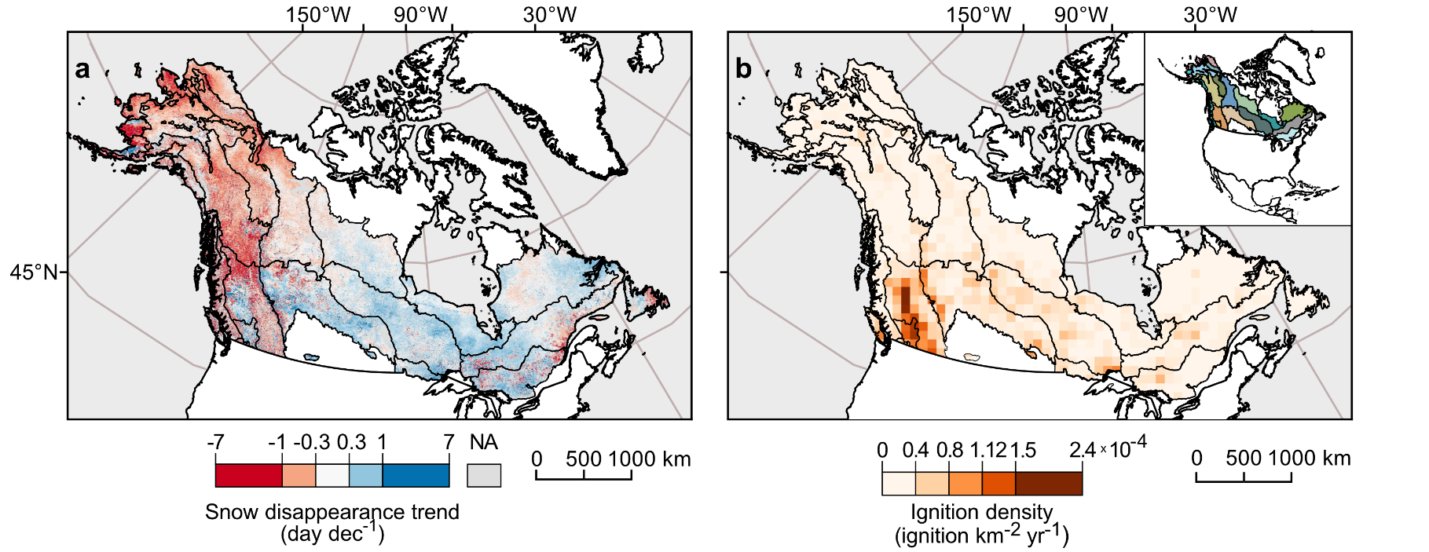
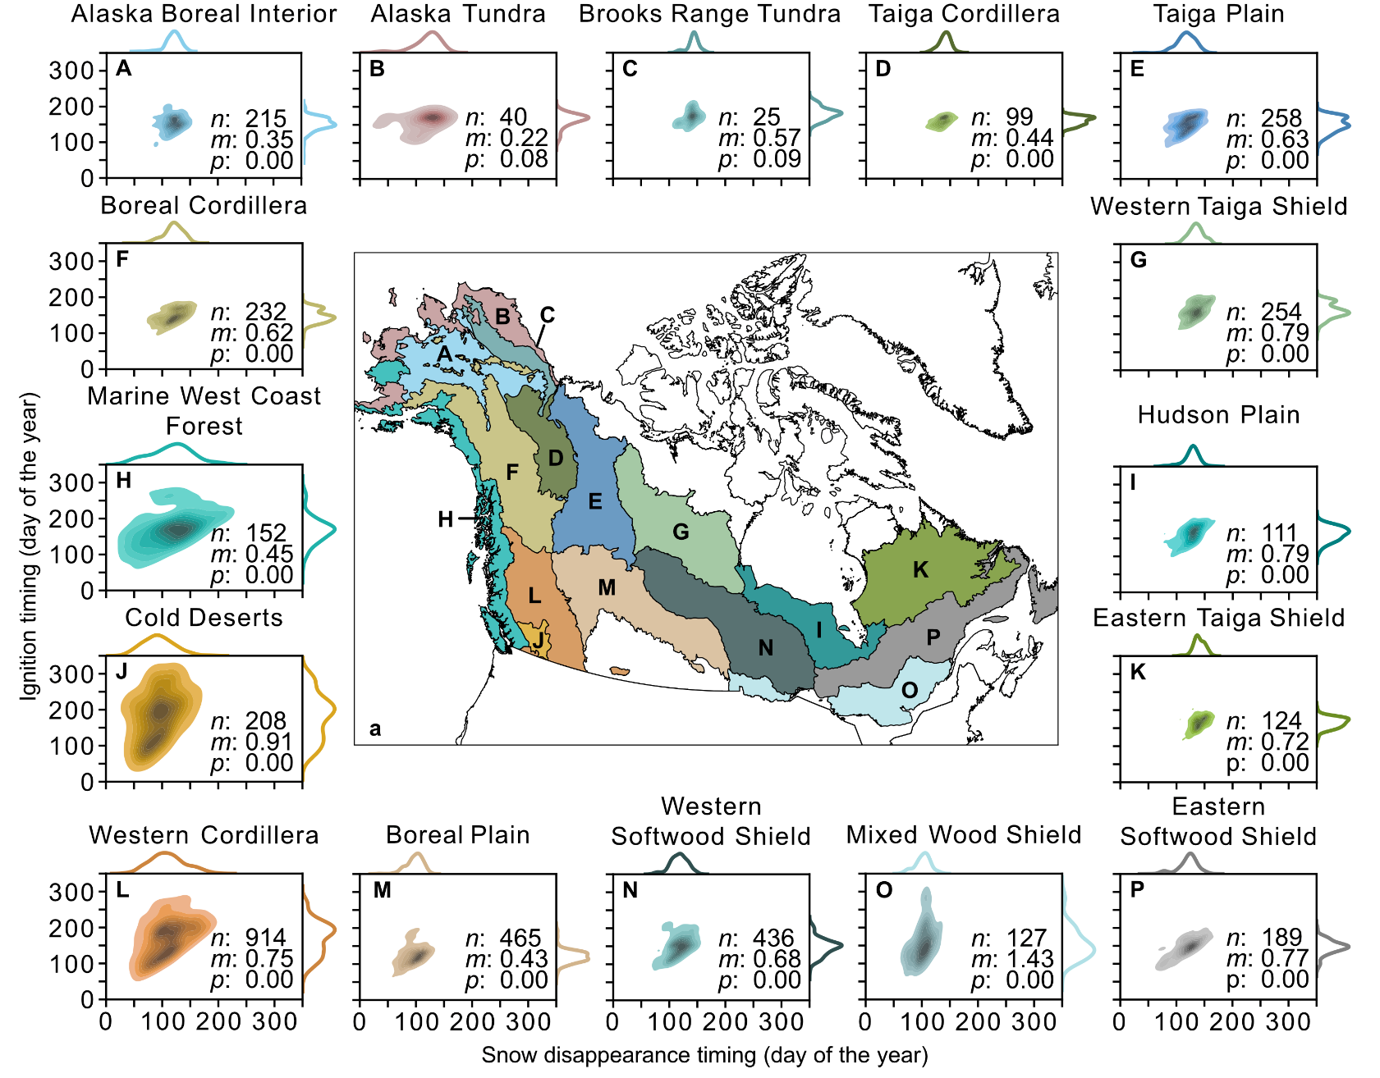
Geographically divergent trends in snow disappearance timing and fire ignitions across boreal North America
Hessilt, T.D., Rogers, B.M., Scholten, R.S., Potter, S., Janssen, T.A.J. & Veraverbeke, S. (2024) Biogeosciences https://doi.org/10.5194/bg-21-109-2024
Background:
Snow cover and forest fires are important drivers in shaping the boreal forests of North America, and may change substantially under future warming. Currently, the temporal changes and effects of earlier snow disappearance on both the timing of the fire season and size of fires are largely unknown.
Methods:
We calculated the annual snow disappearance timing from Moderate Resolution Imaging Spectroradiometer (MODIS) between 2001 and 2019.
Using the ABoVE Fire Emission Database (Potter et al., 2023), we retrieved the ignition timing for each fire detected between 2001 and 2019.
We then matched snow disappearance timing with the ignitions spatiotemporally and their respective burned area.
(A)
(A) Trends snow disappearance timing and (b) mean annual ignition density Trends and ignition density (100x100km) were retrieved from MODIS between 2001-2019 for second-level ecoregions
Findings:
We find that snow disappearance timing and the number of ignitions show spatially divergent trends (increase in western boreal North America and decrease in eastern boreal North America). Nonetheless, earlier snow disappearance timing resulted in earlier ignition timing across all of boreal North America between 2001 and 2019.
Similarly, prolonging snow-free seasons (7.1 day decade⁻¹) in western boreal North America resulted in a lengthening of the fire season (5.8 day decade⁻¹), while opposite in eastern boreal North America (snow-free: -7.3 day decade⁻¹, fire season: 18.2 day decade⁻¹). The length of the two seasons were highly correlated (r: 0.76, p < 0.01).
The earliest 20 % of ignitions across boreal North America resulted in more than 40 % of the total burned area.
Significance:
Snow disappearance timing is an important driver of fire ignition timing that also controls the fire season length.
Early-ignited fires grew larger compared to late-ignited fires sizes.
(B)
(B) Ecoregional snow disapper-rance to ignition timing relation-ships Relationship between snow disappearance and ignition timing for all ignitions of the annual 20th percentile of the ignition timing distribution per ecoregion and their density plots (A–P). The number of ignitions (n), the slope (m), and the significance level (p) are indicated for each ecoregion
Notes:
Full citation: Hessilt, T. D., Rogers, B. M., Scholten, R. C., Potter, S., Janssen, T. A. J., and Veraverbeke, S.: Geographically divergent trends in snow disappearance timing and fire ignitions across boreal North America, Biogeosciences, 21, 109–129, https://doi.org/10.5194/bg-21-109-2024
Grants:
This work was carried out under the umbrella of the Netherlands Earth System Science Centre (NESSC). This project has received funding from the European Union's Horizon 2020 research and innovation program under Marie Skłodowska-Curie grant agreement no. 847504. This work was carried out under the umbrella of the Netherlands Earth System Science Centre (NESSC). This project has received funding from the European Union’s Horizon 2020 research and innovation program under Marie Skłodowska-Curie grant agreement no. 847504. The contribution of Rebecca C. Scholten was partly funded by the Dutch Research Council through Vidi grant 016.Vidi.189.070 awarded to Sander Veraverbeke. The contribution of Rebecca C. Scholten and Thomas A. J. Janssen was funded by the European Research Council through a Consolidator grant under the European Union’s Horizon 2020 research and innovation program (grant agreement no. 101000987) awarded to Sander Veraverbeke. Brendan M. Rogers acknowledges funding from the NASA Arctic–Boreal Vulnerability Experiment (NNX15AU56A), funding from the Gordon and Betty Moore Foundation (grant no. 8414), and funding catalyzed through the Audacious Project.
Abstract: The snow cover extent across the Northern Hemisphere has diminished, while the number of lightning ignitions and amount of burned area have increased over the last 5 decades with accelerated warming. However, the effects of earlier snow disappearance on fire are largely unknown. Here, we assessed the influence of snow disappearance timing on fire ignitions across 16 ecoregions of boreal North America. We found spatially divergent trends in earlier (later) snow disappearance, which led to an increasing (decreasing) number of ignitions for the northwestern (southeastern) ecoregions between 1980 and 2019. Similar northwest–southeast divergent trends were observed in the changing length of the snow-free season and correspondingly the fire season length. We observed increases (decreases) over northwestern (southeastern) boreal North America which coincided with a continental dipole in air temperature changes between 2001 and 2019. Earlier snow disappearance induced earlier ignitions of between 0.22 and 1.43 d earlier per day of earlier snow disappearance in all ecoregions between 2001 and 2019. Early-season ignitions (defined by the 20 % earliest fire ignitions per year) developed into significantly larger fires in 8 out of 16 ecoregions, being on average 77 % larger across the whole domain. Using a piecewise structural equation model, we found that earlier snow disappearance is a good direct proxy for earlier ignitions but may also result in a cascade of effects from earlier desiccation of fuels and favorable weather conditions that lead to earlier ignitions. This indicates that snow disappearance timing is an important trigger of land–atmosphere dynamics. Future warming and consequent changes in snow disappearance timing may contribute to further increases in western boreal fires, while it remains unclear how the number and timing of fire ignitions in eastern boreal North America may change with climate change.

