Slide 1
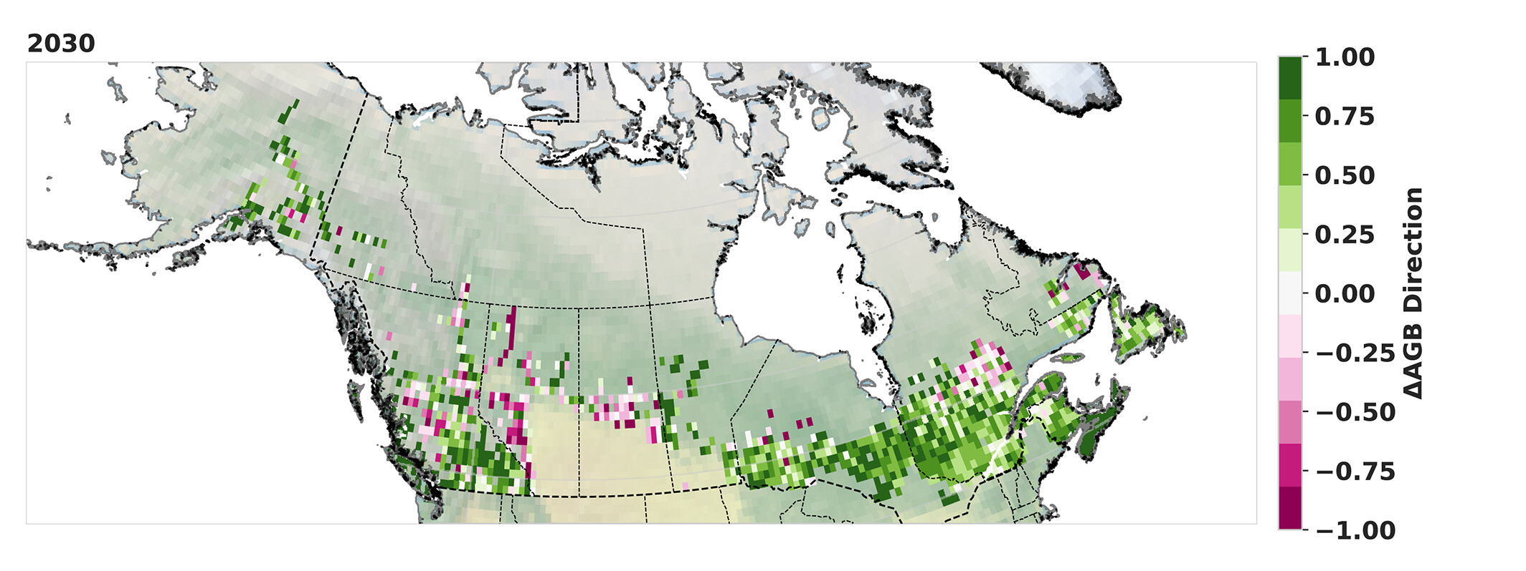
The predictability of near-term forest biomass change in boreal North America.
Burrell et al., (2024) Ecosphere https://doi.org/10.1002/ecs2.4737
Background:
Climate change is driving substantial changes in North American boreal forests, including changes in productivity, mortality, recruitment, and biomass. Despite the importance for carbon budgets and informing management decisions, there is a lack of near-term (5–30 year) forecasts of expected changes in aboveground biomass (AGB)
Methods:
We built a database of 25,000 forest inventory sites repeat measurements along with gridded geospatial datasets.
Using this database, we trained an ensemble of extreme gradient boosted machine learning models to forecast AGB changes across the North American boreal forest
We then applied SHAP value analysis to integrate model performance and behaviour
(a)
(a) ML Model Performance heatmap. Binned heatmap shows the predicted versus observed values for the multi-model ensemble.
Findings:
We find that AGB change can be predicted up to 30 years into the future, and that training on sites across the entire domain allows accurate predictions even in regions with only a small amount of existing field data.
While predicting AGB loss is less skillful than gains, using a multi-model ensemble can improve the accuracy in detecting change direction to >90% for AGB increases and 70% for AGB losses.
Higher stem density, winter temperatures, and the presence of temperate tree species in forest plots were positively associated with AGB change, whereas greater initial biomass, continentality (difference between mean summer and winter temperatures), prevalence of black spruce (Picea mariana), were negatively associated with AGB change.
Across the domain, we predict non disturbance-induced declines in AGB at 23% of sites by 2030.
Significance:
The approach developed here can be used to estimate near-future forest biomass in boreal North America and inform relevant management decisions.
(b)
(b) Future direction of Biomass change. The directional agreement of sites in a 1° × 1° box where the site withholding ensemble multi-model mean predicts an increase in aboveground biomass (AGB) to 2030. A value of 1 indicates all sites had predicted increases in AGB, whereas −1 indicates all sites had predicted decreases in AGB.
Notes:
Full citation: Burrell, A.L., Cooperdock, S., Potter, S., Berner, L.T., Hember, R., Macander, M.J., Walker, X.J., Massey, R., Foster, A.C., Mack, M.C., Goetz, S.J., Rogers, B., 2024. The predictability of near-term forest biomass change in boreal North America. Ecosphere 15, e4737. https://doi.org/10.1002/ecs2.4737
Grants: This work was funded the National Aeronautics and Space Administration (NASA) Arctic-Boreal Vulnerability Experiment (ABoVE) grants NNX17AE44G and 80NSSC19M01 and the Department of Defense Strategic Environmental Research and Development Program (SERDP) contract RC18-1183. We thank the work force involved in planning, collecting, and managing forest inventories, as well access to the inventory data, including the Cooperative Alaska Forest Inventory program run by the United States Department of Agriculture Forest Service and Canadian Provincial agencies including the British Columbia Ministry of Forests, Lands, Natural Resource Operations and Rural Development, Alberta Agriculture and Forestry, Saskatchewan Ministry of Environment Forest Service, Manitoba Conservation and Water Stewardship, Government of the Northwest Territories Department of Environment and Natural Resources, Government of Yukon Forest Management Branch, Ontario Ministry of Natural Resources and Forestry, Ministére des ressources naturelles du Québec, Nova Scotia Department of Natural Resources, New Brunswick Department of Energy and Resource Development, and the Newfoundland and Labrador Department of Fisheries, Forestry, and Agriculture. We also thank the NVIDA Academic Hardware Grant for providing hardware used in this analysis.
Abstract: Climate change is driving substantial changes in North American boreal forests, including changes in productivity, mortality, recruitment, and biomass. Despite the importance for carbon budgets and informing management decisions, there is a lack of near term (5-30 year) forecasts of expected changes in aboveground biomass (AGB). In this study, we forecast AGB changes across the North American boreal forest using machine learning, repeat measurements from 25,000 forest inventory sites, and gridded geospatial datasets. We find that AGB change can be predicted up to 30 years into the future, and that training on sites across the entire domain allows accurate predictions even in regions with only a small amount of existing field data. While predicting AGB loss is less skilful than gains, using a multi-model ensemble can improve the accuracy in detecting change direction to >90% for observed increases, and up to 70% for observed losses. Higher stem density, winter temperatures, and the presence of temperate tree species in forest plots was positively associated with AGB change, whereas greater initial biomass, continentality (difference between mean summer and winter temperatures), prevalence of black spruce (Picea mariana), summer precipitation, and early warning metrics from long-term remote sensing time series were negatively associated with AGB change. Across the domain, we predict non-disturbance induced declines in AGB at 23% of sites by 2030. The approach developed here can be used to estimate near-future forest biomass in boreal North America and inform relevant management decisions. Our study also highlights the power of machine learning multi-model ensembles when trained on a large volume of forest inventory plots, which could be applied to other regions with adequate plot density and spatial coverage.

