Slide 1
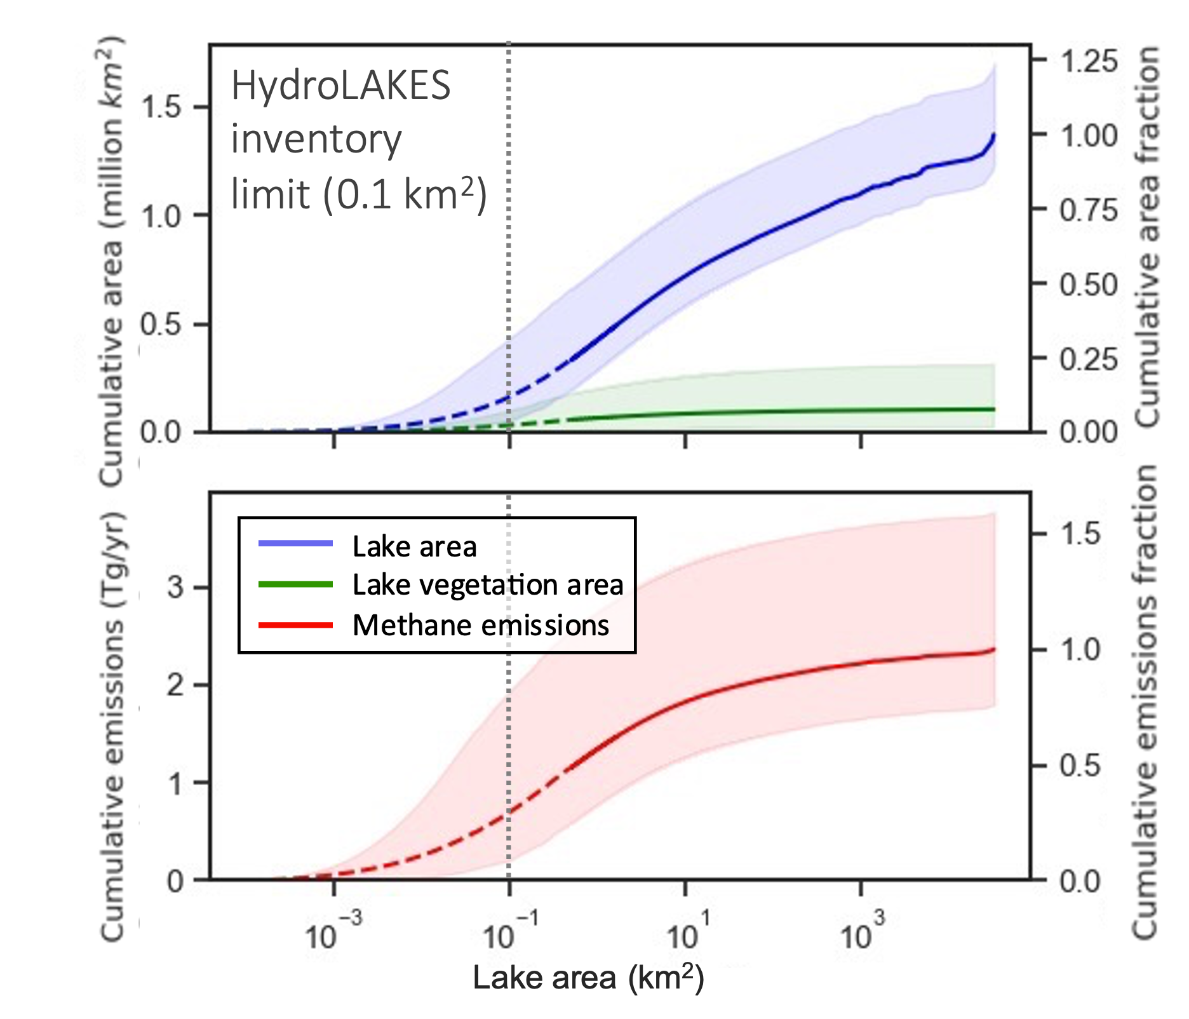
Small lakes are less abundant in the Arctic than previously thought, lowering estimated emissions
Kyzivat, E.D., & Smith, L.C. (2023), GRL, doi:10.1029/2023GL104825
Findings
Non-inventoried small lakes < 0.1 km² are less prevalent than thought (12% of lake area)
Very small ponds <0.001 km² in area are believed to contribute ~40% of lake methane emissions, but we surprisingly find they contribute only 3%.
Double-counting between lakes and wetlands is still prevalent and comprises 11% of lake area
High-resolution remote sensing to 0.001 km² would eliminate virtually all uncertainty.
Significance
Findings match independent measurements of atmospheric methane (top-down models) that have contributed to a longstanding problem of model disagreement.
Implication that previous global lake methane estimates are too high due to over-extrapolation of small lake areas.
Non-inventoried small lakes comprise only 12% of lake area
8% lake aquatic vegetation coverage
… and 30% of methane emissions
Above: Cumulative areas of lakes, lake aquatic vegetation, and associated methane emissions, compared to global lake inventory limit
Background
Arctic lakes are a climate-sensitive source of methane
Emissions from small lakes are uncertain because they are missing from inventories, and often contain wetland vegetation
Analysis
Bottom-up, scaling estimate of pan-Arctic lake methane emissions using high-resolution lake areas from ABoVE datasets
Notes:
NASA resources and products used:
AirSWOT color-infrared camera water mask dataset from ABoVE 2017 airborne campaign (Kyzivat et al. 2019)
UAVSAR L-band lake and wetland map from ABoVE airborne campaigns (Kyzivat et al. 2021)
ABoVE Planet-derived high-resolution lake maps (Mullen et al., 2022)
Paper abstract: Lake methane emissions are commonly upscaled from lake area, with recognition that smaller, non-inventoried lakes emit more per unit area. There is also growing awareness of the importance of lake aquatic vegetation and potential “double-counting” with wetlands, but lack of consensus on which is most impactful. Here, we combine high-resolution data with the comprehensive lake inventory HydroLAKES to rank these three variables based on emissions sensitivity. Including non-inventoried small lakes <0.1 km2 (+30 [range: 9.0 to 82]% change) is greatest, followed by double-counting (−20 [−11 to −34]%) and lake aquatic vegetation (+14 [2.7 to 43]%). Significantly, emissions from non-inventoried lakes contribute far less than the ∼40% previously determined globally through statistical area extrapolation. We produce a first pan-Arctic estimate of lake aquatic vegetation in 1.37 million km2 of lakes, but after correcting for persistent double-counting, its net effect is to decrease emissions estimates by 9%. Thus, previous global emissions estimates are likely too high.
Plain language summary: Lakes are the second-largest natural source of methane, after wetlands. Here, we assess the relative importance of three poorly constrained parameters known to be sources of error in lake methane estimates: lake area distribution, lake aquatic vegetation, and “double-counting” with wetlands. We use newly available high-resolution data to estimate the total areas of mapped and unmapped lakes and produce a first estimate of Arctic lake aquatic vegetation. Our Arctic study domain contains 40% of global lake area and has been emphasized in previous lake methane emission studies. Surprisingly, we find that small, unmapped lakes are far less abundant than thought. In particular, very small ponds <0.001 km² in area are believed to contribute ~40% of lake methane emissions, but we find they contribute only 3%. Although vegetated zones, known emissions hotspots, cover 8% of Arctic lakes, their effect is more than offset by potential wetland double-counting still present in estimates. These findings can help reduce uncertainty by comparing the relative effects of lake area, lake aquatic vegetation, and double-counting and suggest that previous emissions estimates are too high. New maps based on ample high-resolution data from existing satellites could definitively reveal the area of small lakes at the global scale.

Slide 2
Notes
Citation:
Kyzivat, E. D., Smith, L. C. 2023. A Closer Look at the Effects of Lake Area, Aquatic Vegetation, and Double-Counted Wetlands on Pan-Arctic Lake Methane Emissions Estimates. Geophysical Research Letters. 50(24). DOI: 10.1029/2023GL104825
Award Information:
This work was supported by a Future Investigators in NASA Earth and Space Science and Technology (FINESST) fellowship managed by Kathleen Hibbard (Grant 80NSSC19K1361), NASA Terrestrial Ecology grants managed by Hank Margulis (Grants 80NSSC19M0104 and 80NSSC22K1237), and the Reginald A. Daly Postdoctoral Fellowship at the Harvard Department of Earth and Planetary Sciences.

