Slide 1
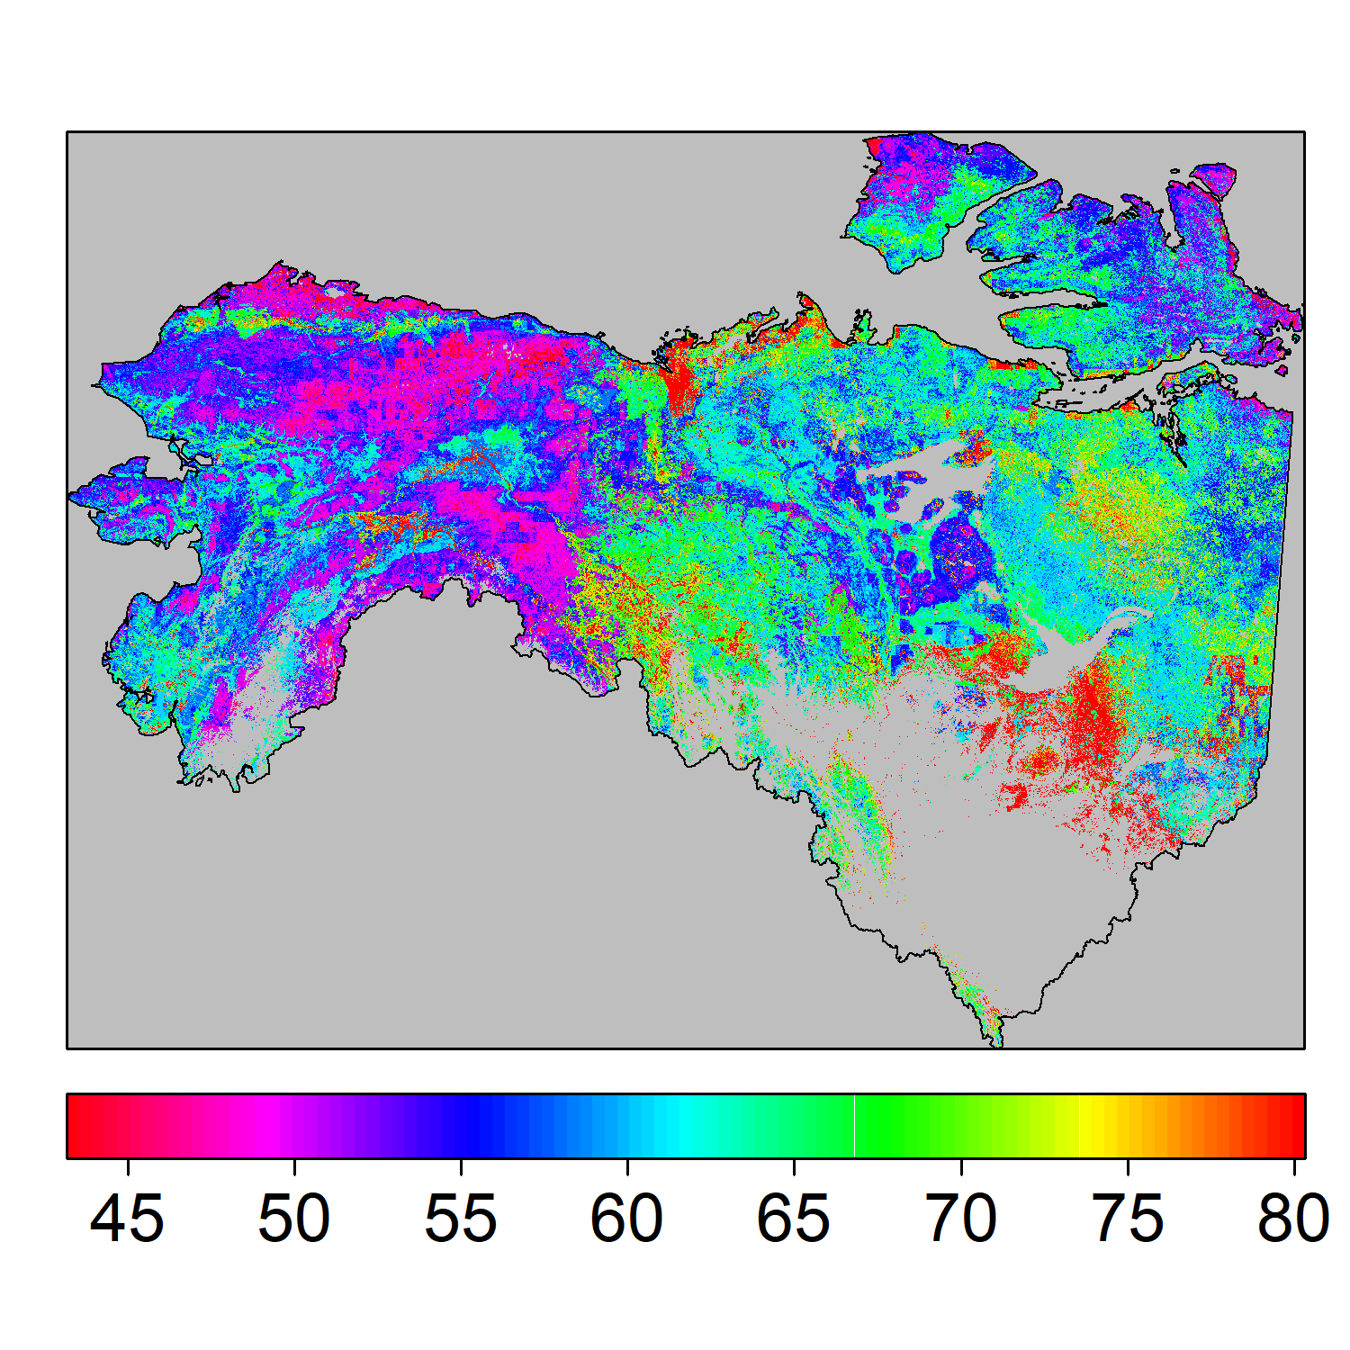
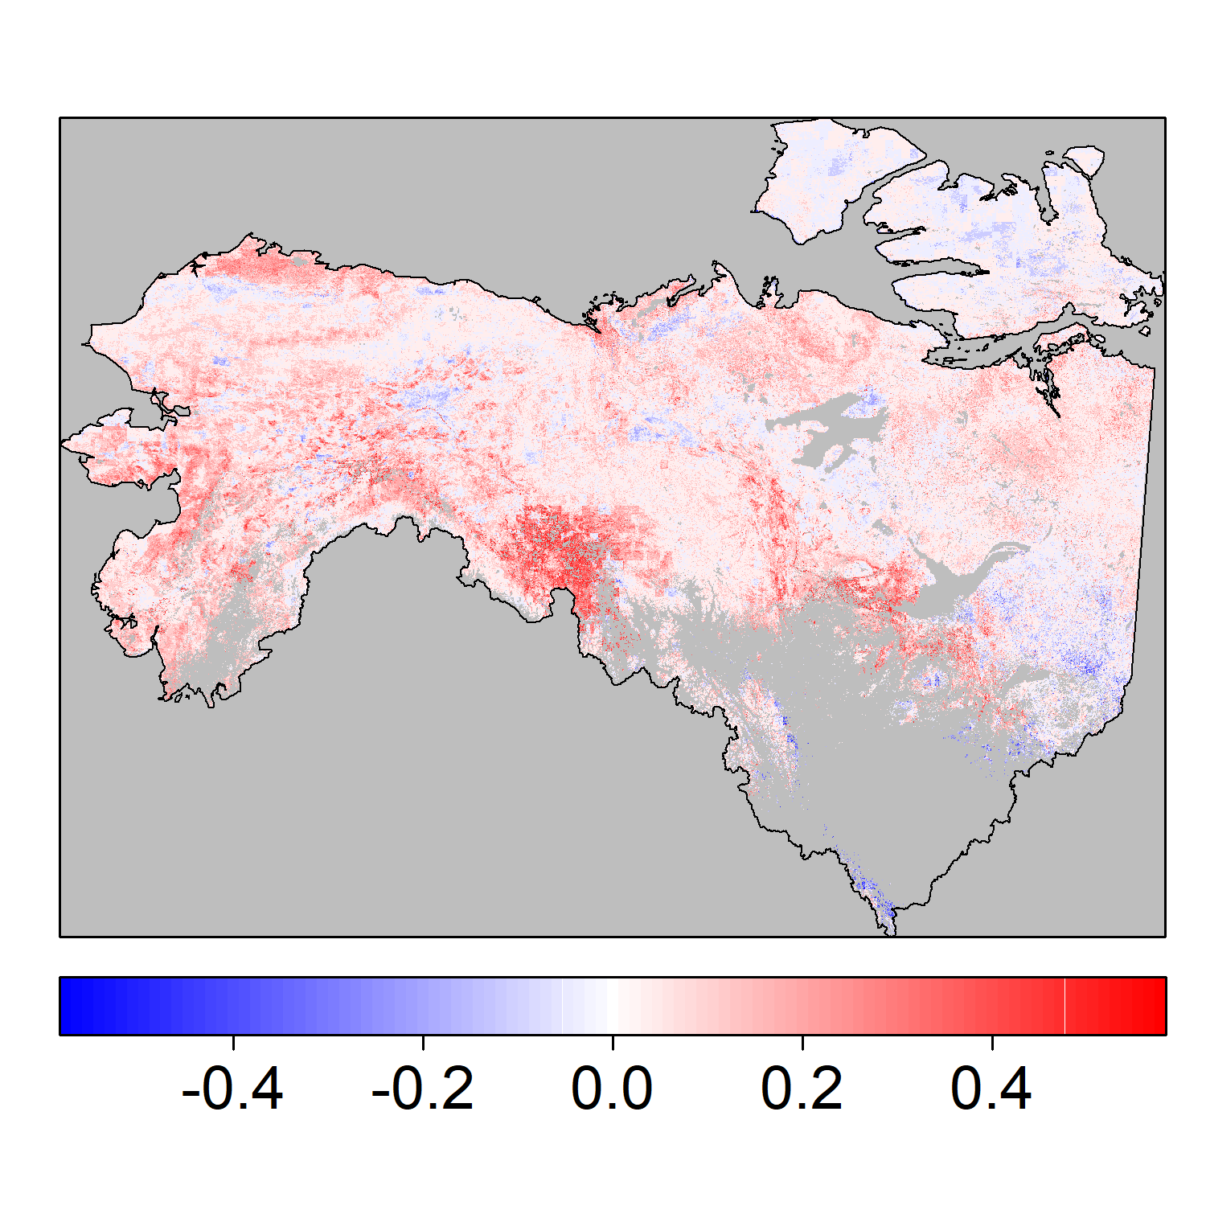
Extensive thaw-driven active layer deepening in northern permafrost regions from 2003-2020
Liu, Kimball, Ballantyne, Watts, Natali, Rogers, Yi, Klene, Moghaddam, Du, 2023. ERL, DOI:10.1088/1748-9326/ad0f73
Problem: The seasonally thawed soil active layer thickness (ALT) overlying permafrost may be deepening from enhanced thawing due to global warming, with major impacts to Arctic-boreal ecosystems, communities, and climate feedbacks. However, our understanding of landscape level (1-km Res.) ALT trends is limited by sparse and inconsistent monitoring in the vast northern permafrost region (NPR).
Methods: We used Machine Learning (ML) models developed and validated from regionally extensive in situ ALT measurements (2966 site-years), and driven by a suite of complimentary satellite data to predict ALT annual trends from 2003 to 2020 over the NPR, including the NASA ABoVE domain in AK and NW Canada (right).
Results: Favorable ML accuracy vs CALM site network ALT measurements (R²: 0.97, Bias: 4.02 cm); Significant ALT deepening from 0.29 to 0.81 cm/yr (25 - 75% quantile) found in 65% of the NPR. Landscape controls on ALT stability include terrain complexity, soil organic content, soil moisture, and LST.
Significance: New observation constrained ALT record with enhanced (1-km) resolution and performance for understanding the progression and drivers of thawing in the NPR.
ALT mean (cm)
ALT trend (cm/yr)
Estimated ALT mean (top) & trend (bottom) from 2003-2020 over AK and NW Canada; non-permafrost areas are masked (in grey).
Notes:
Full Citation: Liu, Z., J.S. Kimball, A.P. Ballantyne, J.D. Watts, S.M. Natali, B.M. Rogers, Y. Yi, A.E. Klene, M. Moghaddam, J. Du, and D. Zona, 2023. Widespread deepening of the active layer in northern permafrost regions from 2003 to 2020. Environmental Research Letters, DOI 10.1088/1748-9326/ad0f73.
Acknowledgements: Portions of this work were conducted at the University of Montana with funding provided from NASA (80NSSC19M0114, 80NSSC22K1238). JDW, SN, BR acknowledge funding from the Gordan and Betty Moore Foundation (Award 8414).
Data availability: All data analyzed in this study are publicly available. The ML derived ALT dataset for the NPR domain has been submitted to the NASA ORNL DAAC for public access.
Abstract: The changing thermal state of permafrost is an important indicator of climate change in northern high latitude ecosystems. The seasonally thawed soil active layer thickness (ALT) overlying permafrost may be deepening as a consequence of enhanced polar warming and widespread permafrost thaw in northern permafrost regions (NPR). The associated increase in ALT may have cascading effects on ecological and hydrological processes that impact climate feedback. However, past NPR studies have only provided a limited understanding of the spatially continuous patterns and trends of ALT due to a lack of long-term high spatial resolution ALT data across the NPR. Using a suite of observational biophysical variables and machine learning (ML) techniques trained with available in situ ALT network measurements (n = 2966 site-years), we produced annual estimates of ALT at 1-km resolution over the NPR from 2003 to 2020. Our ML-derived ALT dataset showed high accuracy (R2 = 0.97) and low bias when compared with in situ ALT observations. We found the ALT distribution to be most strongly affected by local soil properties, followed by topographic elevation and land surface temperatures. Pair-wise site-level evaluation between our data-driven ALT with Circumpolar Active Layer Monitoring (CALM) data indicated that about 80% of sites had a deepening ALT trend from 2003 to 2020. Based on our long-term gridded ALT data, about 65% of the NPR showed a deepening ALT trend, while the entire NPR showed a mean deepening trend of 0.11 ± 0.35 cm/yr [25% - 75% quantile: (-0.035, 0.204) cm/yr]. The estimated ALT trends were also sensitive to fire disturbance. Our new gridded ALT product provides an observationally constrained, updated understanding of the progression of thawing and the thermal state of permafrost in the NPR, as well as the underlying environmental drivers of these trends.

