Slide 1
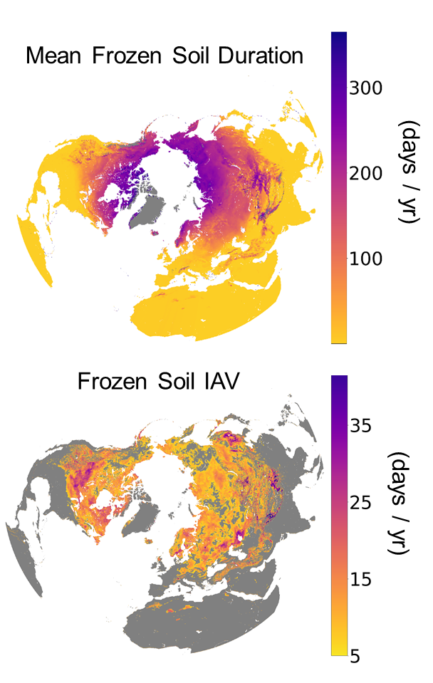
Resolving Soil Freeze-Thaw Dynamics with Satellite-Driven Deep Learning
Donahue, Kimball, Du, Bunt, Colliander, Moghaddam, et al., 2023. Front. Big Data 6: 1243559.
Problem: Satellite microwave radiometers can detect freeze/thaw (FT) related controls on soil respiration and greenhouse gas (GHG) emissions. Low frequency (L-band) sensors have enhanced soil sensitivity, but prevailing FT products don’t distinguish soil from other landscape features, leading to uncertainty about how climate change is affecting the frozen soil season and GHG emissions.
Method: AI Deep Learning (DL) models were trained on topsoil (≤5cm depth) FT observations using SMAP and AMSR2 multi-frequency TBs as key drivers. 9-km daily soil FT estimates were derived over the Northern Hemisphere from 2016-2020 and validated using soil FT observations from regional weather stations and reanalysis (ERA5).
Finding: Resulting mean annual soil FT accuracy (MA≥91%) is superior to other FT records. SMAP L-band provides enhanced soil FT sensitivity and performance gain over alternative DL results derived using only AMSR2 data. Large spatial and inter-annual variability in the frozen soil season revealed.
Impact: Better understanding of the soil FT cycle and related controls on ecosystem carbon and climate feedbacks.
Climatological mean frozen soil season and inter-annual variation (IAV) derived from the new soil FT daily record (2016-2020).
Notes:
Full citation:
Donahue, K., J.S. Kimball, J. Du, F. Bunt, A. Colliander, M. Moghaddam, J.V. Johnson, Y. Kim, and M.A. Rawlins. Deep learning estimation of northern hemisphere soil freeze-thaw dynamics using satellite multi-frequency microwave brightness temperature observations. Frontiers in Big Data 6:1243559, https://doi.org/10.3389/fdata.2023.1243559.
Abstract:
Satellite microwave sensors are well suited for monitoring landscape freeze-thaw (FT) transitions owing to the strong brightness temperature (TB) or backscatter response to changes in liquid water abundance between predominantly frozen and thawed conditions. The FT retrieval is also a sensitive climate indicator with strong biophysical importance. However, retrieval algorithms can have difficulty distinguishing the FT status of soils from that of overlying features such as snow and vegetation, while variable land conditions can also degrade performance. Here, we applied a deep learning model using a multilayer convolutional neural network driven by AMSR2 and SMAP TB records, and trained on surface (~0-5cm depth) soil temperature FT observations. Soil FT estimates were derived for the local morning (6 a.m.) and evening (6 p.m.) conditions corresponding to SMAP descending and ascending orbital overpasses, mapped to a 9-km polar grid spanning a five-year (2016-2020) record and Northern Hemisphere domain. Continuous variable estimates of the probability of frozen or thawed conditions were derived using a model cost function optimized against FT observational training data. Model results derived using combined multi-frequency (1.4, 18.7, 36.5 GHz) TBs produced the highest soil FT accuracy over other models derived using only single sensor or single frequency TB inputs. Moreover, SMAP L-band (1.4 GHz) TBs provided enhanced soil FT information and performance gain over model results derived using only AMSR2 TB inputs. The resulting soil FT record showed favorable and consistent performance against soil FT observations from ERA5 reanalysis (mean percent accuracy, MPA: 92.7%) and in situ weather stations (MPA: 91.0%). The soil FT accuracy was generally consistent between morning and afternoon predictions and across different land covers and seasons. The model also showed better FT accuracy than ERA5 against regional weather station measurements (91.0% vs 86.1% MPA). However, model confidence was lower in complex terrain where FT spatial heterogeneity was likely beneath the effective model grain size. Our results provide a high level of precision in mapping soil FT dynamics to improve understanding of complex seasonal transitions and their influence on ecological processes and climate feedbacks, with the potential to inform Earth system model predictions.
Acknowledgements:
This research was conducted at the University of Montana with funding provided by NASA (80NSSC19M0114, 80NSSC19K0649, 80NSSC18K0980, 80NSSC22K1238).
Data Availability:
The soil FT data record developed from this study is available from the NTSG online data holdings (http://www.ntsg.umt.edu/freeze-thaw/data-page/default.php) and will be archived at the NASA ORNL (DOE Oak Ridge National Laboratory) DAAC (https://daac.ornl.gov).

