Slide 1
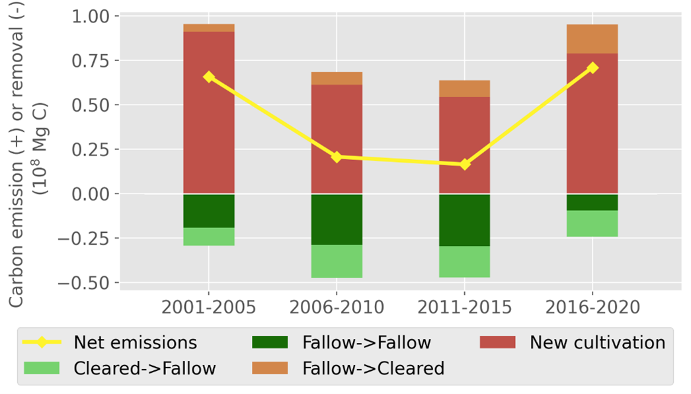
Satellite data reveals a recent increase in shifting cultivation and associated carbon emissions in Laos
Chen et al. (2023). Environmental Research Letters, 18(11), 114012.
Science Question
How to monitor shifting cultivation using satellite data?
How did shifting cultivation practice change over time?
How do we track carbon emissions from shifting cultivation over time?
What are the carbon emissions and sequestration associated with shifting cultivation?
Analysis
Used Landsat to monitor shifting cultivation in Laos.
Combined Landsat-derived products and GEDI to track carbon emissions.
Results
Shifting cultivation activities increased in Laos.
Carbon emissions from shifting cultivation increased in Laos.
Conversion from intact forests to shifting cultivation (New shifting cultivation) is the largest carbon source.
Significance
We created the first 30-meter shifting cultivation map in Laos.
We tracked carbon emissions from shifting cultivation in Laos nationally for the first time.
The method can potentially used in other countries with shifting cultivation.
Our study highlighted the importance of including shifting cultivation systems in carbon accounting.
Acknowledgements
This research was supported by the NASA Carbon Monitoring System (NNH18ZDA001N-CMS) under NASA Award number 80NSSC20K0022.
Carbon emissions and removals associate with shifting cultivation in Laos

