Slide 1
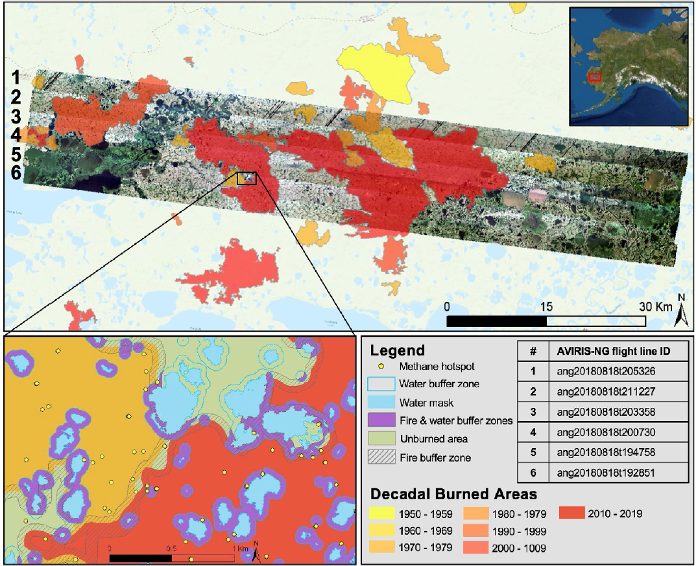
Tundra fire increases the likelihood of methane hotspot formation in the Yukon–Kuskokwim (YK) Delta, Alaska, USA Yoseph, E., Hoy, E., Elder, C., Ludwig, S., Thompson, D. and C. Miller 2023 Environ. Res. Lett. 18 104042 [10.1088/1748-9326/acf50b]
Background
The YK Delta is a regional hotspot for CH₄ emissions; however, few studies have operated at scales able to determine the influence of fire on process-level carbon dynamics and gas emissions.
Analysis
We utilized high-resolution (∼25 m² pixels) AVIRIS-NG airborne imaging spectroscopy (from JPL) to determine whether CH₄ hotspots were more likely in areas burned within the last 50 years.
Results
CH4 hotspots are roughly 29% more likely on average in tundra that burned within the last 50 years compared to unburned areas and that this effect is nearly tripled along burn scar perimeters that are delineated by surface water features.
Significance
We conclude that enhanced CH₄ emissions following tundra fire represent a positive feedback that will accelerate climate warming, tundra fire occurrence, and future permafrost carbon loss to the atmosphere.
Figure Caption
Top: YK Delta study region with AVIRIS-NG flight line imagery. The red box in the inset map shows the location of the study region within Alaska. Bottom: a detailed view of YK Delta study area showing CH4 hotspots (yellow dots) amongst the complex interface between lakes (blue), fire buffer zones (hashing), combined fire/water buffer zones (purple), a 2015 burned region (deep red), a burn from the 1970s (orange), and unburned areas (light green) all within a few hundred meters.
Notes:
This slide contains a sample of the contents of an MSR Slide that we suggest

Slide 2
Notes
Citation:
Yoseph, E., E. Hoy, C. D. Elder, et al. 2023. "Tundra fire increases the likelihood of methane hotspot formation in the Yukon–Kuskokwim Delta, Alaska, USA." Environmental Research Letters, 18 (10): 104042 [10.1088/1748-9326/acf50b]
Award Information:
This research was supported by the NASA Terrestrial Ecology Arctic-Boreal Vulnerability Experiment (ABoVE); the NASA summer internship program; the Carbon Cycle and Ecosystems Office; the Jet Propulsion Laboratory, California Institute of Technology, under a contract
with NASA (80NM0018D0004); a NASA FINESST Grant (80NSSC19K1301); and the NASA
High-End Computing (HEC) Program through the NASA Center for Climate Simulation (NCCS) at Goddard Space Flight Center.

