Slide 1
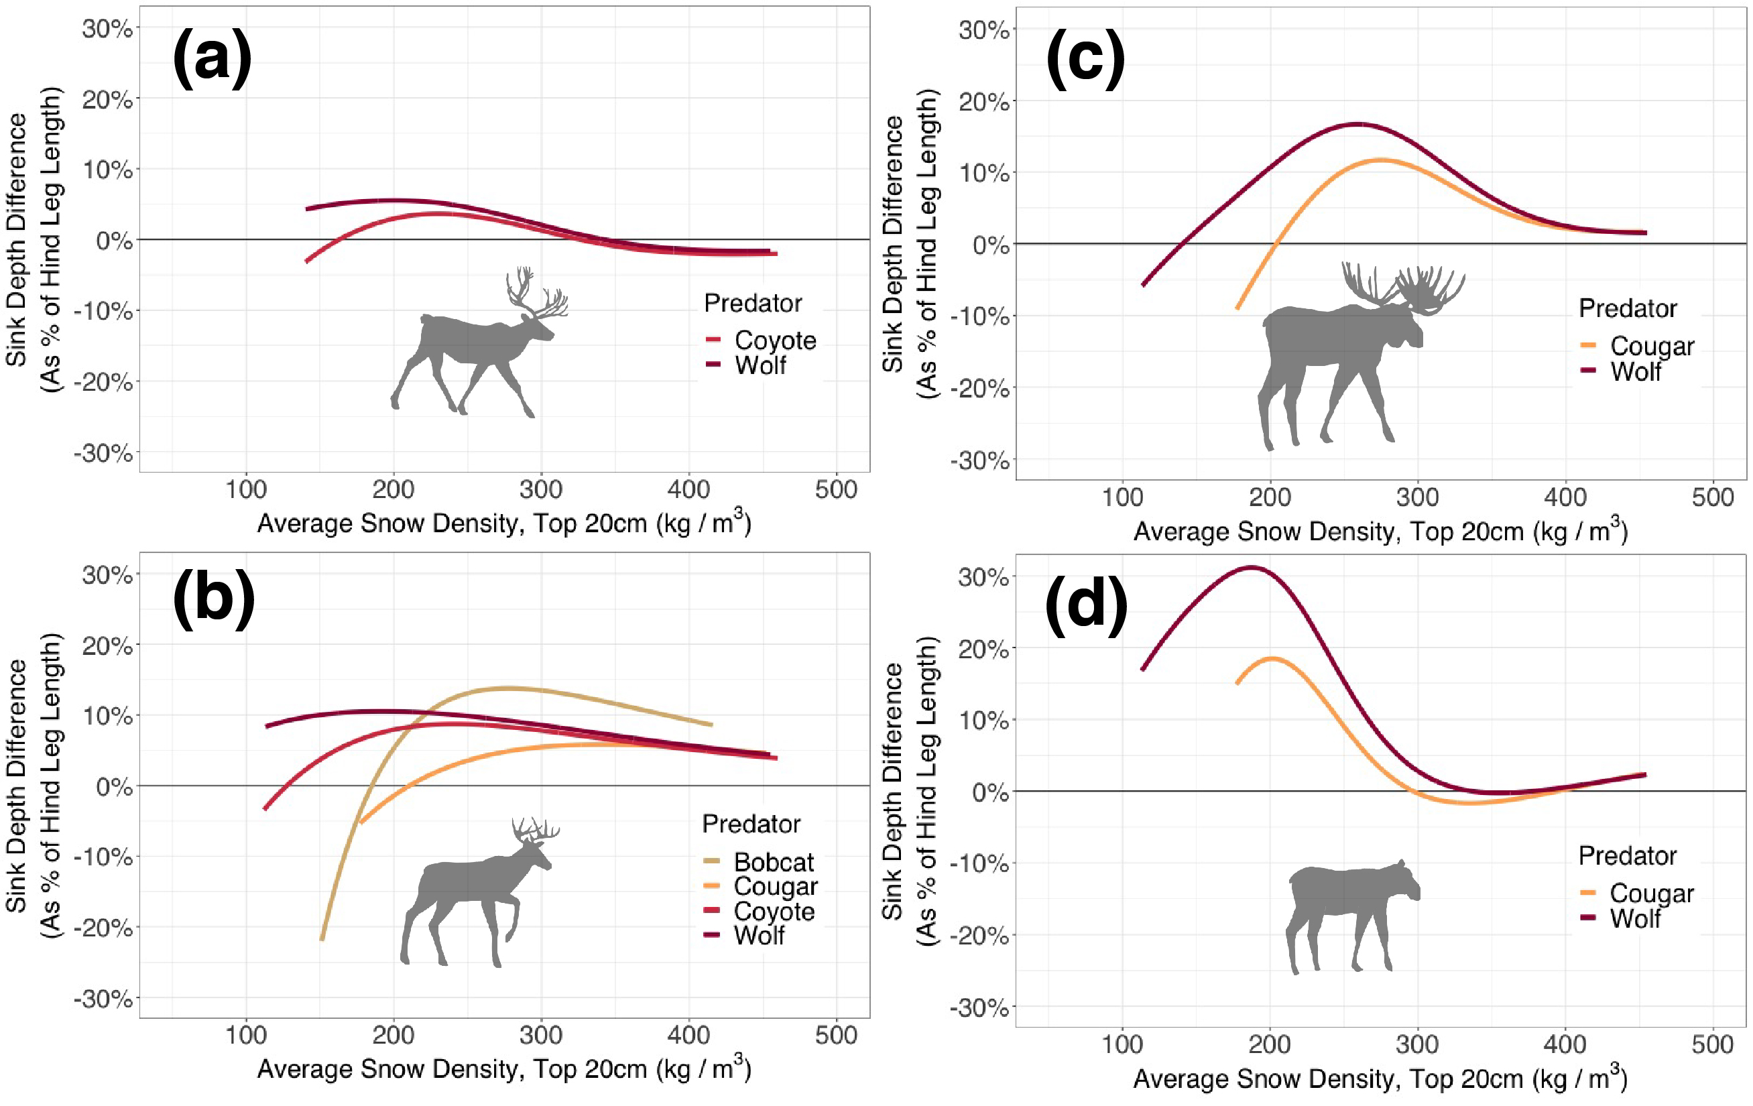
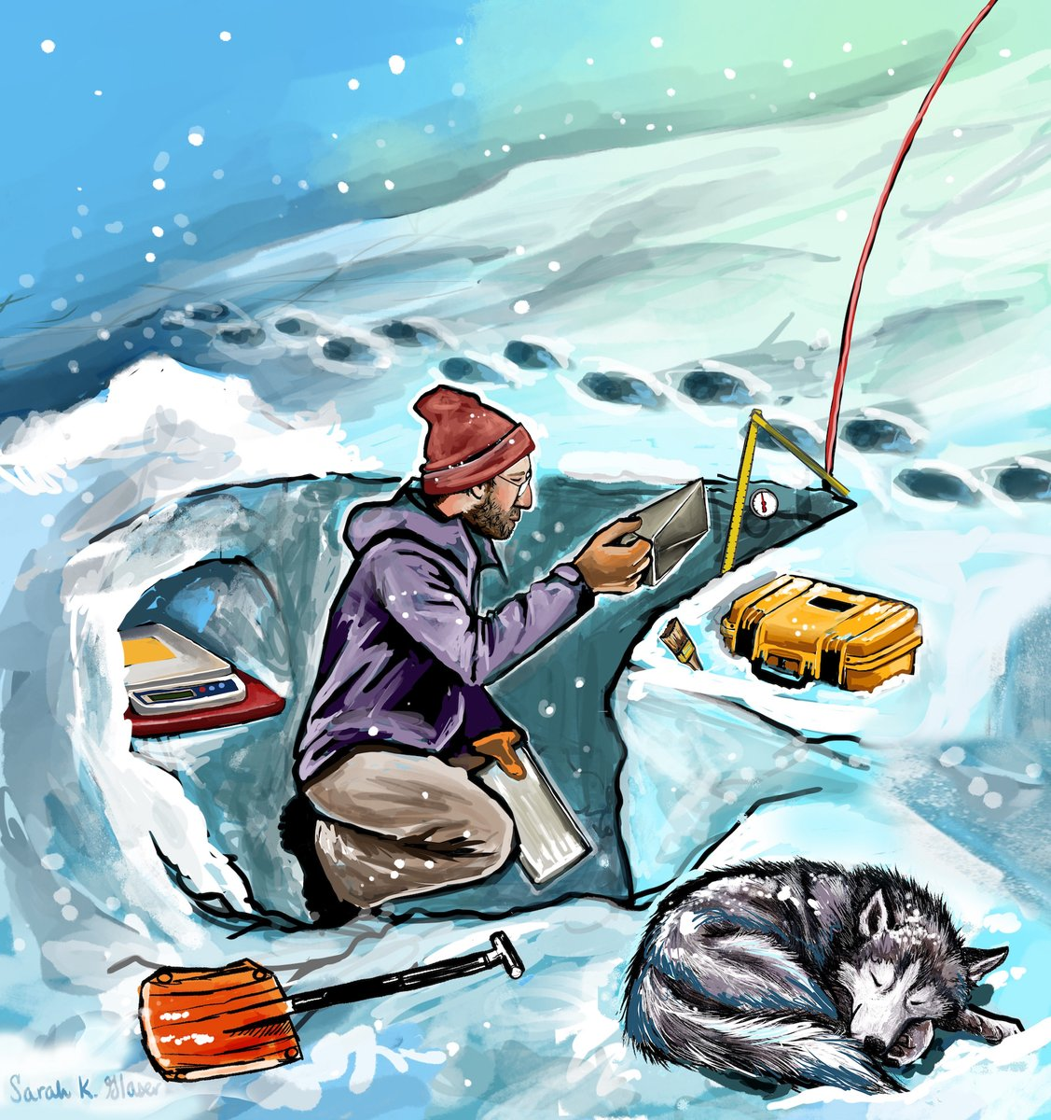
Defining the Danger Zone: Critical Snow Properties for Predator-Prey Interactions
caribou
Benjamin K. Sullender, Calum X. Cunningham, Jessica D. Lundquist, Laura R. Prugh (2023), Oikos DOI: https://doi.org/10.1111/oik.09925
Background: Snow conditions are critically important to wildlife, driving habitat selection, migration patterns, and even population trends in some large mammals. A mechanistic link between animal movement and specific snow properties is needed to understand how snow shapes predator-prey relationships.
Analysis: For seven large mammal species in Washington and Alaska, we measured snow track sink depths and snow properties at 707 sites (Fig 1). We then used generalized additive models to quantify which properties best predicted sink depth for predator-prey pairs.
deer
Results: Snow density of the top 20 cm best predicted track sink depths across all species (R² = 0.51). Intermediate snow densities (190-340 kg/m³) created ‘danger zones,’ in which prey sink as much as 31% more than predators (Fig 2).
Fig 1. B. Sullender measuring snow properties at wildlife tracks (Artwork: Sarah Glaser)
Fig 2 (right). “Danger zones” for (a) caribou, (b) deer, and (c) moose occur when their relative sink depths are higher than those of their predators (wolves, cougars, coyotes, and bobcats). Positive values are danger zones, which peak for all predator-prey pairs at intermediate snow densities.
moose
Significance: In most snow conditions, predators have a mobility advantage over prey. A warming climate may lead to denser snow that reduces predator hunting success. Prioritizing measurements of near-surface snow density in future remote sensing and modeling efforts will improve ecological applicability.
Notes:
Study sites: Alaska and Washington, USA
Funding: NASA Interdisciplinary Research in Earth Science (IDS) grants 80NSSC20K1291 to JDL and LRP
Citation: Sullender, B, C Cunningham, J Lundquist, LR Prugh. 2023. Defining the danger zone: Critical snow support thresholds for predator-prey interactions. Oikos. https://doi.org/10.1111/oik.09925
Dataset: Sullender, B.K., C.X. Cunningham, J.D. Lundquist, and L.R. Prugh. 2023. Snow Properties and Wildlife Tracks in Washington and Alaska. ORNL DAAC, Oak Ridge, Tennessee, USA. https://doi.org/10.3334/ORNLDAAC/2188

