Slide 1
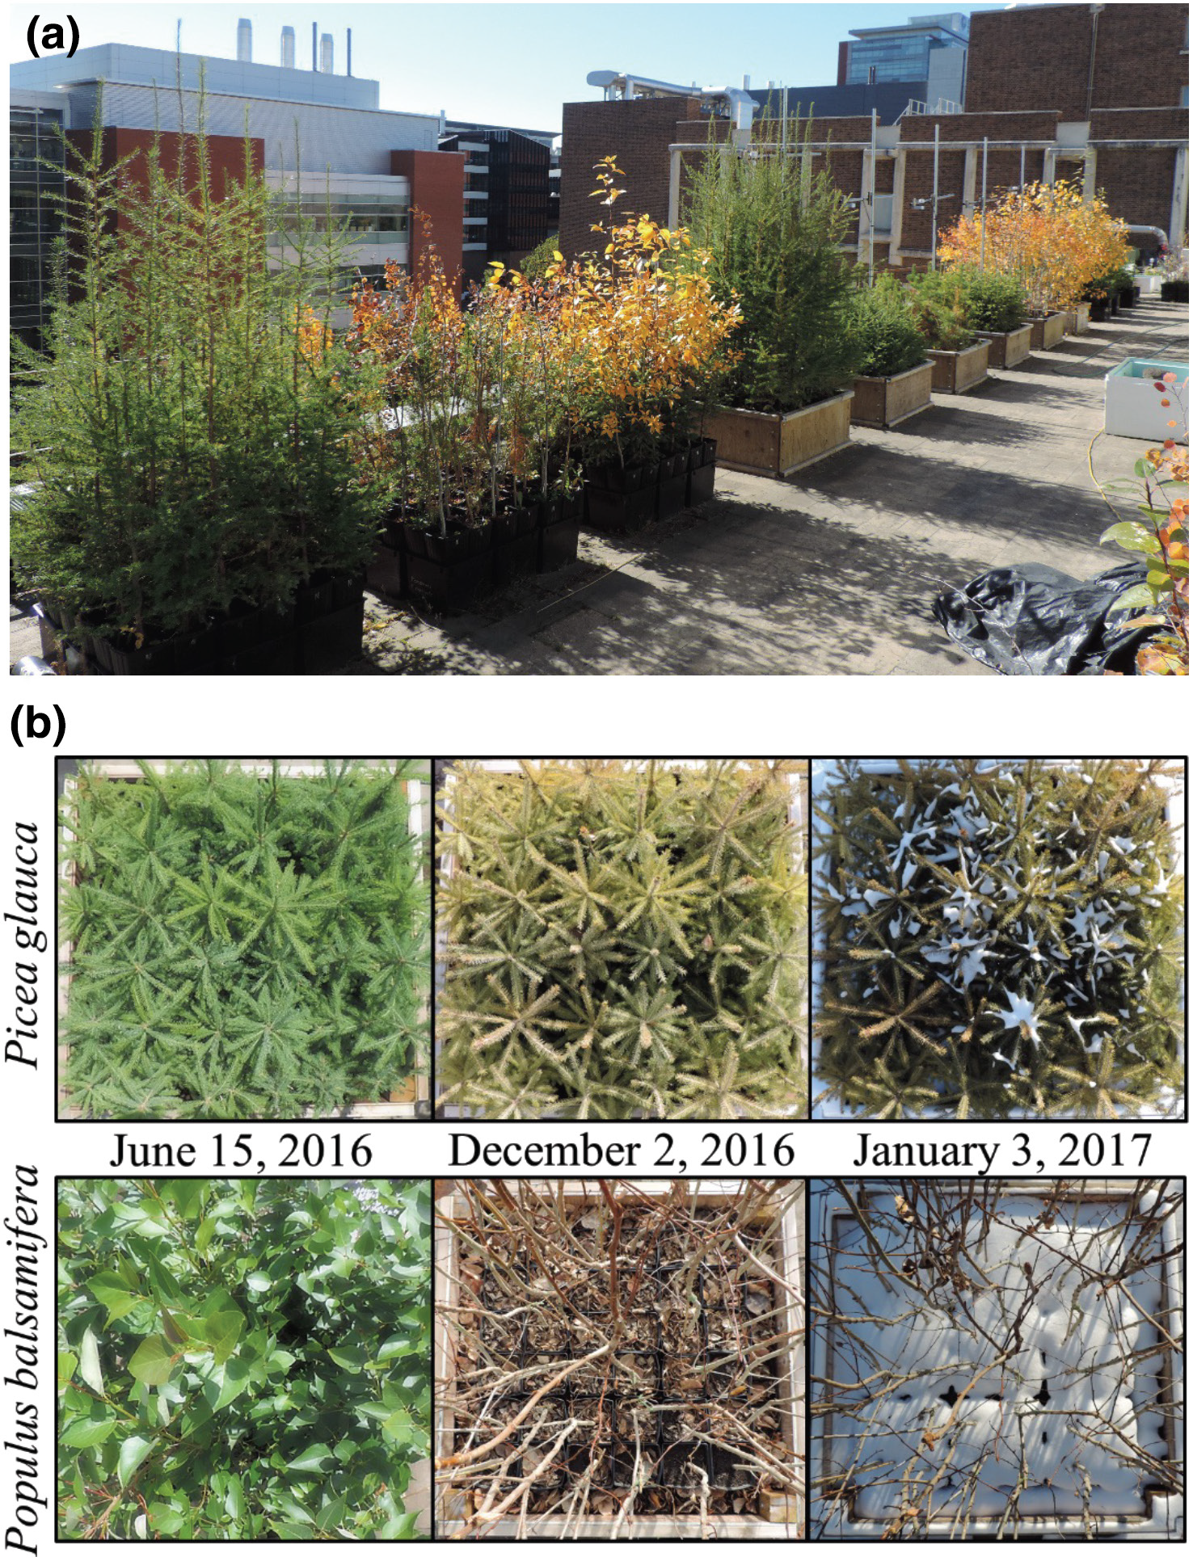
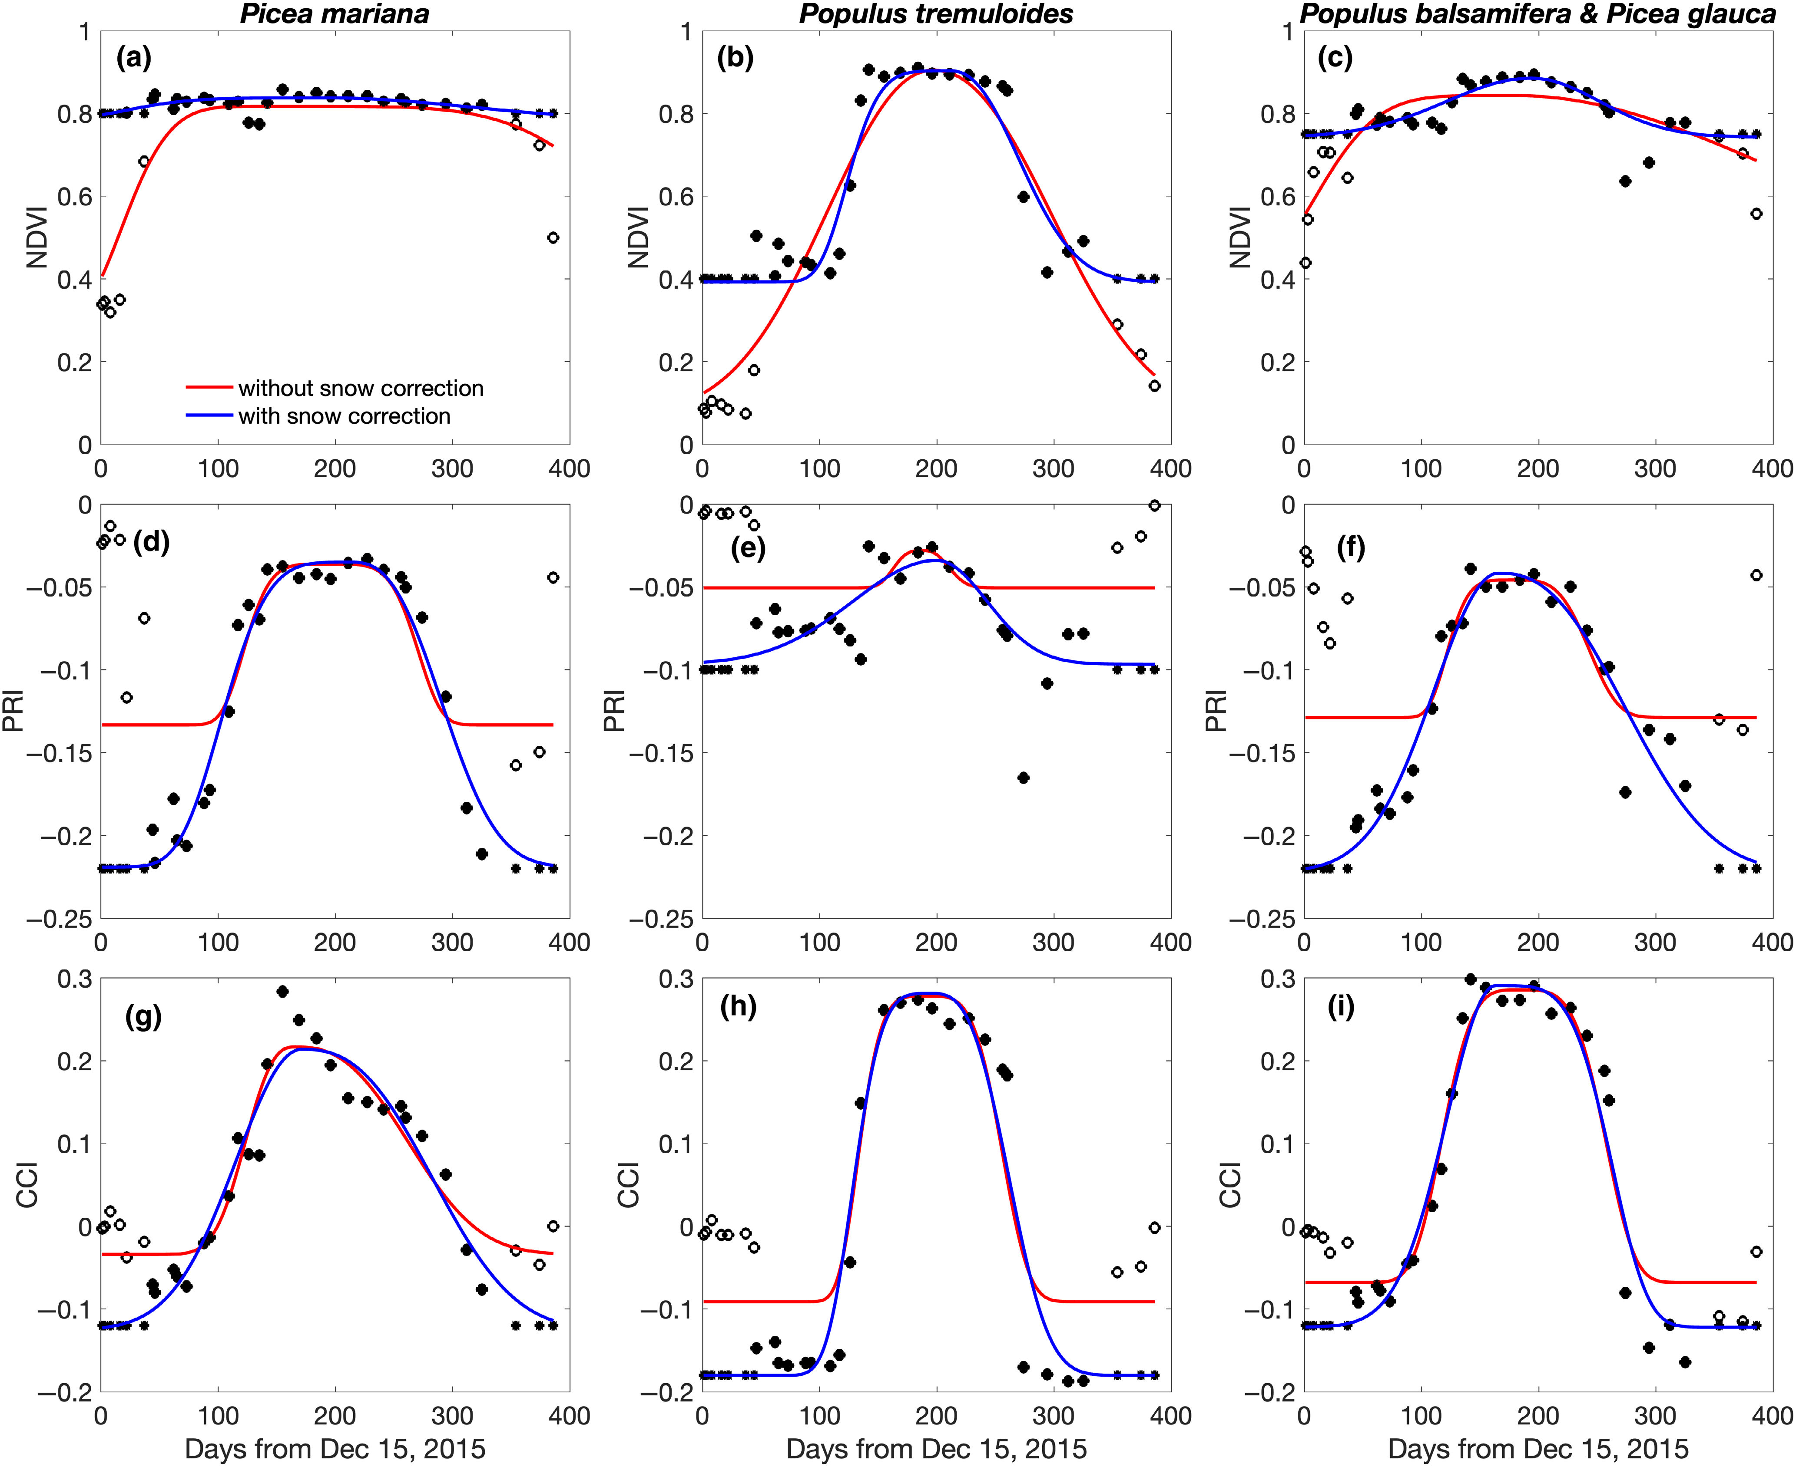
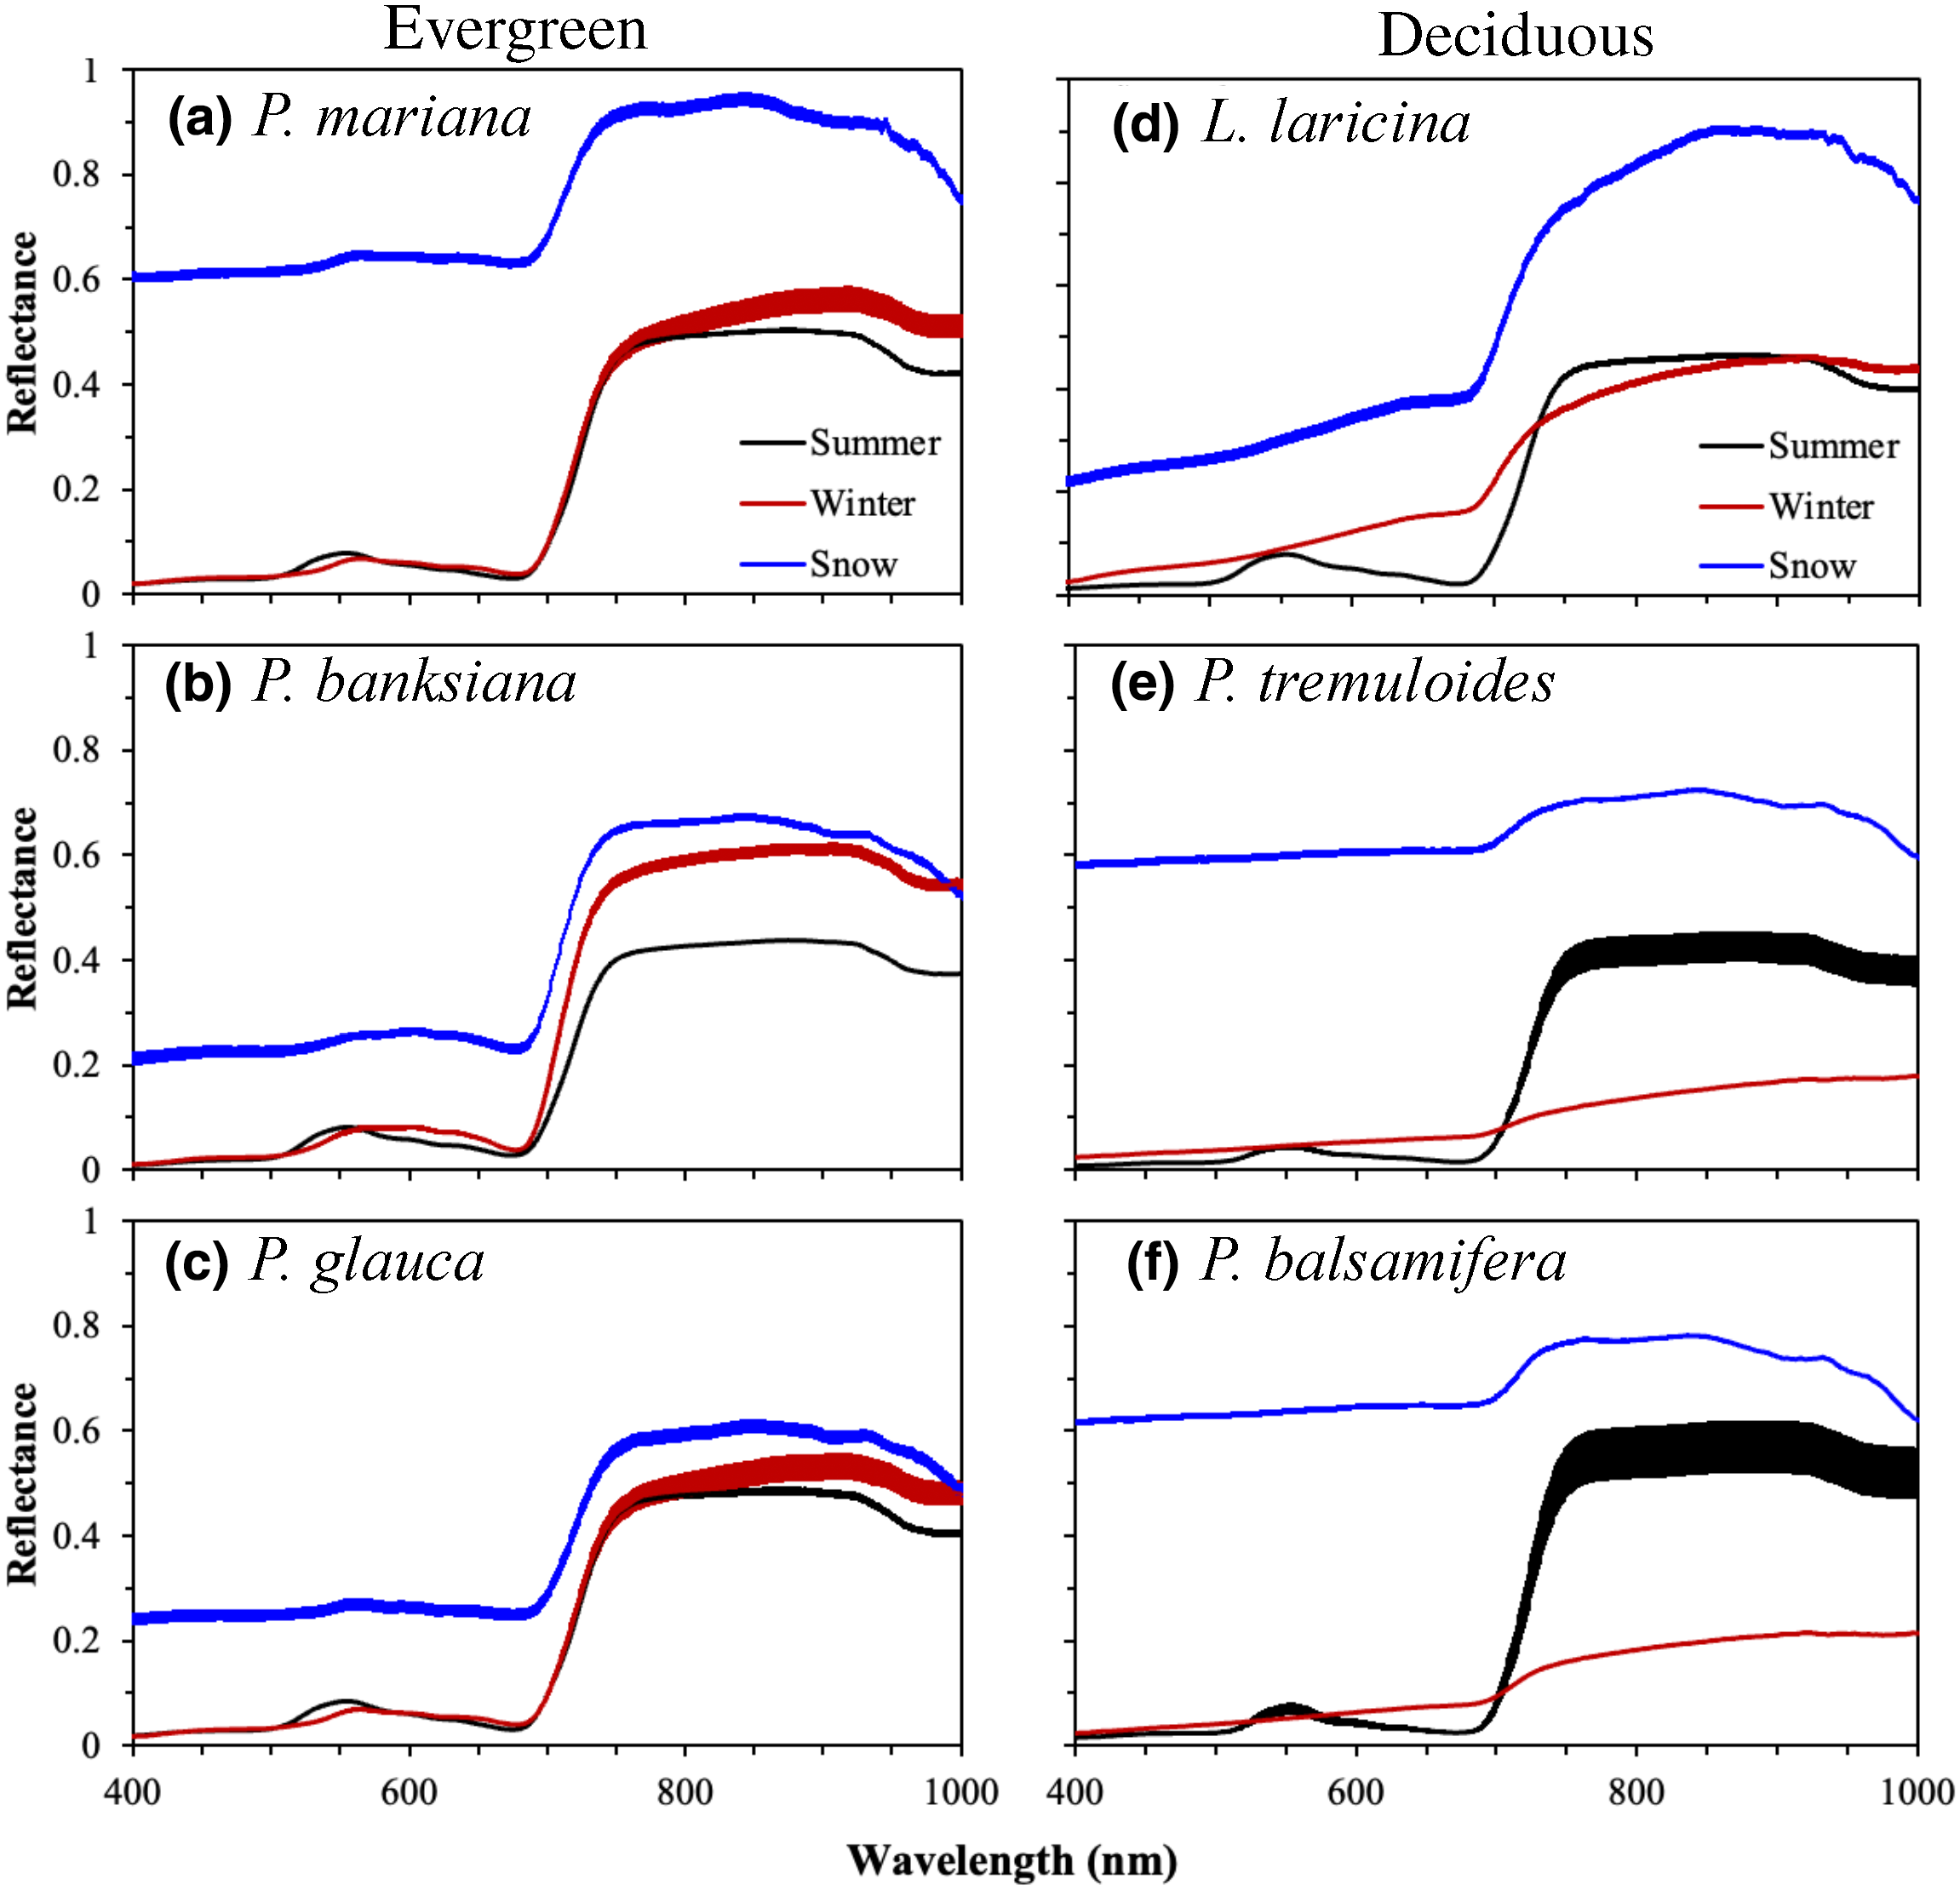
Confounding effects of snow cover on remotely sensed vegetation indices of evergreen and deciduous trees: An experimental study. Wang R, Springer KR. Gamon JA (2023) Global Change Biology. 29(21): 6120 – 6138. https://doi.org/10.1111/gcb.16916.
Method: Using an experimental study design with potted boreal tree species, we analyzed the effect of snow on vegetation indices (NDVI, PRI, CCI) used for GPP calculations.
Fig. 1 Experimental design involving synthetic canopies of potted trees in Alberta, CA
Fig. 3. Snow altered the seasonal patterns of vegetation indices in ways that affected GPP estimates; these effects were largely removed by snow correction
Research Question: How does snow influence vegetation indices used as indicators of GPP in boreal forests? How does snow correction alter estimates of GPP phenology from vegetation indices.
Fig. 2. Snow altered the reflectance spectra of tree canopies, and these effects differed for evergreen and deciduous canopies
Significance: Vegetation index phenology can be confounded by snow, supporting similar conclusions drawn from analysis of MODIS data and flux tower GPP. Snow removal reveals the underlying biological relationships with GPP. These effects should be considered when assessing GPP with vegetation indices, particularly during spring and fall transitions.
Acknowledgement: Supported by NASA Arctic-Boreal Vulnerability Experiment grant (NNX15AT78A), iCORE/AITF grants (G224150012 & 200700172), and an NSERC Discovery (RGPIN-2015-05129) grant to JAG.

