Slide 1
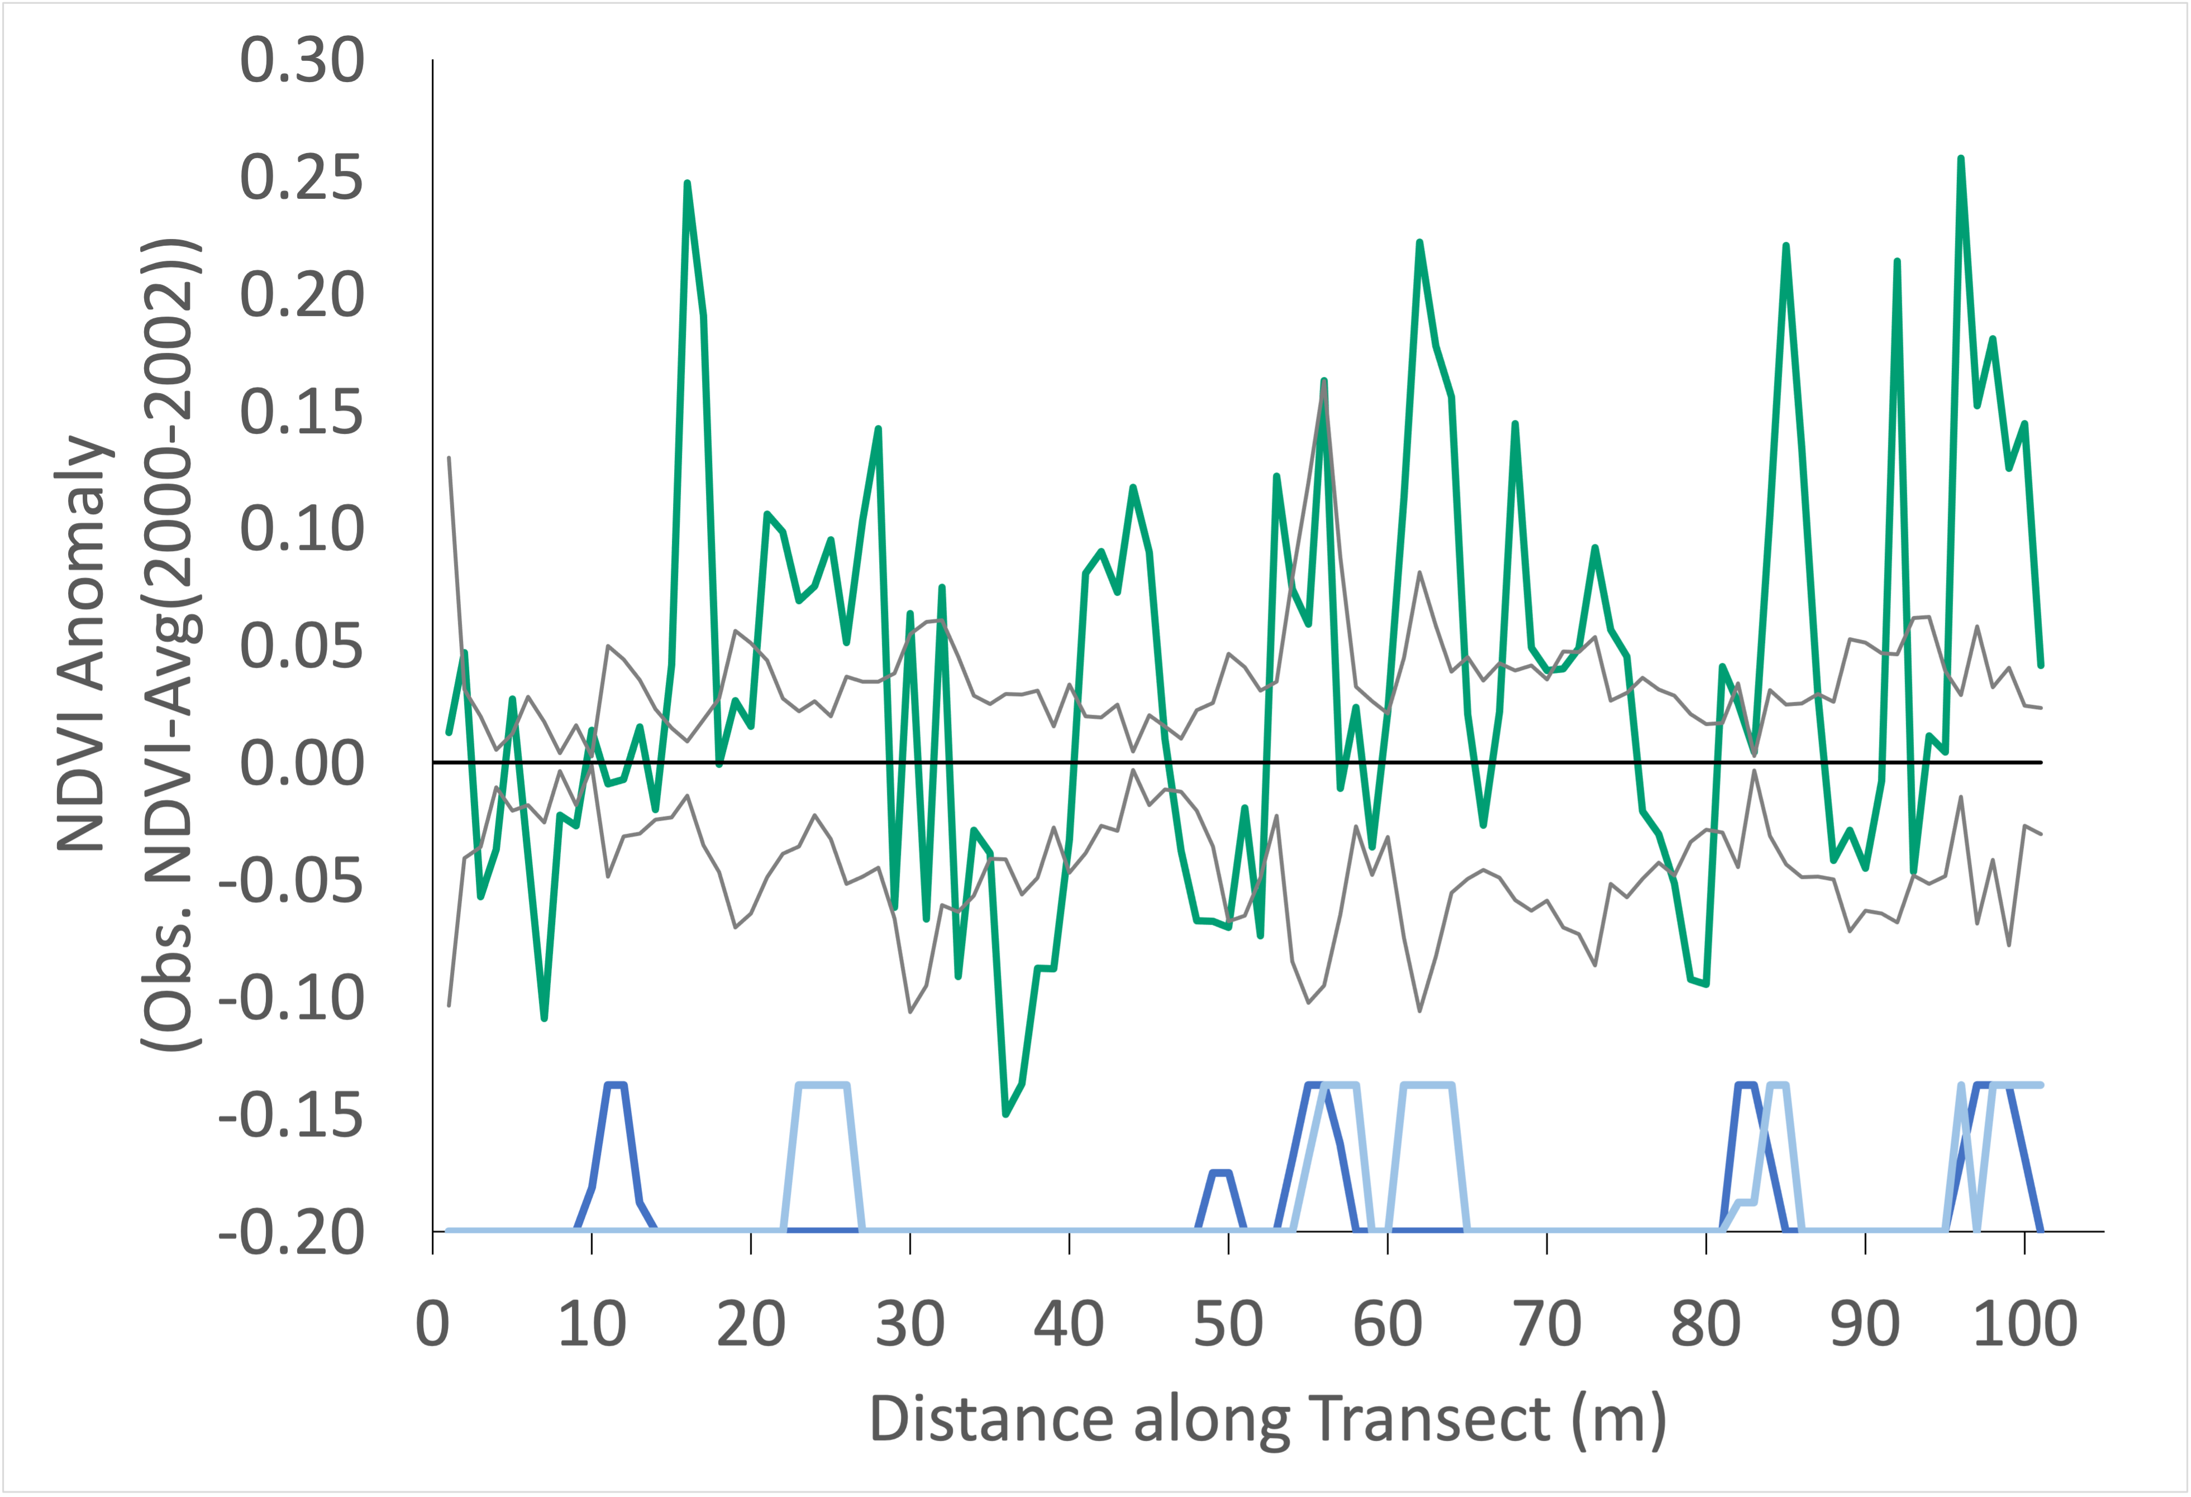
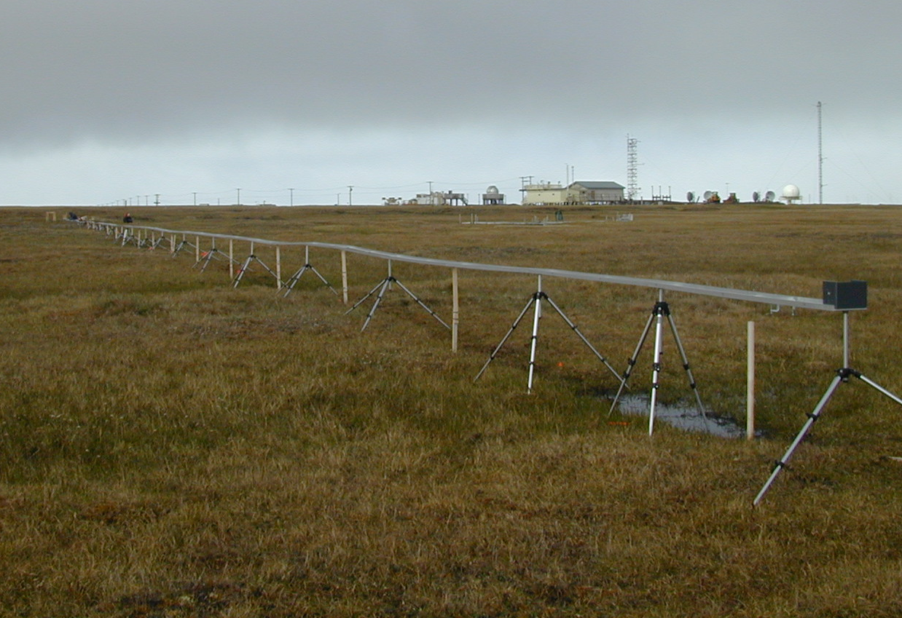
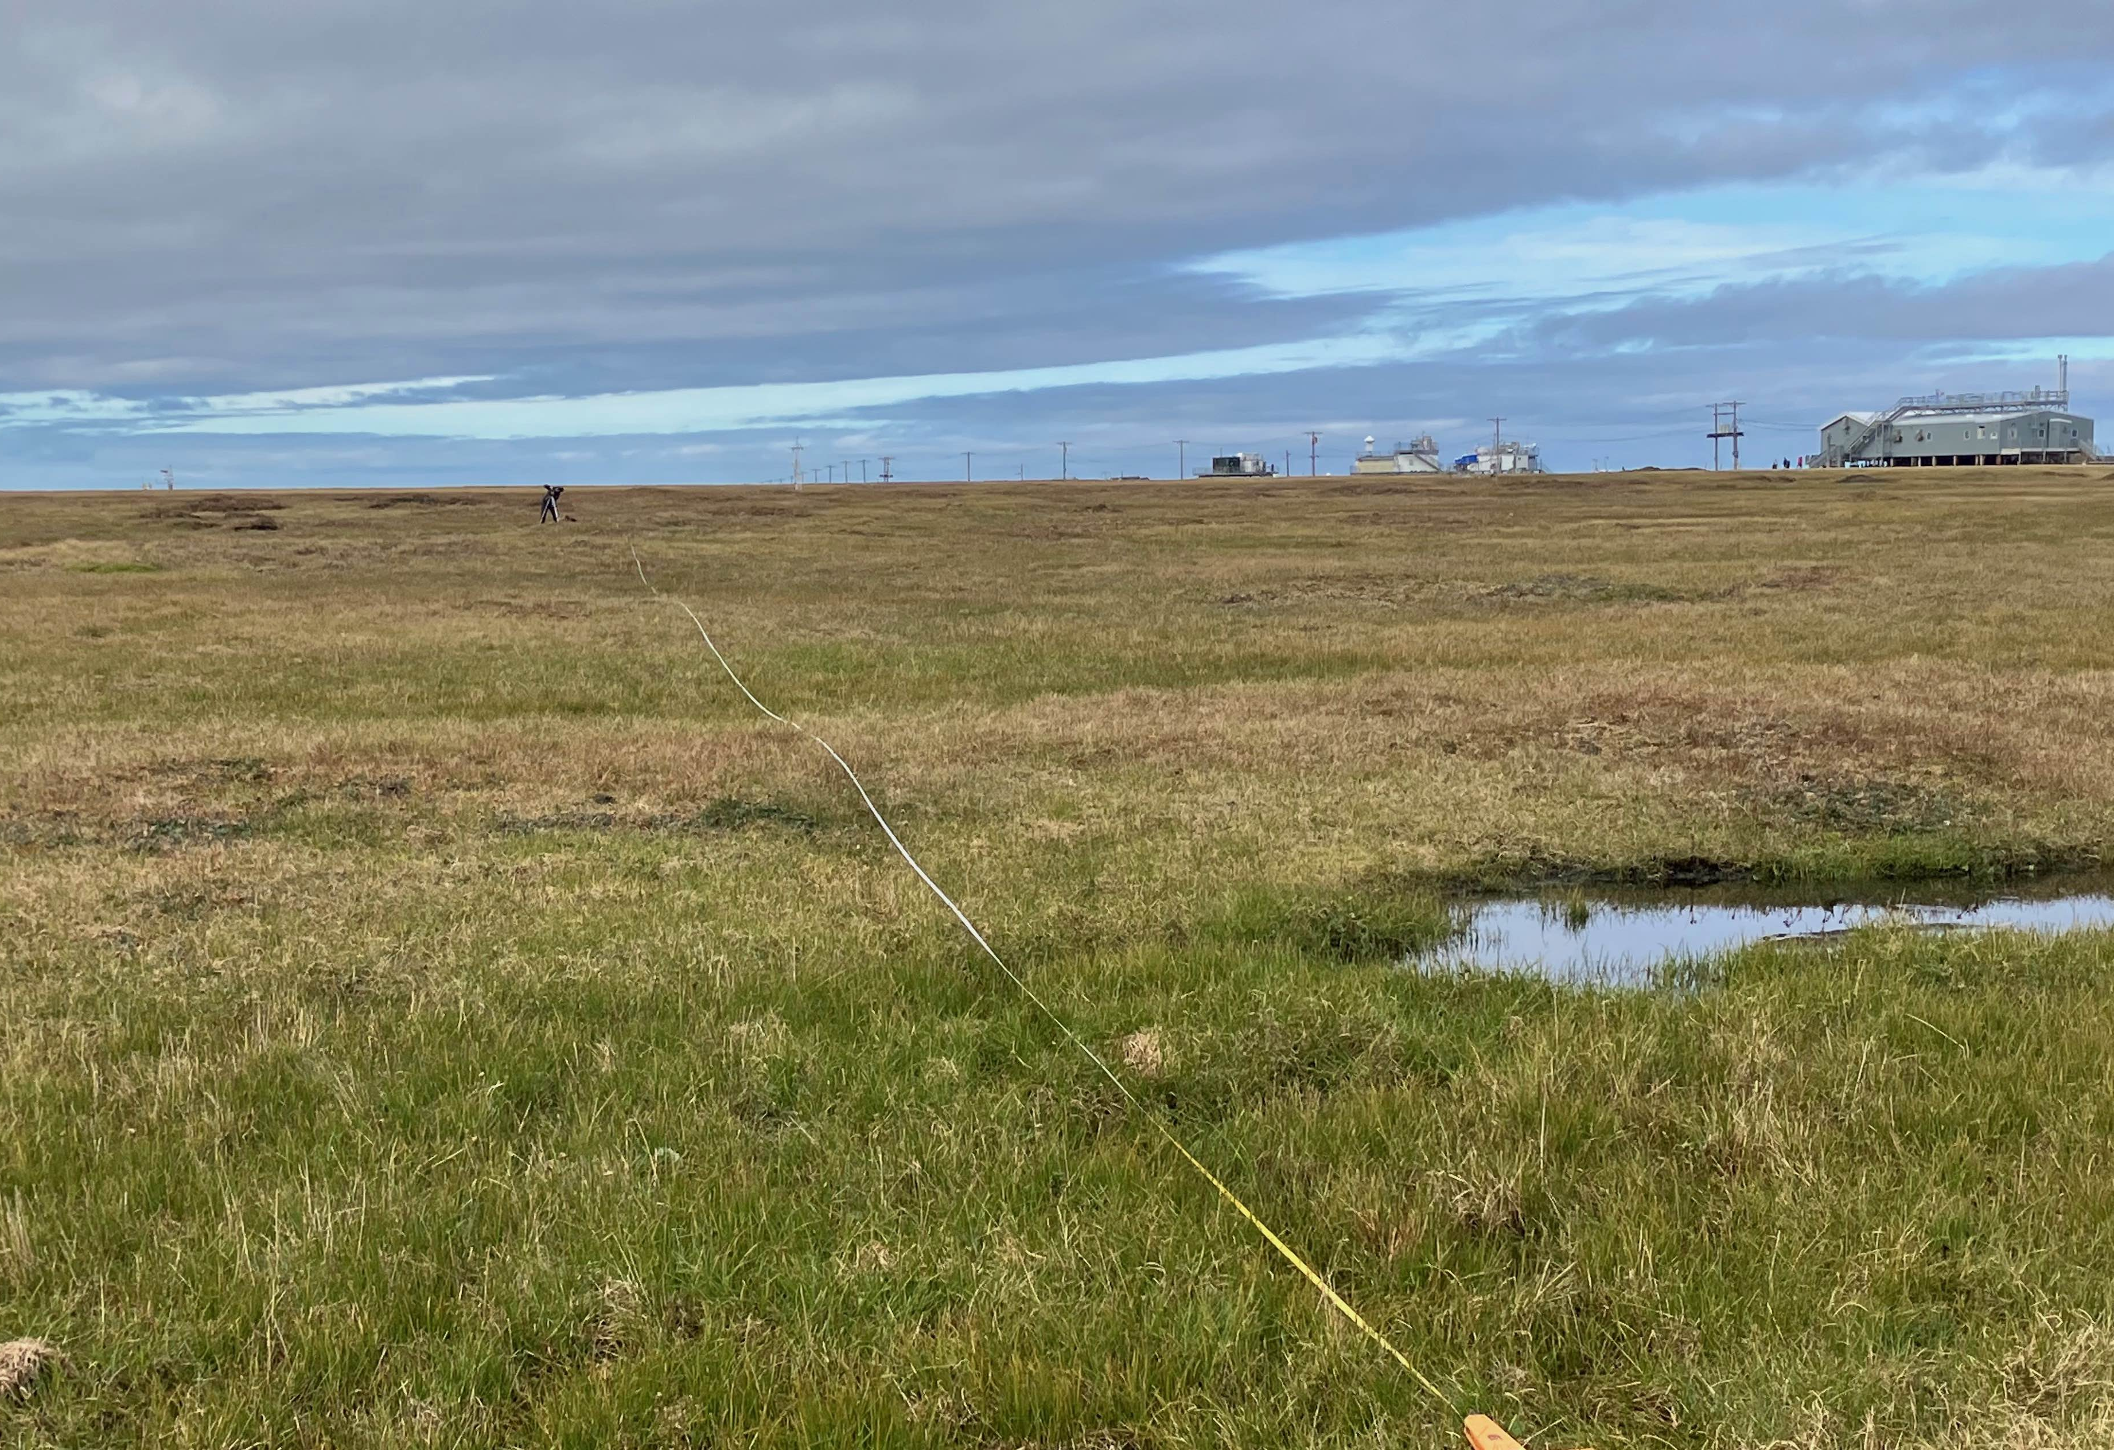
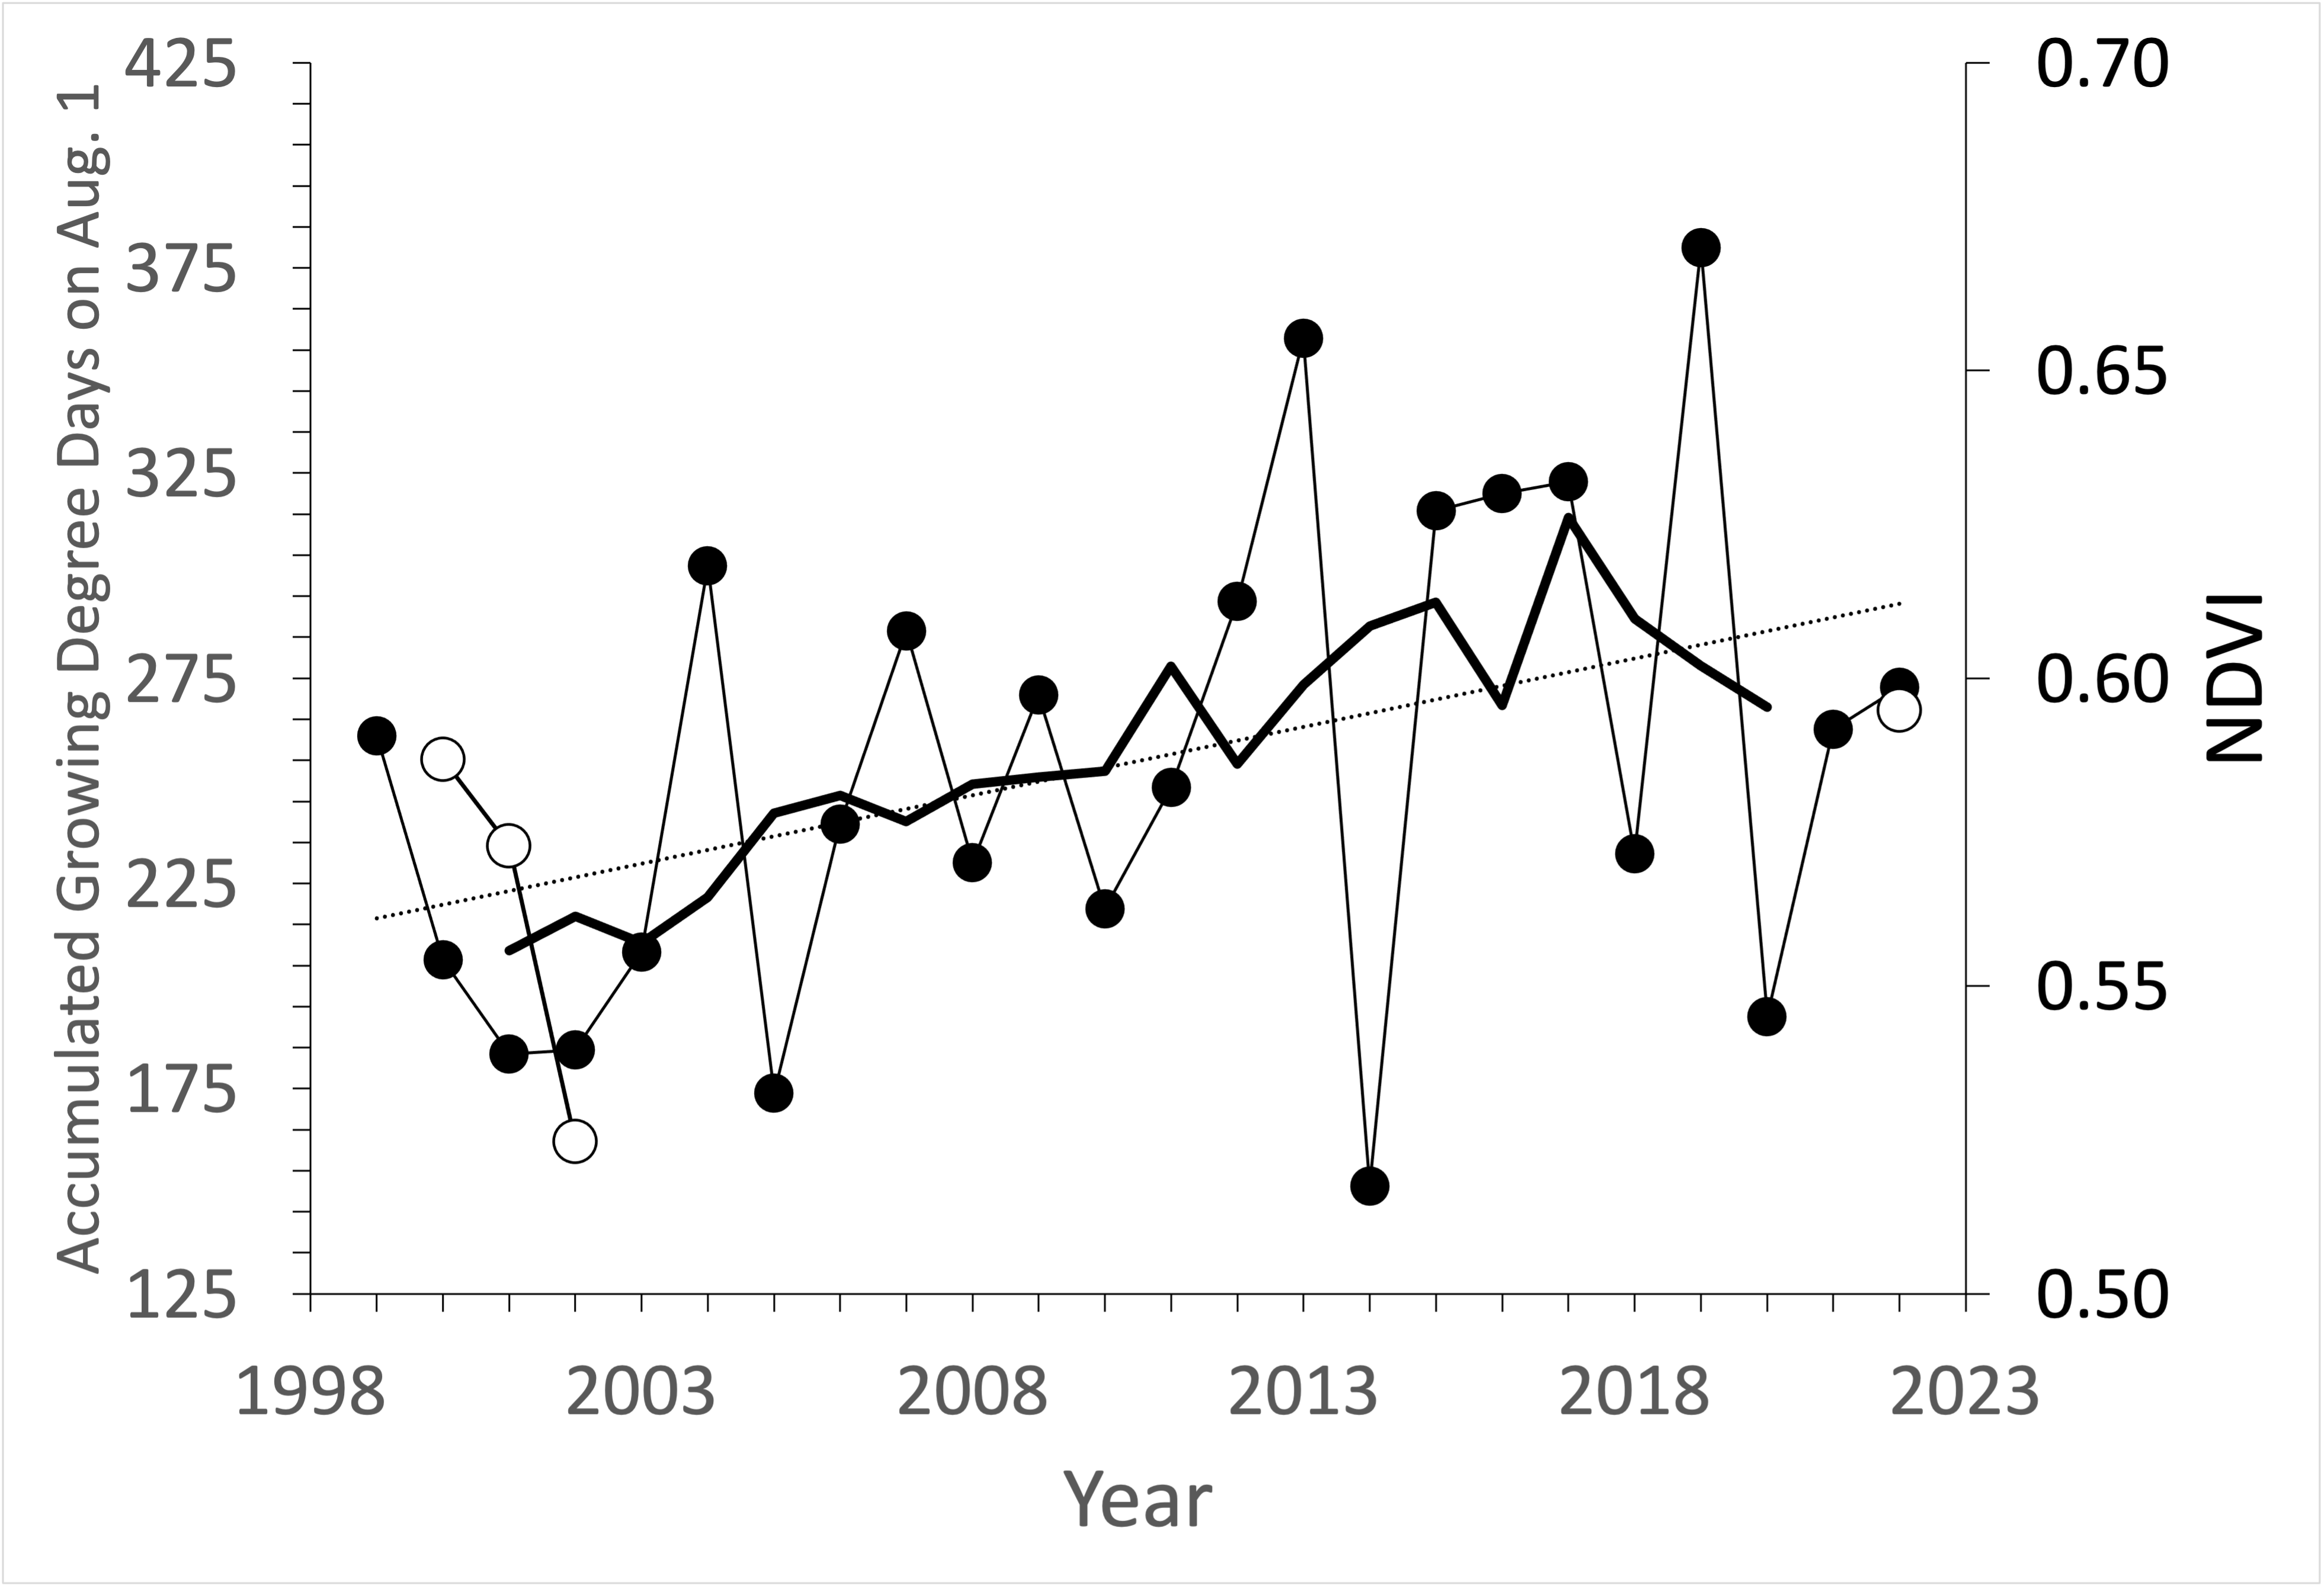
20 Years of Change in Tundra NDVI from Coupled Field and Satellite Observations
K Fred Huemmrich, John Gamon, Petya Campbell, Marianna Mora, Sergio Vargas Z., Brenda Almanza and Craig Tweedie
2023 Environ. Res. Lett. 18 094022, DOI 10.1088/1748-9326/acee17
Background: Numerous satellite studies (e.g., using MODIS in figure at left) have shown trends of increasing Normalized Difference Vegetation Index (NDVI)(greening), but little is known about what these changes mean on the ground.
Research Question: How has NDVI changed at 1 m scale over 20 years at a site MODIS shows as greening on the Alaska North Slope and what landscape changes are associated with the NDVI change.
NDVI anomaly (NDVI minus the average NDVI for maximum NDVI for years 2000–2002) along transect (heavy green line). Thin gray lines show the NDVI anomaly for the maximum and minimum midsummer NDVI over the 2000–2002 period. Positive values indicate greening, negative values browning. Blue lines at bottom of the plot indicate the presence of surface water in 2001 (dark blue) and 2022 (light blue).
Greening
Browning
From: Frost et al. (2022) Arctic Report Card 2022: Tundra Greenness https://arctic.noaa.gov/report-card/report-card-2022/tundra-greenness/
Methods: In 2022 we resampled NDVI at 1 m intervals along a 100 m transect in tundra near Utqiagvik, AK that had been previously measured through the 2000–2002 growing seasons. Photos of every meter from 2001 and 2022 were compared to describe physical change associated with NDVI change. Weather data show over this period, while there is significant year to year variability, the study area is experiencing trends for warmer and wetter conditions.
Results: Multidecadal NDVI change was spatially variable across the transect with nearly half of the transect showing greening, about a third not showing conclusive change, and about 20% browning. Most greening occurred in wet areas, associated with increased green leaf area index. Browning was not related to change in species cover and appeared to be due to increased coverage of standing dead material in graminoid dominated canopies.
Significance: These types of detailed observations provide insights into the interpretation of satellite based NDVI trends and emphasize the importance of microtopography and surface hydrology in mediating vegetation change in a warming Arctic. The minimal change in plant functional types suggests at this site climate induced changes are reversable and not near an ecological tipping point.
30 July 2001
Accumulated growing degree days (GDD) to 1 August measured at the Barrow Airport ~7 km from transect. The heavy black line is the 5- year running average. Unfilled points are the transect average midsummer maximum NDVI.
7 August 2022
Acknowledgement: Original field measurements funded by the International Arctic Research Center. This work supported by NASA ABoVE Grants NNX17AC58A and 80NSSC19M0110.

