Slide 1
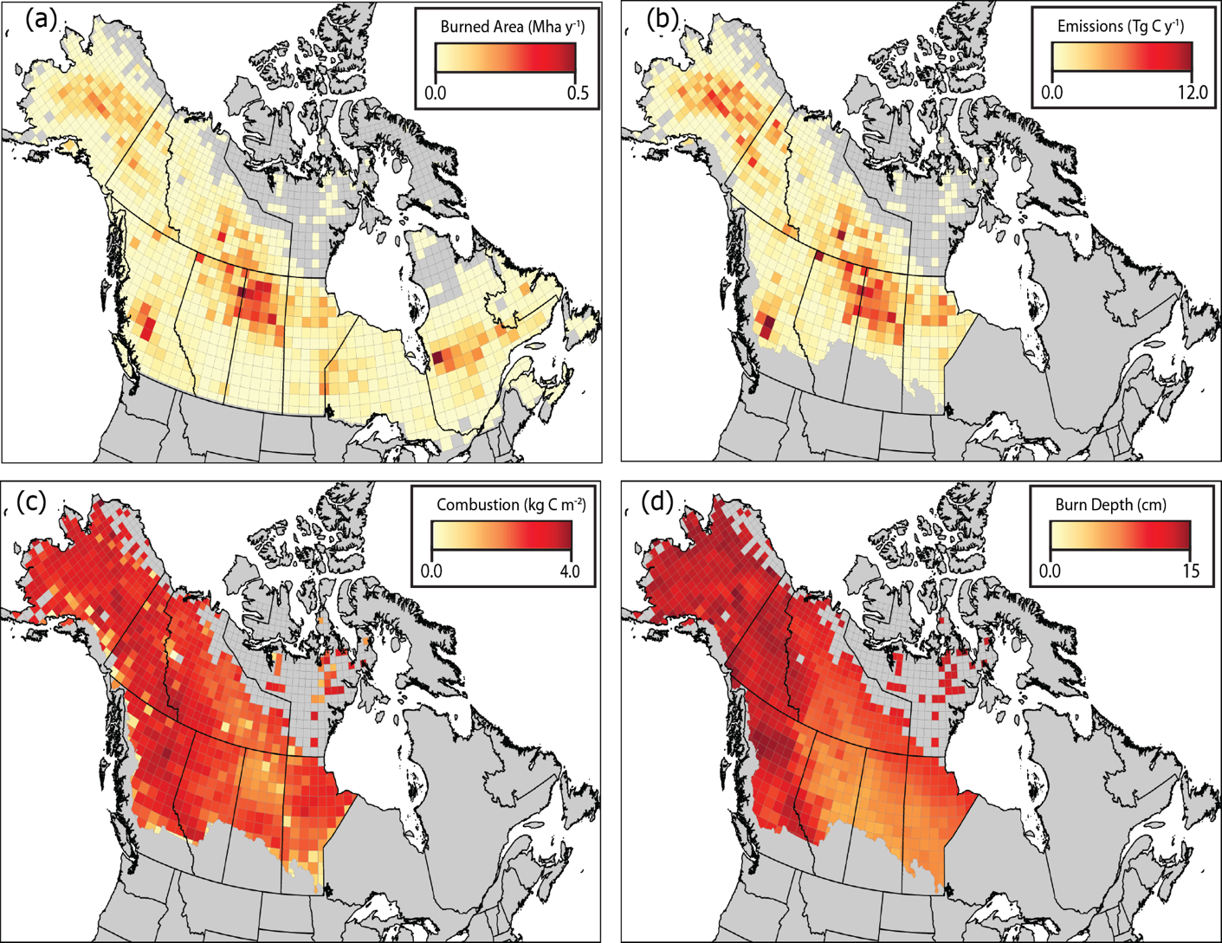
Burned Area and Carbon Emissions Across Northwestern Boreal North America from 2001-2019
Potter, S., Cooperdock, S., Veraverbeke, S., Walker, X., Mack, M. C., Goetz, S. J., Baltzer, J., Bourgeau-Chavez, L., Burrell, A., Dieleman, C., French, N., Hoy, E. E., Jenkins, L., Johnstone, J. F., Kane, E. S., Natali, S. M., Randerson, J. T., Turetsky, M. R., … Rogers, B. M. (2023). Burned area and carbon emissions across northwestern boreal North America from 2001–2019. Biogeosciences, 20(13), 2785–2804. https://doi.org/10.5194/bg-20-2785-2023
Background: Fire frequency, intensity and burned area have been increasing in Alaskan and Canadian boreal forests and these trends are expected to continue throughout the 21st century due to a warmer and drier climate. Changes in the fire regime have the potential to transition at least some North American boreal forests from a carbon sink to a source. To better understand how changing boreal fire regimes influence carbon dynamics, it is critical to accurately map burned area and estimate resulting carbon emissions over time.
Analysis: We created a new burned area product at 500 m which was informed by 30 m satellite data. We also developed statistical models to predict burn depth and carbon combustion across the NASA ABoVE core and extended domain which were constrained using a database of field observations across the domain.
Findings:
We found burned area and total emissions are highly variable by year, averaging 2.37 Mha of burned area and 79.26 +/- 28.65 Tg C emitted per year across the ABoVE domain with a mean combustion level of 3.13 +/- 1.20 kg C m^{-2.}
Significance: Previous estimates across boreal North America have generally underestimated both burned area and carbon emissions compared to our study.
Top: Temporal variability in ABoVE-FED burned area (a), and emissions (b) from 2001-2019 ; Bottom: Total burned area (a), total carbon emissions (b), mean combustion (c), and mean burn depth (d) between 2001-2019 aggregated to a 70 km grid.

