Slide 1
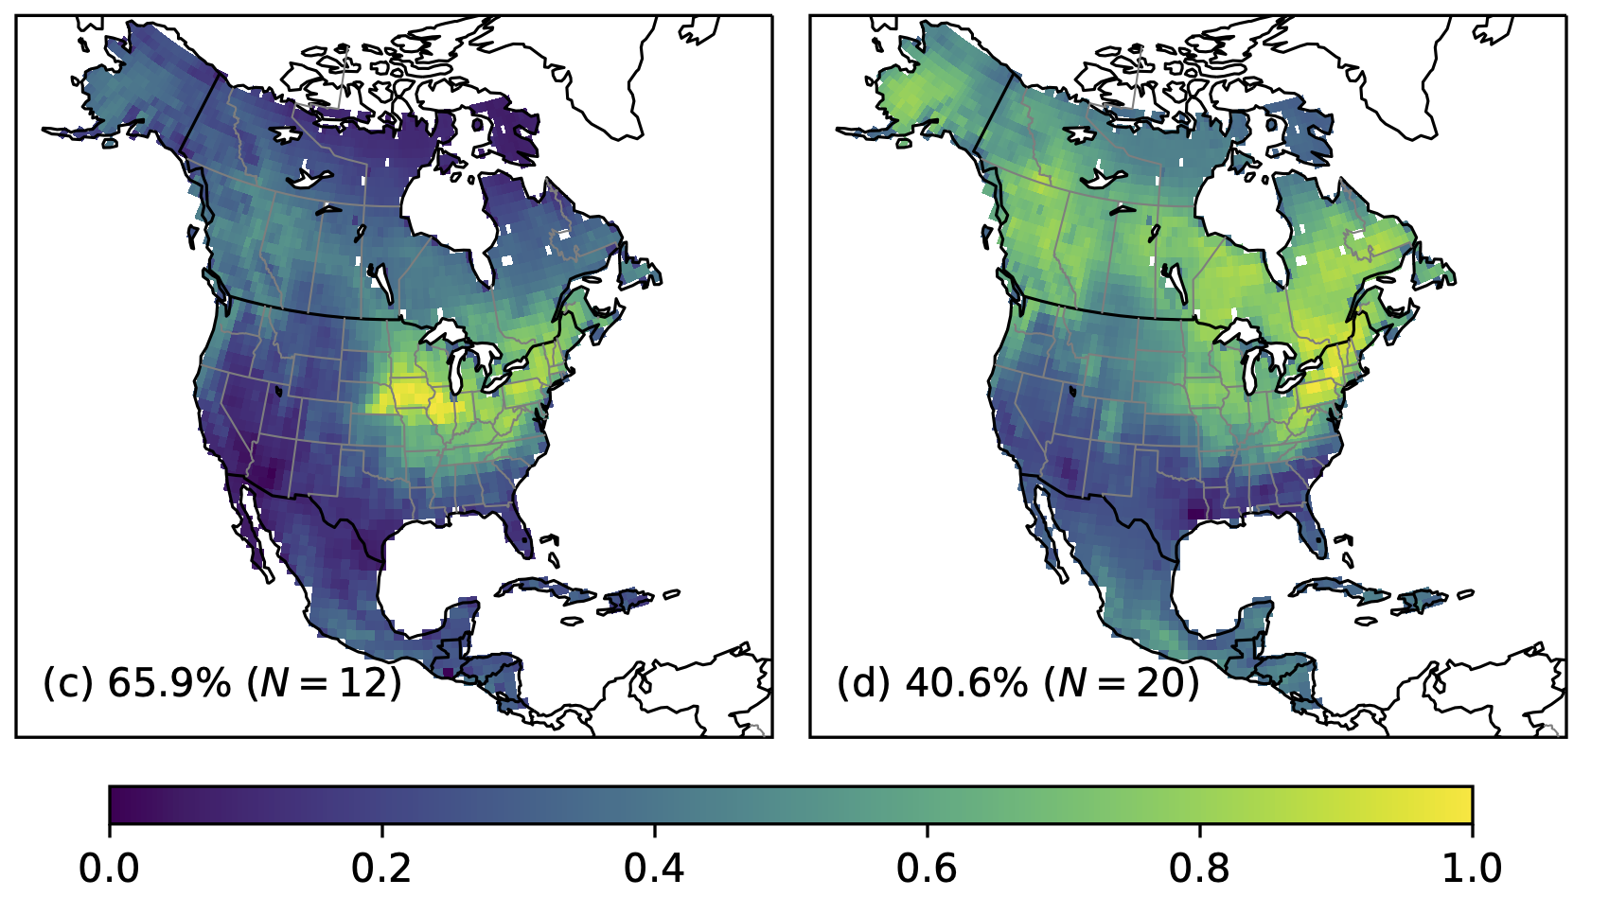
US croplands do heavy lifting on summer CO₂ drawdown
Sun, W., Fang, Y., Luo, X., Shiga, Y. P., Zhang, Y., Andrews, A. E., Thoning, K. W., Fisher, J. B., Keenan, T. F., & Michalak, A. M. (2021). Midwest US croplands determine model divergence in North American carbon fluxes. AGU Advances 2(2), doi: 10.1029/2020AV000310
Science Question
The North American land biosphere acts as a carbon sink, but how the carbon balance is distributed among its ecosystems and seasonally remains uncertain. Most land biosphere models show stronger summer CO₂ uptake in temperate forests than in croplands, but observations suggest otherwise.
Analysis
We leveraged atmospheric CO₂ observations from tall towers and remotely sensed proxies of photosynthesis to assess how well land biosphere models resolve regional-scale carbon flux patterns. We compared common patterns between models that explain CO₂ variability well and those that do not.
Results
Atmospheric CO₂ observations reveal that Midwestern croplands are a hotspot of carbon uptake in the summer, outpacing carbon uptake in temperate forests. However, most land models do not capture this cropland hotspot, because they have the wrong crops or do not represent the life cycles of crops well.
Significance
The results underscore a need to resolve crops in land biosphere models for accurate assessment of carbon flows between the atmosphere and the biosphere. To ensure models capture regional carbon flux patterns, evaluation with atmospheric CO₂ observations is needed. Better representations of crops in models will aid future projections of the carbon cycle, thus providing a robust scientific context for land management and climate policy decisions.
Models with net carbon uptake that explain CO₂ variability well
Models with net carbon uptake that explain CO₂ variability poorly
a
b
Summer mean pattern of the first principal component (normalized)
The dominant summer carbon uptake patterns among (a) models with net carbon uptake that explain space–time variability in atmospheric CO₂ observations well, and (b) models with net carbon uptake that explain CO₂ variability less well. Those land biosphere models that match atmospheric CO₂ variability best have stronger summer carbon uptake in croplands, whereas those that do not have stronger carbon uptake in forests.
Notes:
Full citation: Sun, W., Fang, Y., Luo, X., Shiga, Y. P., Zhang, Y., Andrews, A. E., Thoning, K. W., Fisher, J. B., Keenan, T. F., & Michalak, A. M. (2021). Midwest US croplands determine model divergence in North American carbon fluxes. AGU Advances, 2(2), e2020AV000310. https://doi.org/10.1029/2020AV000310
Data: Model evaluation results presented in this study are available at https://gitlab.com/wusun/na-carbon-flux-eval, under a CC-BY 4.0 License. Geostatistical inverse estimates of NEE are available upon request addressed to Yoichi P. Shiga. All other data sets used in this study are available online and/or from original data contributors, as listed in Table S5 in the Supporting Information.
Funding support: This study was funded by the National Aeronautics and Space Administration (NASA) Terrestrial Ecology Interdisciplinary Science award NNH17AE86I (Keenan IDS 2016).
Abstract: Large uncertainties in North American terrestrial carbon fluxes hinder regional climate projections. Terrestrial biosphere models (TBMs), the essential tools for understanding continental-scale carbon cycle, diverge on whether temperate forests or croplands dominate carbon uptake in North America. Evidence from novel photosynthetic proxies, such as those based on chlorophyll fluorescence, has cast doubt on the “weak cropland, strong forest” carbon uptake patterns simulated by most TBMs. However, no systematic evaluation of TBMs has yet been attempted to pin down space-time patterns that are most consistent with regional CO₂ observational constraints. Here, we leverage atmospheric CO₂ observations and satellite-observed photosynthetic proxies to understand emergent space-time patterns in North American carbon fluxes from a large suite of TBMs and data-driven models. To do so, we evaluate how well the atmospheric signals resulting from carbon flux estimates reproduce the space-time variability in atmospheric CO₂, as is observed by a network of continuous-monitoring towers over North America. Models with gross or net carbon fluxes that are consistent with the observed CO₂ variability share a salient feature of growing-season carbon uptake in Midwest US croplands. Conversely, the remaining models place most growing-season uptake in boreal or temperate forests. Differences in model explanatory power depend mainly on the simulated annual cycles of cropland uptake—especially, the timing of peak uptake—rather than the distribution of annual mean fluxes across biomes. Our results suggest that improved model representation of cropland phenology is crucial to robust, policy-relevant estimation of North American carbon exchange.

