Slide 1
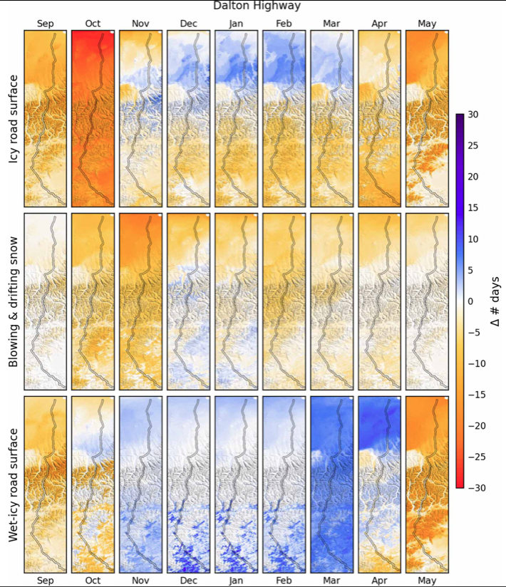
Future climate impacts on cold-season driving hazards in Arctic-Boreal regions HE Greaves, NT Boelman, TJ Brinkman, GE Liston, LR Prugh, & AK Reinking, ERL, 2023
Background: With rapid warming in Arctic-boreal regions, the frequency & seasonal timing of hazardous cold-season driving conditions on highways will change. Because these roads link remote areas to the main road system, such changes will affect safety & quality of life for northern residents & commercial enterprises.
Analysis: We built machine learning models to link past weather (simulated by SnowModel driven by MERRA-2 reanalysis data) to records of road conditions for highways in northern Alaska and Yukon Territory, and applied them to climate projections to estimate future trends in hazardous driving conditions.
Results: The number of days/year with icy or snowy road surfaces are projected to decrease by 31‒51 days by 2100. Wet conditions tended to increase proportionally as Spring- and Fall-like conditions occurred increasingly earlier & later, respectively. The number of days/year with blowing and drifting snow are projected to decrease, although they intensified over time, with higher snowfall totals and wind speeds when they did occur. Although the number of days with wet-icy road surfaces decreased over time, this slippery and especially dangerous condition occurred more often during darker periods of the year when they may be difficult to recognize. Select findings for northern Alaska are shown in figures, while those for the Yukon can be found in the published manuscript.
Significance: This information may help road managers and drivers adapt their expectations and behaviors to minimize accident risk on Arctic-boreal roads in the future.
Monthly difference (2081–’00 minus 2006–’21 monthly means) in # of days with selected hazardous driving conditions predicted along the Dalton Highway, Alaska. Highway is shown with a 2 km buffer for reference. Findings for the Dempster Highway,Yukon, found in published manuscript.
Icy surface
Blowing/drifting snow
Change in # of days
Wet-Icy surface
Month
Mean fraction of days per month that hazardous driving conditions were predicted to occur during Sep- May of future time periods for the Dalton Highway. Findings for the Dempster Highway Corridor, Yukon Territory, can be found in the published manuscript.
Icy/snowy surface
Blowing/drifting snow
Wet-icy surface
Notes:
Full citation: H.E. Greaves, N.T. Boelman, T.J. Brinkman, G.E. Liston, L.R. Prugh, A.K. Reinking (2023) Simulating future climate change impacts on snow- and ice-related driving hazards in Arctic-boreal regions. Env. Res. Lett. DOI: 10.1088/1748-9326/acb5b1
Grants: This work was funded by NASA ABoVE grant 80NSSC19M0109 and NASA EPSCoR grant 80NSSC21M0321.

