Slide 1
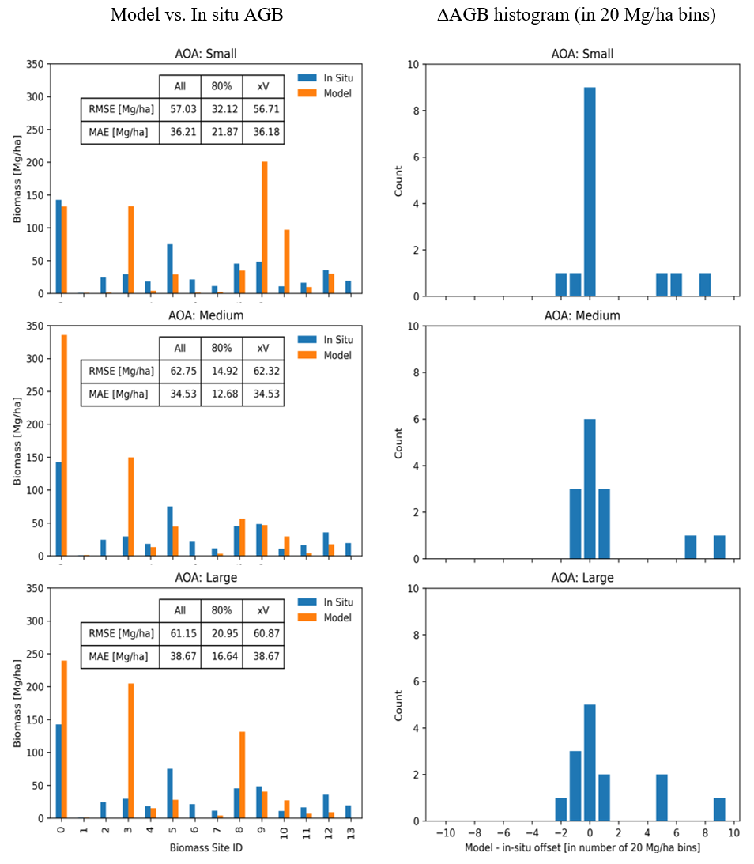
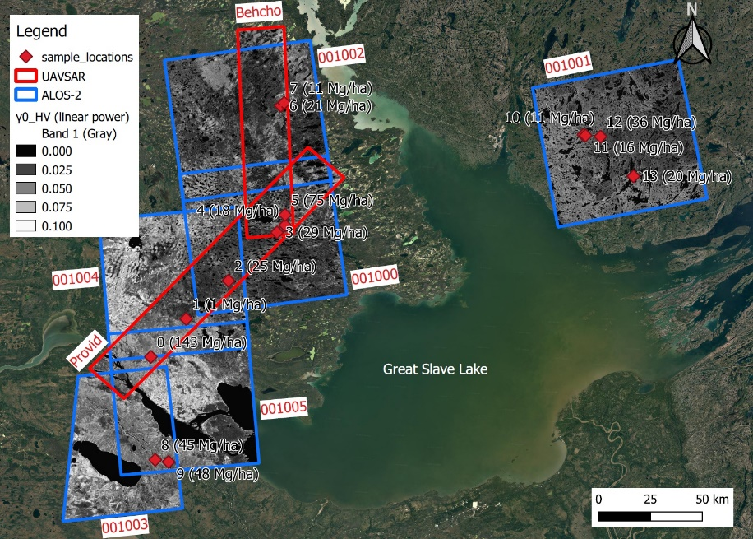
Mapping and scaling of in situ Above Ground Biomass to regional extent with SAR in the Great Slave Lake Region
Kraatz S, Bourgeau-Chavez LL, Battaglia M, Poley A, Siqueira P (Dec. 2022). Earth and Space Science. doi: 10.1029/2022EA002431
Background:
The upcoming NISAR mission is to produce above-ground biomass (AGB) maps at 1 ha x 1 ha scale with an accuracy requirement of 20 MG/ha (for AGB < 100 MG/ha)
This study conducts a scaling experiment to assess under what conditions, if any, the NISAR science requirement for AGB can be met in the Great Slave Lake region, which presents a challenge due to its dynamic hydrology.
Findings:
Air and Spaceborne SAR data (L-band) are interoperable
The issue of scaling-correspondence is important for enabling sufficiently accurate AGB mapping/modeling with SAR data. It is important to test mapping/modeling efforts at multiple scales of data aggregation to reduce scaling-correspondence errors between radar, in situ, and landscape-scale hydrology.
The scaling experiments revealed that NISAR’s science requirement for AGB mapping (requiring RMSE < 20 Mg/ha) could only be met when aggregating SAR data to 2 ha x 2 ha grids (RMSE=15 MG/ha). Using NISAR’s intended scheme (1 ha x 1 ha grids) yielded an RMSE of 57 Mg/ha.
Significance:
This study generated maps of AGB using UAVSAR and ALOS-2 PALSAR-2 L-band radar data about the Great Slave Lake area.
This study presents additional guidance and capability for NISAR’s AGB mapping science algorithm. The presented approach is compatible with the science algorithm in that it shows how its 1 ha x 1 ha results can be re-used to explore regionally-variable scaling-correspondence relationships for further improving AGB mapping accuracy beyond the science algorithm. It can also be useful for tallying best aggregation scales globally.
Study area and data: Field data of AGB was collected at 14 validation sites in 2019. Temporal averages (2017-2021, depending on site) of UAVSAR and ALOS-2 PALSAR-2 radar data are also shown.
Analysis: Radar data were aggregated at three different scales and evaluated over <<1 ha, ~4 and ~16 ha ROIs to the evaluate scaling-correspondence between in situ, SAR and landscape-scale processes.
Notes:
Citation: Tourian, M. J., Reager, J. T., & Sneeuw, N. (2018). The total drainable water storage of the Amazon river basin: A first estimate using GRACE. Water Resources Research, 54, 3290–3312. https://doi.org/10.1029/2017WR021674

